Slide 1
Advanced Business Research (BMO-31306)
16 April 2020
Writing your MSc Thesis
Notes:
These guidelines also apply to the MSc thesis

Slide 2
“Bad research but good writing may still convince readers; good research but bad writing will never convince readers”
Unknown author
“What most distinguishes research writing from other writing is the high degree of intellectual rigour required”
Kumar, 2005, p. 314

Slide 3
This lecture
Understanding the function of the MSc thesis
Presenting the basis structure of the MSc thesis
Content of the core chapters
Additional elements
Referencing and making reference list

Slide 4
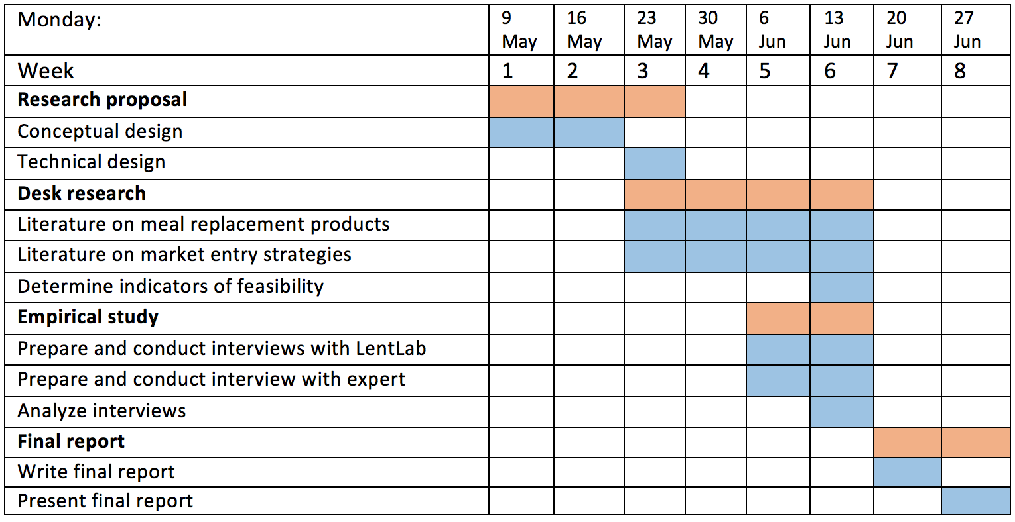
Should you schedule the writing of the thesis in the last week(s)?

Slide 5
Should you plan writing the thesis only in the last week(s)?

Slide 6

Always keep in mind the function(s) of the thesis
Multiple functions, depending on the audience.
Who are the (potential) readers of your thesis?

Slide 7
Audiences for the MSc thesis
Teacher / supervisor
  To comply with course requirements
  To get a good grade
Commissioner
  To answer his/her questions
Yourself
  To bring the thesis project to a good end
  To have tangible results
Rest of the world
  To show your expertise

Slide 8
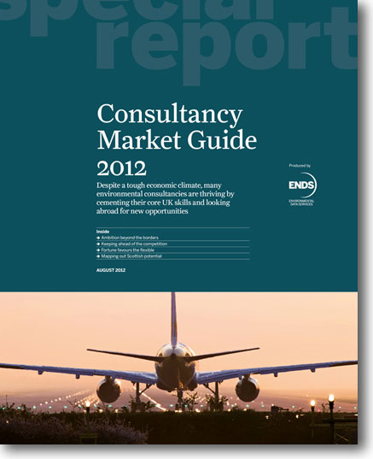
Research or Consultancy?
While MSc thesis may contain recommendations for companies, it is primarily a scientific report.
The thesis is science-based:
  Using (business) theory
  Building on what is already known
  Using rigorous methods
Notes:
Using business theory: shown in conceptual framework, in hypotheses
Building on what is already known: literature review
Using rigorous methods: Methodology chapter is most important chapter

Slide 9
Assessment of the MSc thesis
Assessment criteria | Partial Grade
1. Clearness of problem; objectives, research questions; delineation
2. Review of literature
3. Theoretical framework, conceptual framework (hypotheses)
4. Use of methods and data (research design; sample selection; methods of data collection; methods of data analysis; reliability/validity)
5. Presentation of the findings (completeness, attractiveness, clearness)
6. Critical reflection on the findings and methods (= Discussion)
7. Clarity of conclusions and recommendations
8. Clarity of structure and writing
Overall Grade

Slide 10
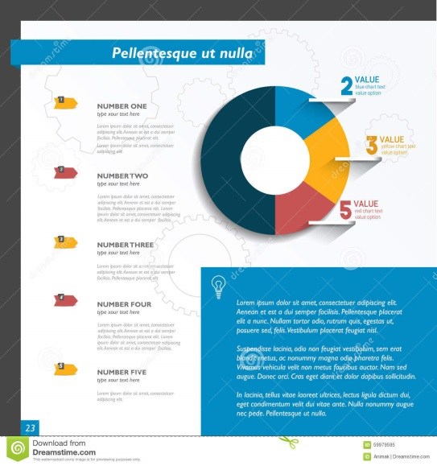
Preparing the Thesis
Decide on structure:
  Length (max 80 pages)
  Chapters and sections
  Additional elements
Decide on style:
  Lay-out
  Language (BE or AE)
  Use of visual objects

Slide 11
Basic structure of the Thesis
Introduction
Literature Review (→ Conceptual Framework)
Methods and Material
Results / Findings
Discussion
Conclusion
Recommendations

Slide 12
Cover and First Page
Cover
  Title (and picture)
  cover can be the same as first page
First Page presents the administrative information:
  Title (and subtitle)
  Name of student and registration number
  Study program and specialisation
  Course code
  Supervisor(s)
  Date of submission

Slide 13
Other elements of Final Report
Preface / Acknowledgements (optional)
Executive summary
Table of contents
List of Abbreviations (optional, but recommended)
References
Appendices
  Additional tables
  Interview Guide / Questionnaire
  Transcripts of interviews
  Please note: these elements are not chapters and do not get a chapter number

Slide 14
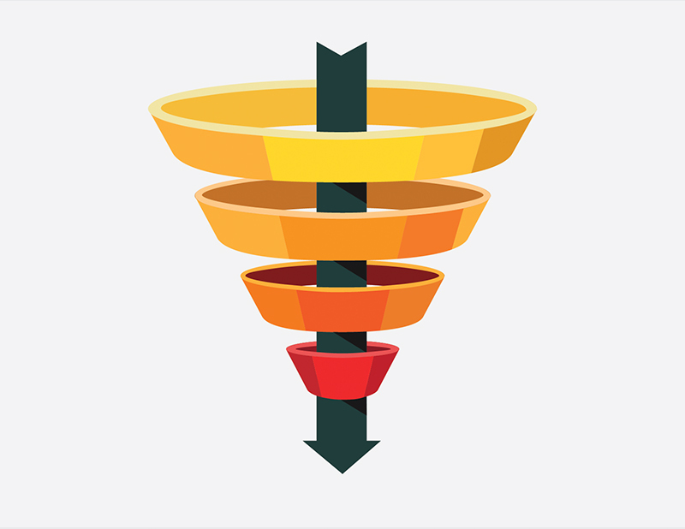
Chapter 1. Introduction
Gives the context and motivation of the research
Starts with a broad perspective on the research topic, than gradually narrowing the focus to the central problem and CRQ.
Elements of the Introduction:
  Historical perspective / Trends / Developments
  Key ideas from literature review (on theory, empirical findings and methods)
  Problem statement
  Research Questions
  Structure of the Report

Slide 15
Chapter 2. Literature Review
To present and discuss what is already known on your research topic
To discuss different theoretical perspectives that have been used to describe and explain your topic
To discuss different methodological approaches that have been used to study this topic
➔ often results in the conceptual framework and/or the hypotheses
Note: a literature review is not just summarizing the literature, but also discussing it.

Slide 16
Chapter 3. Methods and Material
Background information on the study population and sample (or on the case organisation, when doing a case study)
Research design
Operationalization: how will you measure your key concepts?
Data collection methods
  Include questionnaire and interview guide in the Appendix
Data analysis methods (statistics; comparative analyse; coding)
Discussion on reliability and validity of the measurement instruments

Slide 17
Reliability and Validity
 |  | Validity
 |  | High | Low
High
Reliability
Low

Slide 18
Reliability
A measurement instrument is reliable to the degree that it supplies consistent results.
Are the measures consistent and stable?
  Stability over time: no time-specific results
  Internal reliability: are the measurement items sufficiently related (Crombach Alpha > 0.70)
  Inter-observer reliability

Slide 19
Validity
Validity refers to the extent in which a test/instrument measures what we wish to measure
(see Blumberg et al., 2014, pages 398-403)
Construct validity:
The degree to which a research instrument is able to measure or infer the presence of an abstract property
Content validity:
The degree to which a research instrument provides adequate coverage of the topic under study
Notes:
Content validity: e.g. sustainability: does the instrument cover people, profit, planet, or only one or two dimensions

Slide 20
Example of reliability and validity of measurement instrument
We have three scales and two kilo bags. Evaluate the following conditions in terms of reliability and validity?
 | First bag | Second bag | Third bag
Scale A | 2.5 kg | 2.5 kg | 2.5 kg
Scale B | 2 kg | 2.5 kg | 1.5 kg
Scale C | 2 kg | 2 kg | 2 kg

Slide 21
Chapter 4. Findings / Results
Use a chapter structure that follows the research questions or the hypotheses
Present data in tables and figures
Present information from various sources
Description and (statistical) analysis
Place the transcripts of your interviews in the Appendix

Slide 22
Using tables and graphs
Guidelines:
  Keep it simple
  Graphs are easier to read than tables
  All tables and graphs have a number and a title
  All tables and graphs have a source
  All tables and graphs are mentioned in the text

Slide 23
Chapter 5. Discussion
Discuss your results:
  Compare results among themselves
  Compare results with hypotheses / propositions
  Compare results with literature
  Discuss surprising results
  Discuss limitations of results
In qualitative research, Findings and Discussion may be placed together in one chapter, but be clear on what is findings and what is discussion.

Slide 24
Chapter 6. Conclusion(s)
What do we learn from this study?
  Repeat the objective of the study
  Provide answers to the main research questions
What are the implications of the findings (for the company, for academia, for policy-makers)
What are strong and weak points of the study?
What further research can be done?
After the Conclusions you may add recommendations

Slide 25
Appendices
List of interview questions / questionnaire
Additional tables
Transcripts of interviews
Any other material

Slide 26
Referencing
There are several referencing systems, but in business research most common is:
  Author-year system
  (e.g., Bijman et al., 2013)
In case you quote an author, also provide page number:
  “Surprise, surprise, we don’t live in an ideal world!” (Beech, 2015: 115)

Slide 27
Making a reference list (= bibliography)
There are several well-established systems for making a reference list
Your choice depends on what is common in your discipline, or depends on the journal for which you write
In Management studies:
  Harvard system
  American Psychological Assocation (APA)
  Journal-specific systems

