Slide 1
WFBR Protein Data Central
Henk Wensink
Rutger Vlek

Slide 2
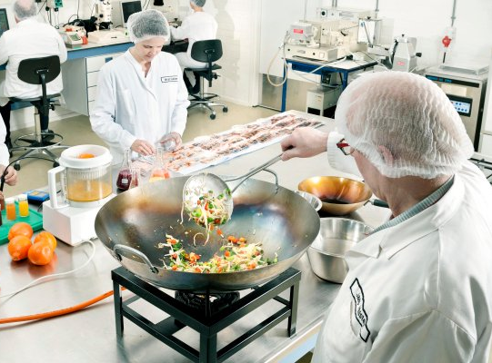
WFBR Protein Data Central
What
WFBR FAIR data infrastructure for food protein & health data, supporting research programmes on responsible food choices, protein transition, nutrition & health.
Why
Strengthen WFBR data strategy and create FAIR data infrastructure fitting to requirements of WFBR research, to make food protein data accessible.

Slide 3
WFBR Protein Data Central
Issue
“Protein” is identified as one of the overarching topics for WFBR research. But Protein data is scattered over many projects in the 20 WFBR expertise groups.
This results in a lot of ad hoc data on protein, organised mainly by project and for the project needs……
Supply chain design
Biomass fractionation
Food technology
Fermentation
Data Science and Informatics
Biochemistry
Post-harvest technology
Consumer behaviour
Water treatment
Nutrition & health
Food Microbiology
…………

Slide 4
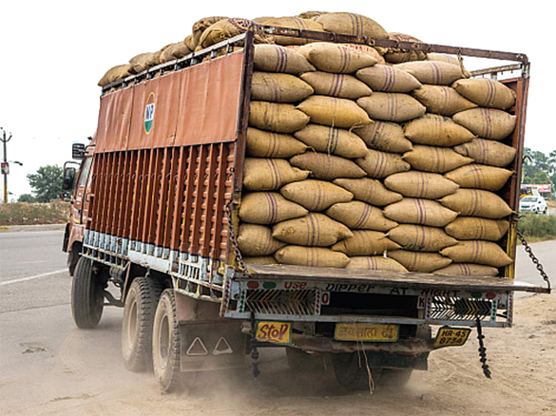
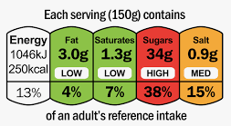
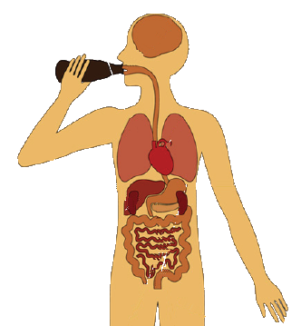
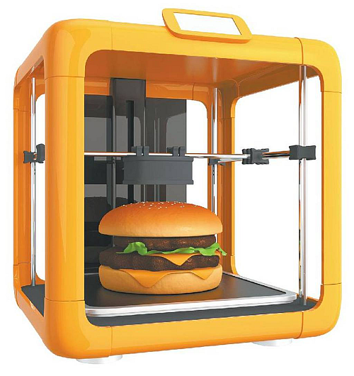
WFBR Protein Data Central
WFBR has scattered protein data on:
Sustainability and biodiversity
Storage and supply
Nutrient values
Taste and texture
Health effects
Allergy response
Processability

Slide 5
WFBR Protein Data Central
Linking it in a FAIR way opens opportunities.
Sustainability and biodiversity
Storage and supply
Protein
Data
Central
Nutrient values
Taste and texture
Allergy response
Health effects
Processability

Slide 6
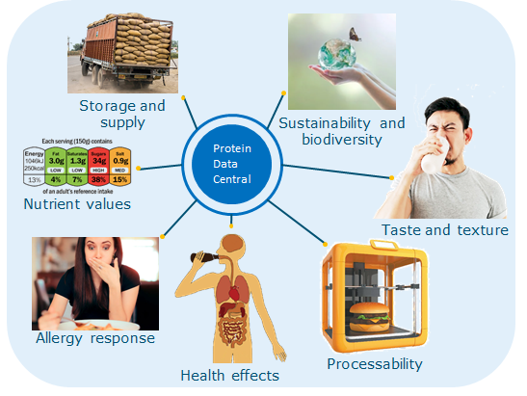
WFBR Protein Data Central
Opportunities:
Re-usability of research results.
More options to mine the data
Incentive for multidisciplinary research
Caution:
Involve the domain researcher and tend to their needs.
Do not store everything, only information that is (potentially) overarching the projects.
WFBR already made a FAIR data infrastructure on Microsoft Azure on food properties like nutrition, taste and eating moment (accessible through API).
Bridging this approach with YODA could expand the accessible protein data within WUR.

Slide 7
WFBR Protein Data Central
 | 1 | 2 | 3 | 4 | 5 | 6 | 7 | 8 | 9 | 10 | 11 | 12
Requirements analysis. Overview of relevant, available data
Investigation & design of the infrastructure
Dissemination workshops with early adopters
Presentation in WFBR business unit meeting
Contribution to WFBR data strategy
Results:
A protein data central for WFBR and WUR
A way of working to create other overarching WFBR data centrals
which is a contribution to the WFBR data strategy

Slide 8
WFBR Protein Data Central
Questions?

Slide 9
WFBR Protein Data Central
Storage and supply
Sustainability and biodiversity
Protein
Data
Central
Nutrient values
Taste and texture
Allergy response
Processability
Health effects

