Slide 1
WCDS in-situ data
Management and opening of field experimental data
1 February 2024 – Hendrik Boogaard

Slide 2
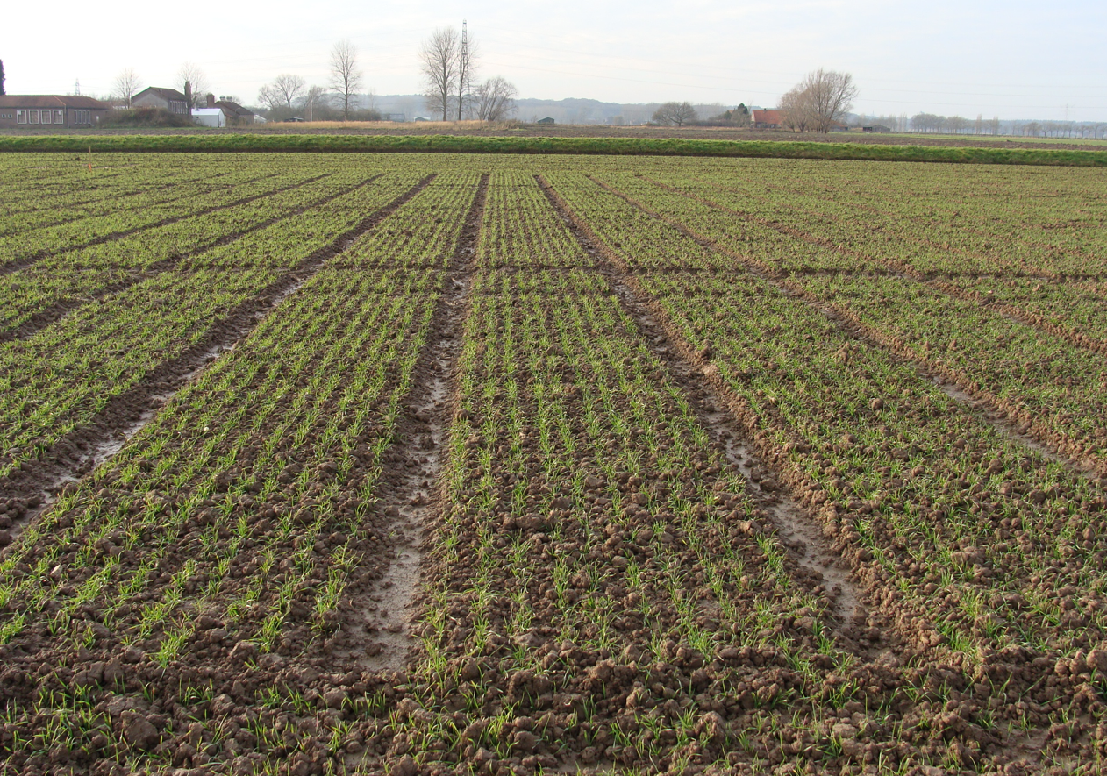
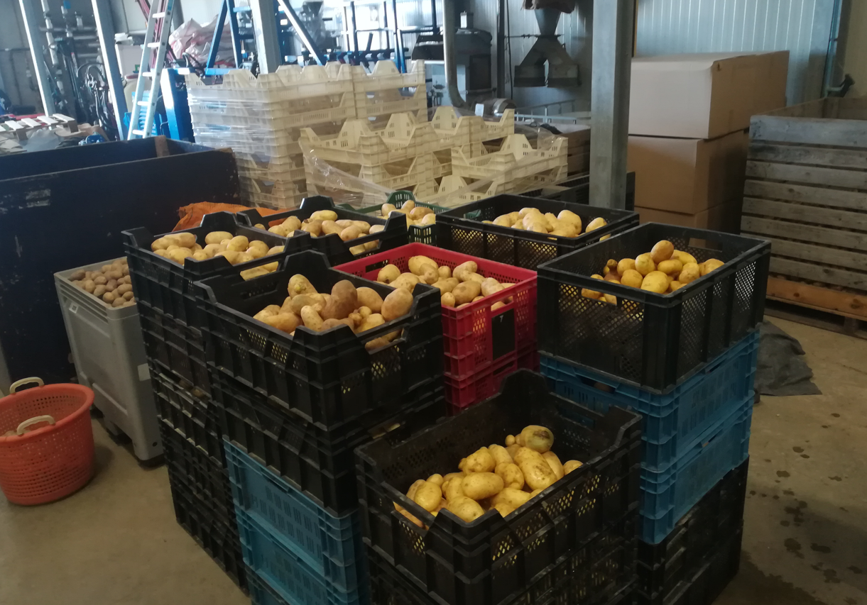
Why project “WCDS in-situ data”?
In-situ data is needed for effective and efficient crop productivity analysis and exploration
For example to calibrate and validate models and algorithms for yield analysis (GYGA, CocoaSoils), crop yield forecasting (MARSOP), creating crop type maps (WorldCereal) etc.
WUR wheat experiment
WUR potato experiment

Slide 3
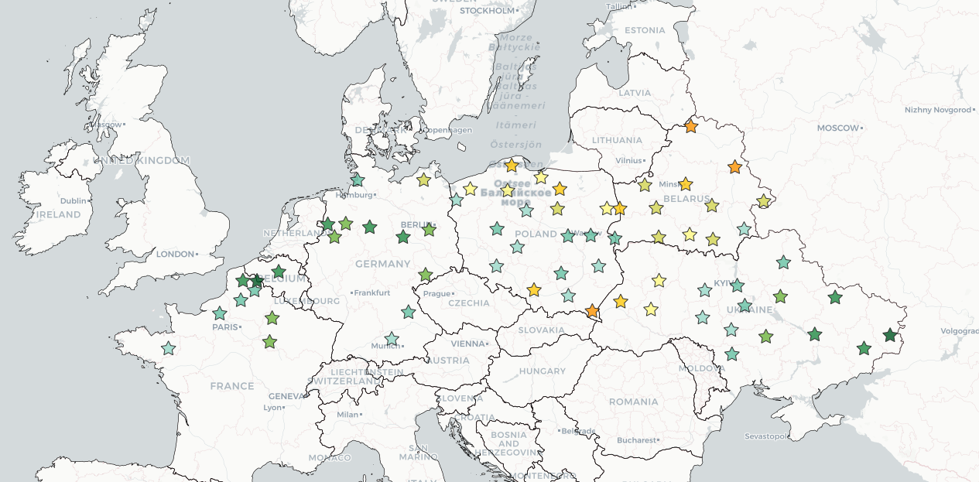
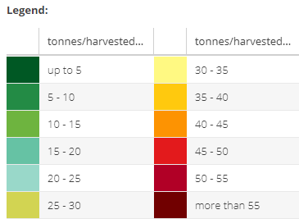
Global Yield Gap Atlas
Yield gap of rain fed potato: difference between potential and and actual yield
www.yieldgap.org

Slide 4
Update potato parameters
To study crop productivity we use crop growth models (e.g. WOFOST)
Models are parametrized for certain crop and cultivar
Parameters are calibrated and validated using field experimental data (in situ data, ground truth)
Parameters could be outdated (e.g. potato):
Potato potential yield simulations are too low (24% in 2019 and 29% in 2020)
Model parameters date back to 60s and old cultivar such as ‘bintje’
Breeding efforts changed properties of modern cultivars, not reflected in old parameters

Slide 5
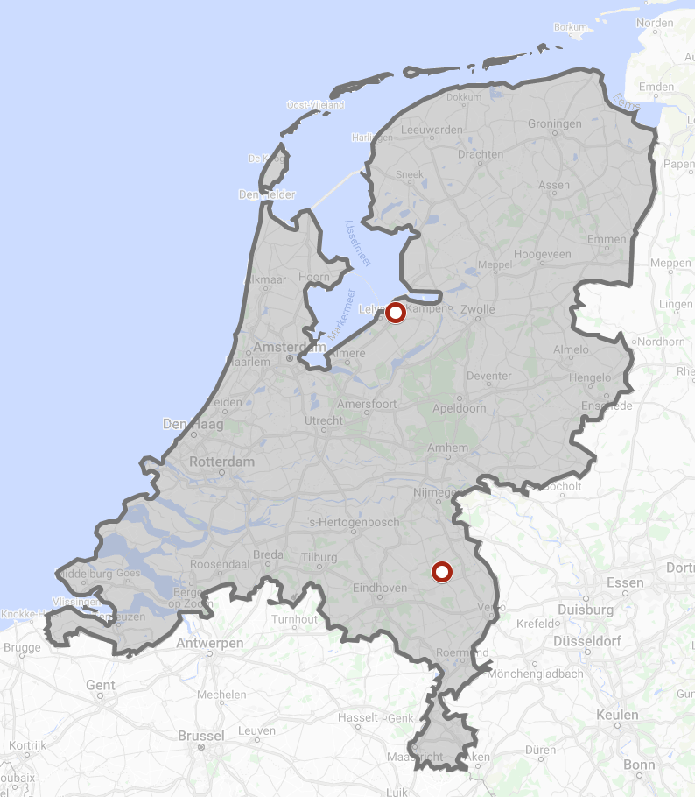
Update potato parameters
2019 and 2020
Lelystad, Vredepeel
ten Den, T., van de Wiel, I., De Wit, A., van Evert, F.K., van Ittersum, M.K. and Reidsma, P., 2022. Modelling potential potato yields: Accounting for experimental differences in modern cultivars. European Journal of Agronomy, 137, p.126510.

Slide 6
Update potato parameters
Calibrate biomass allocation and related parameters using measured leaf, stem and tuber biomass
Black dots are observations, black lines are simulations with the new parameter sets and the grey lines are with the old potato_701 parameter set

Slide 7
In situ agronomy data
Data scarcity
Unstructured data (such as text, doc, IoT sensor data) and structured (relational databases acquired via mobile app) stored on various platforms
Not accessible for community (drop box, w-drive)
Available data often have incomplete metadata (structured and unstructured)
Lacks data sharing protocols, and collaborative re-use of data
Clear need to publish/share following FAIR principles

Slide 8
In situ agronomy data
Why sharing?
Make your research more efficient avoiding redundant work
Make your work more visible
Get credits for the work that you did to generate the data
Make use of the valuable work of your colleagues
Many funders require that you make your data reusable
Research organisations are making it part of their data policies
Data might need to go with your publications
Improves quality!

Slide 9
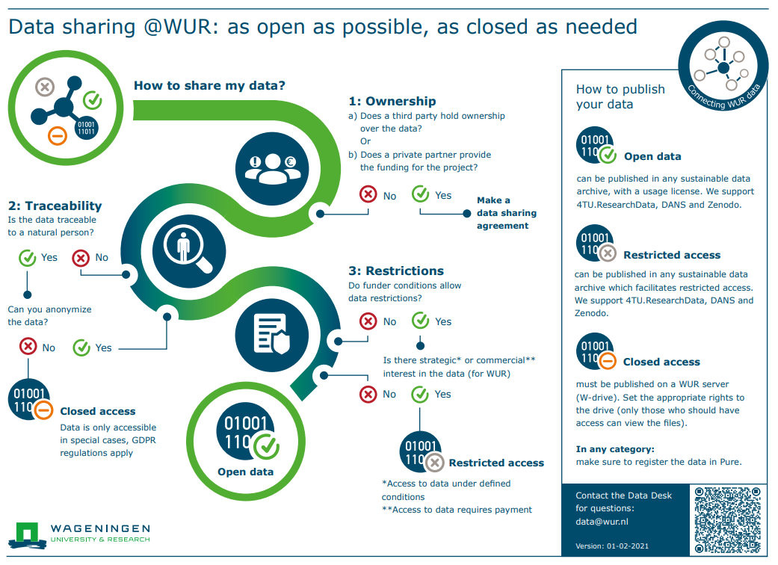
In situ agronomy data
* WUR data sharing guidelines

Slide 10
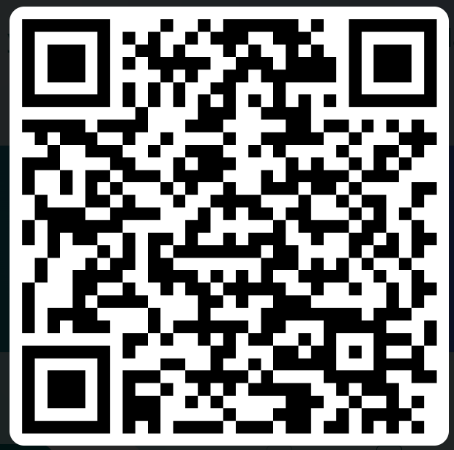
In situ agronomy data & WUR
Understand use and availability of crop field experimental data within WUR
1) Survey
link
2) Interviews

Slide 11
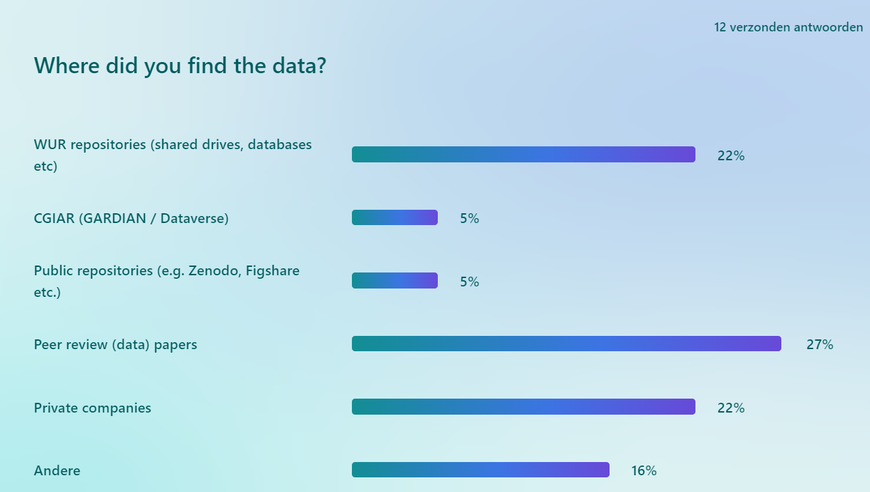
In situ agronomy data & WUR

Slide 12
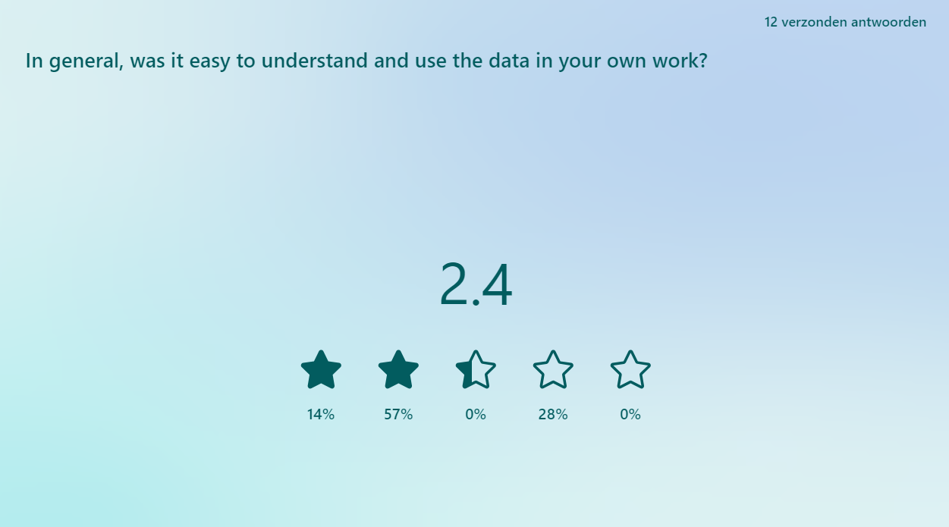
In situ agronomy data & WUR

Slide 13
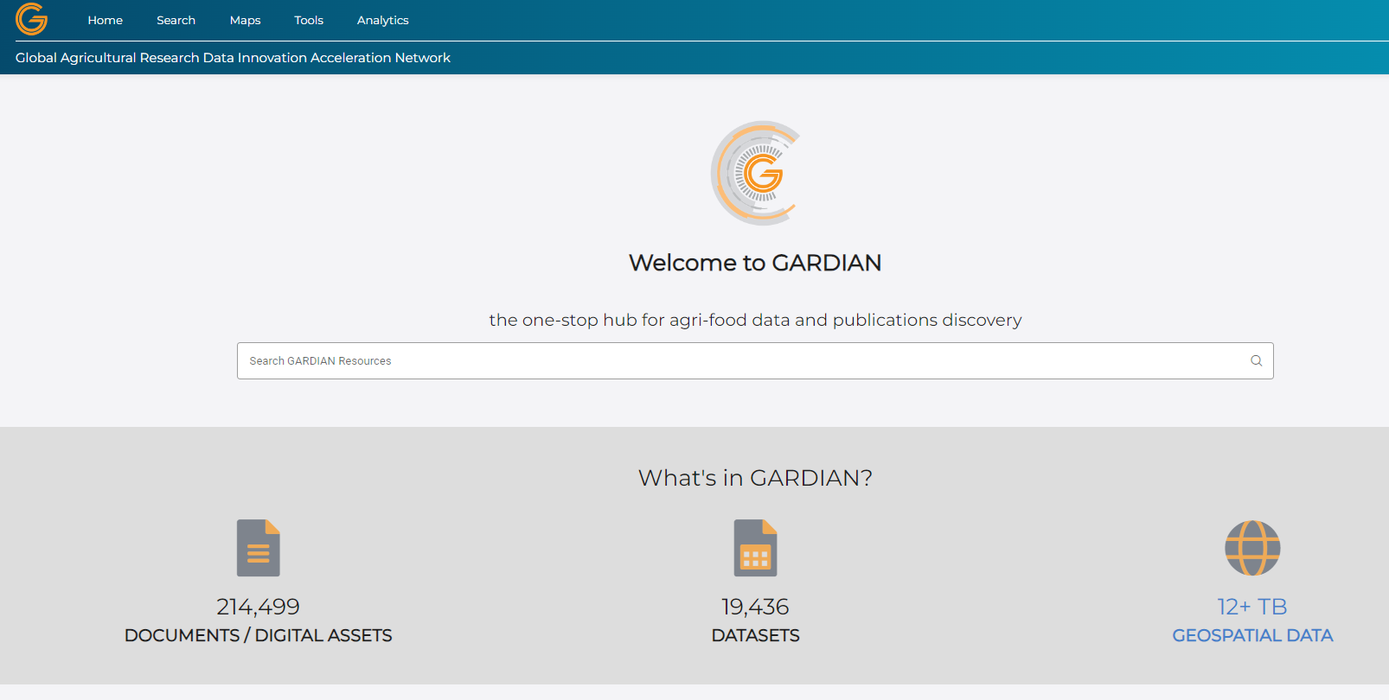
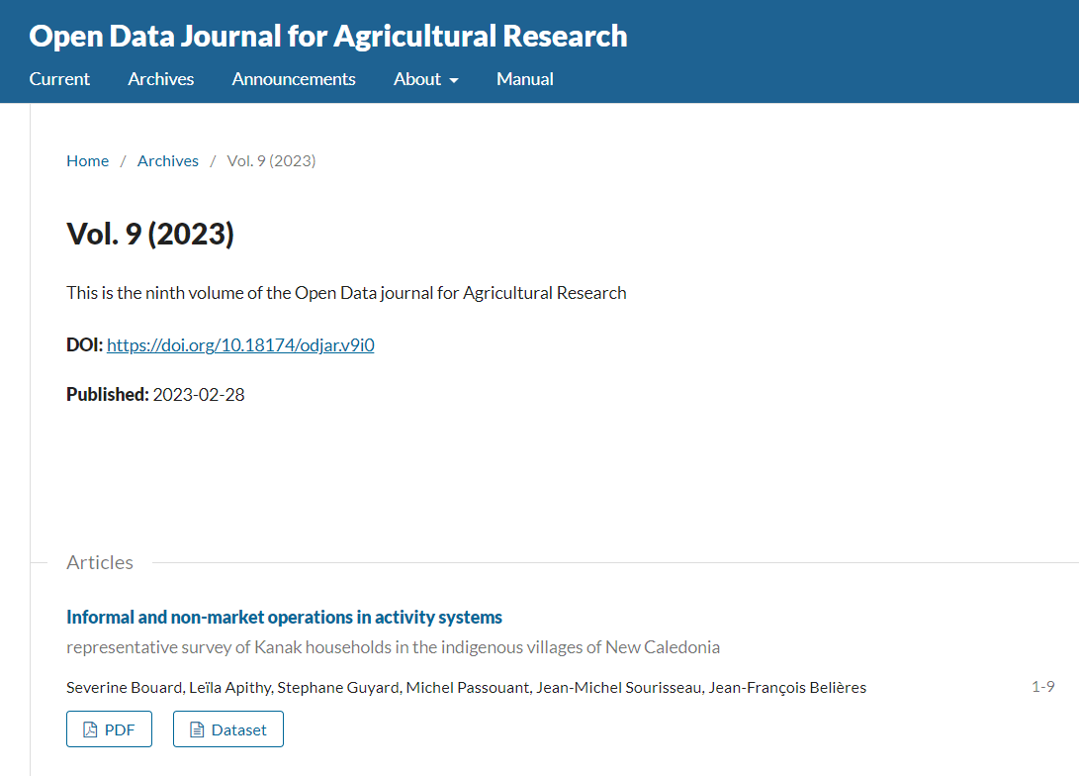
AGROSTAC
Even published data is not yet ready for re-use and need additional harmonization

Slide 14
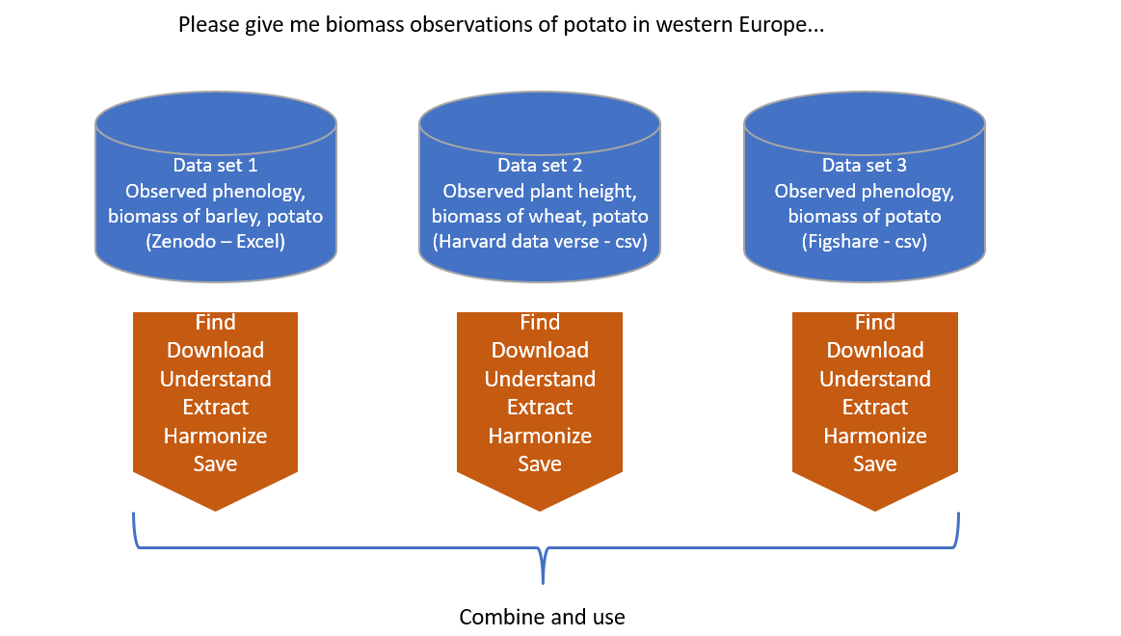
AGROSTAC

Slide 15
AGROSTAC

Slide 16
Project activities
Run on-line survey January 2024
Report on WUR in-situ agronomy data (overview, current practices around storage and metadata) based on analysis and synthesis of interviews, reports, on-line survey
Review iRODS-Yoda and other open source repositories via SWOT analyses and define changes / improvements

Slide 17
Project activities
Update AGROSTAC importer and update technical manual
Harmonize and import selected datasets in AGROSTAC
See next slide
Write a use case to demonstrate added value AGROSTAC
Outreach on our WUR review and AGROSTAC:
Trainings, workshops, datathons, blogs, WDCC portal
Link to GARDIAN
Link to GEOSS portal and GeoKnowledgeHub

Slide 18
New leads
Recent and old WUR wheat experiments
WUR potato experiment (irrigated, rain fed)
An experimental dataset on yields of pulses across Europe
Potato datasets (Agrosysteemkunde)
Global Crop Nutrient Removal Database
C2D2: CropLife Europe Crop Development Database
A global dataset for crop production under conventional tillage and no tillage systems

