Slide 1
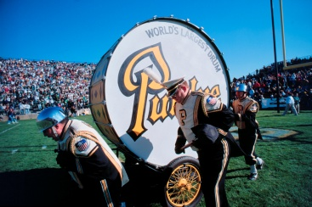
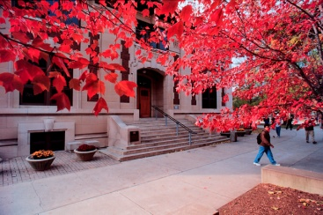
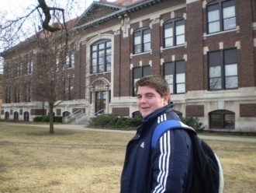
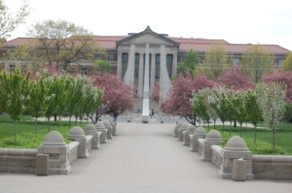
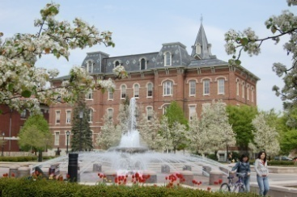
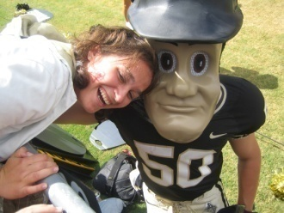
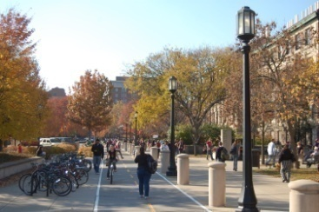
Purdue University
Exchange Program

Slide 2
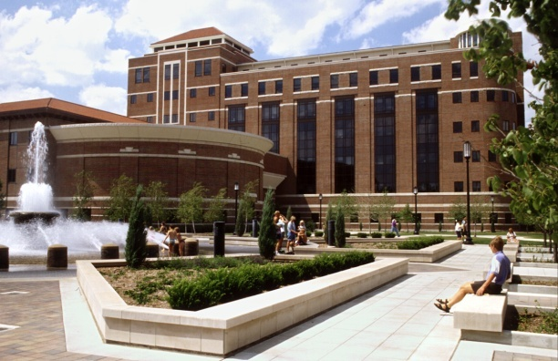
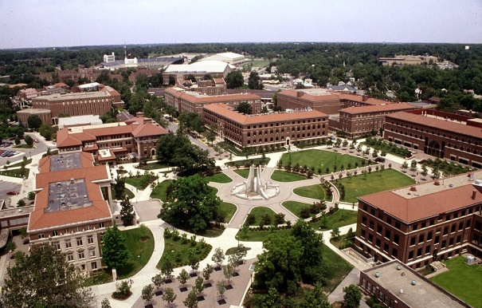
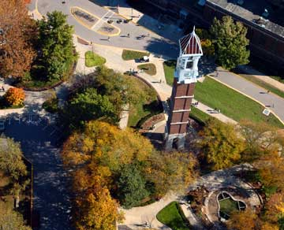
Purdue University
Discover Purdue
Global reputation
Great location
Vibrant campus life
High-tech facilities
Exciting courses
Diverse students

Slide 3
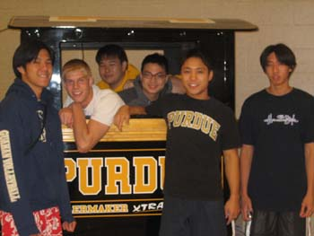
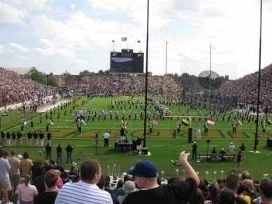
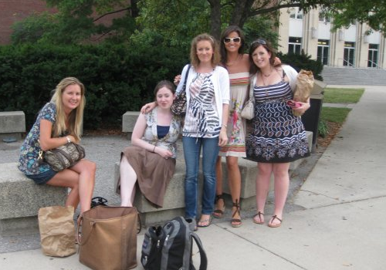
Purdue University
Reasons to Study Abroad
Broaden your academic experience
Be more marketable towards employers
Gain lifetime friendships
Increase understanding of the world
Explore new interests
Appreciate your country
Influence the rest of your life
Learn about yourself
Gain self confidence
Make extraordinary memories
Have fun!

Slide 4
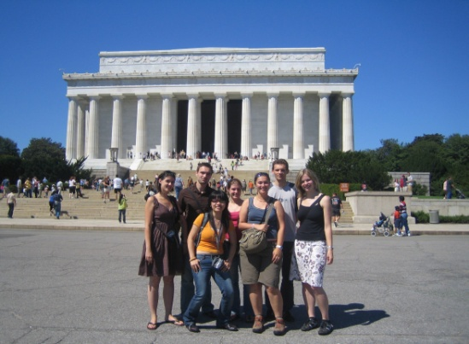
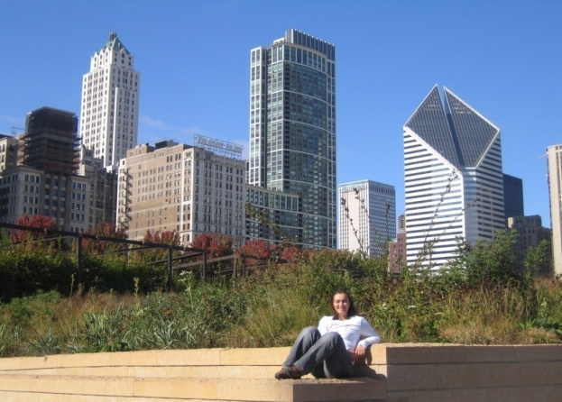
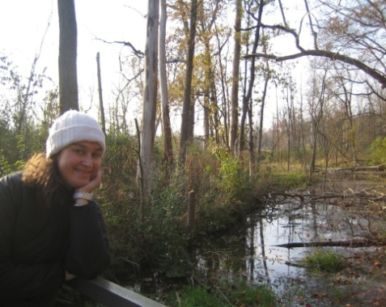
Purdue University
YouTube
“Studying abroad for me means finding a second home and new friends somewhere else in the world. For me a dream came true at Purdue!”
Anna Pichler - Austria

Slide 5
Purdue University
Location & Climate
Location:
West Lafayette, Indiana
Between Chicago and Indianapolis
Population:
Lafayette/West Lafayette: 97,000 people
Climate:
4 seasons
Hot, humid summers
Snowy, icy winters
Colorful falls and springs
 | Jan | Apr | Jul | Oct
Avg. High | -0.5°C | 16.1°C | 30°C | 18.3°C
Avg. Low | -9.4°C | 4.4°C | 17.8°C | 5.6°C
Mean | -4.4°C | 10.6°C | 23.9°C | 12.2°C
Avg. Precip. | 4.3 cm | 9.1 cm | 9.4 cm | 6.35 cm

Slide 6
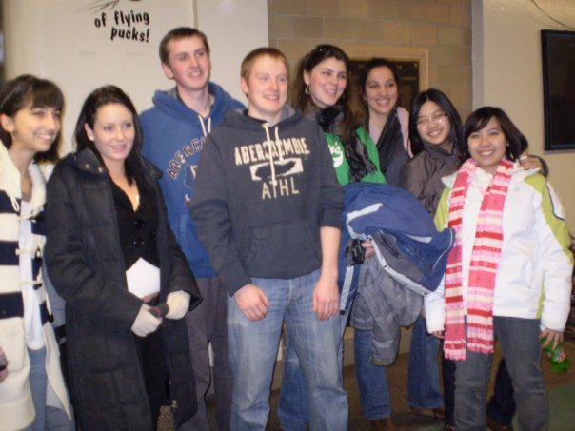
Purdue University
Student Demographics
40,000 students
50 states and 127 foreign countries
Ranks 3rd among other U.S. public institutions in international enrollment
9,303 international students
International student body comprises 23% of the total number of enrolled students
57% males vs. 43% females

Slide 7
Purdue University
Student Demographics
International Student Breakdown at Purdue

Slide 8
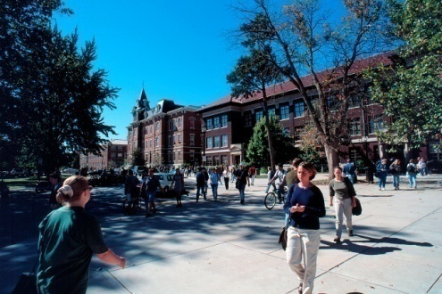
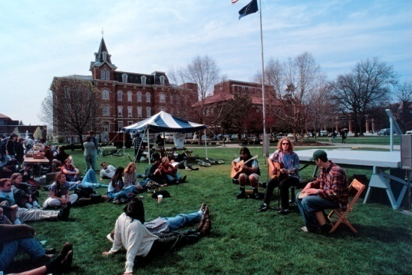
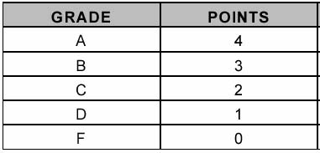
Purdue University
Academics
Requirements of courses:
1.) Attend class
2.) Participate
3.) Take short quizzes
4.) Do homework
5.) Complete exams
True/False
Multiple choice
Short answer
Essay
6.) Take midterm and final exams
7.) Get grades

Slide 9
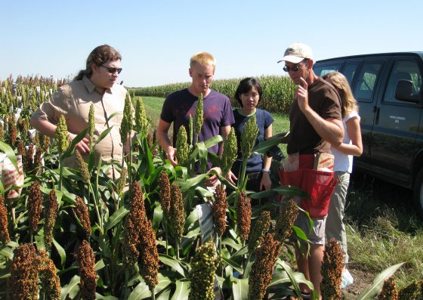
Purdue University
Courses
11 Schools within Purdue: | Liberal Arts
Agriculture | Management
Education | Pharmacy
Engineering | Science
Exploratory Studies | Technology
Health and Human Sciences | Veterinary Medicine
400 undergraduate majors
5,800 courses
Course Catalog

Slide 10
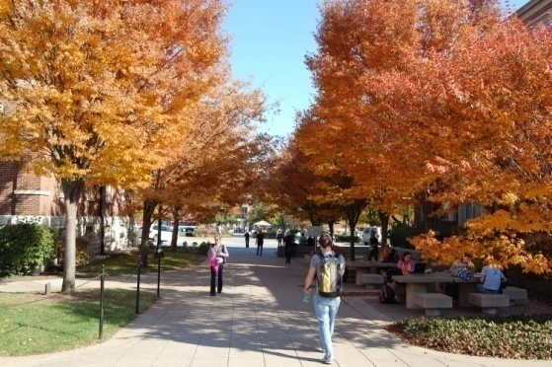
Purdue University
Calendar
Spring Semester 2021
Classes Begin: January 19
Classes End: May 1
Final Examinations: May 3-8
Semester Ends: May 8

Slide 11
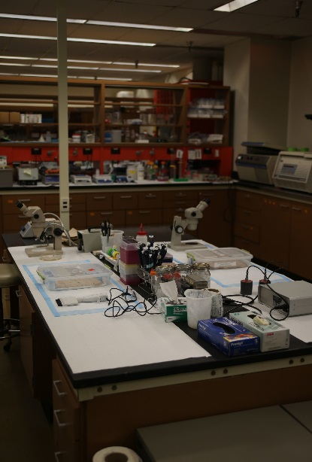
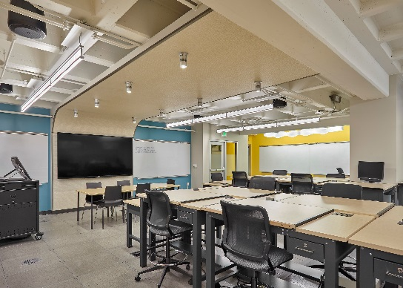
Purdue University
Services & Facilities
Computer Access:
Wireless internet on campus
50 computer labs
2000 computers
Some labs are open 24 hours
Libraries:
15 libraries
Different academic areas

Slide 12
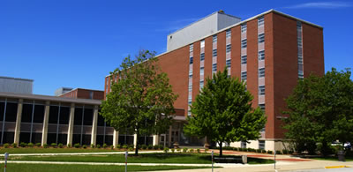
Purdue University
On-Campus Accommodation
Benefits:
Exchange students guaranteed
Walking distance to class
Meal plans
No additional costs for utilities
Provide a way to meet students
Convenient
Lounges, recreational place, dining rooms, kitchens, laundry facilities, computer labs
Furnished rooms: beds, desks, chairs, desk lamps, closets, phones
www.housing.purdue.edu

Slide 13
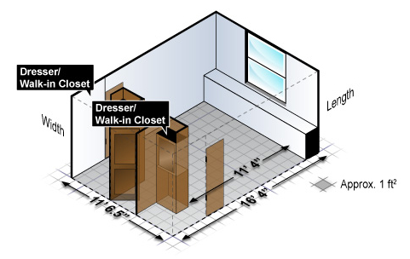
Purdue University
On-Campus Living
Co-educational Housing:
Earhart
First Street Towers
Third Street Suites
Hillenbrand
Meredith
Harrison
McCutcheon
Owen
Shreve
Wiley
Male Housing:
Cary Quadrangle
Tarkington Hall
Female Housing:
Windsor Hall
Purdue Village
Hilltop Apartments
2-4 per room
Self catering
Hawkins Hall
20 years +
Housing Choices

Slide 14
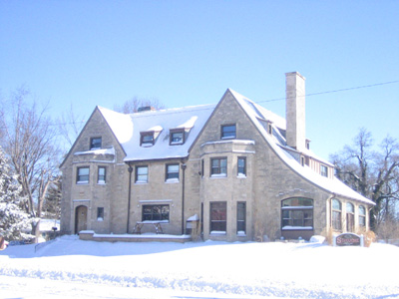
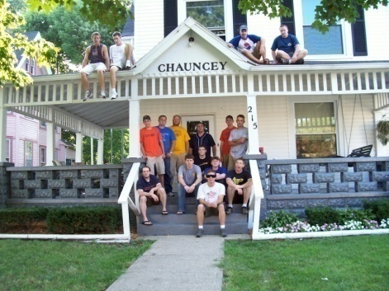
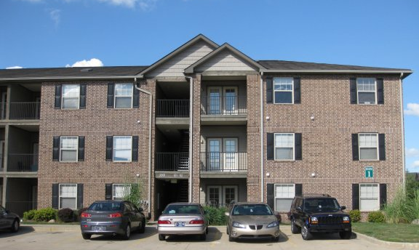
Purdue University
Off-Campus Accommodation
Benefits:
Self catering
More privacy and space
Less expensive
Cooperative Housing:
Group living - 20-60 students
5 men’s houses
7 women’s houses
3-5 hours of house duties
Apartments:
Sublease or short-leases
Search online for apartment
http://purduecooperatives.org/

Slide 15
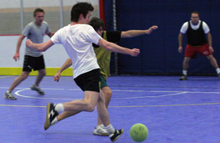
Purdue University
Student Life - Sports
Spectator sports:
Big 10 Athletic Conference
Fall: American football, volleyball, soccer, tennis, cross-country, golf
Spring: basketball, swimming, track and field, baseball, wrestling
Recreational Sports Center:
Free for students
Weight training, indoor soccer, racquetball, basketball, handball, swimming, aerobics, rock climbing
Club sports teams (Skiing)

Slide 16
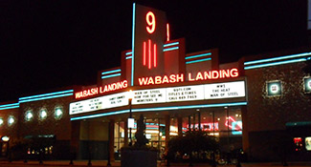
Purdue University
Student Life – Arts & Movies
Performing Arts
Purdue Convocations
Musicals, rock concerts, opera, symphony, dance performances, jazz, orchestra
Purdue’s Theater Department
Movies
PSUB – Fowler movie night
Wabash Landing (walking distance)
Eastside 9
Lafayette 7

Slide 17
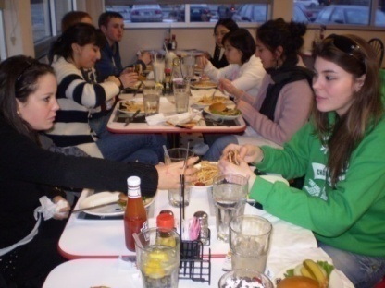
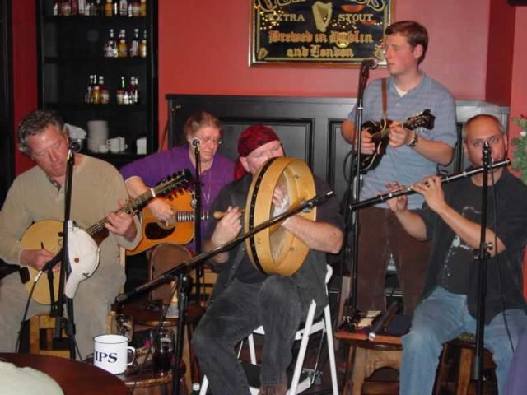
Purdue University
Shopping & Dining
Grocery Stores:
Marsh, Payless, Wal-Mart, Meijer
Clothes:
Tippecanoe Mall
Local bars and restaurants:
Over 250 restaurants in the area
Popular bars close to campus
Must be 21 years of age
Fast food:
Subway, Arby’s, Domino’s, Taco Bell, Papa John’s, McDonald’s

Slide 18
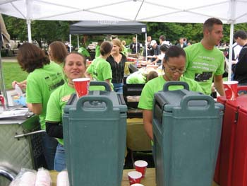
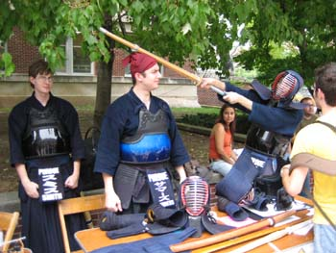
Purdue University
Student Organizations
Over 1000 student organizations
85 internationally focused
Reasons to join:
Meet friends
Develop skills
Become active
Learn something new
Types of organizations
Sports club
Academic organization
Volunteering
Political
Professional group
International student club
https://boilerlink.purdue.edu/

Slide 19
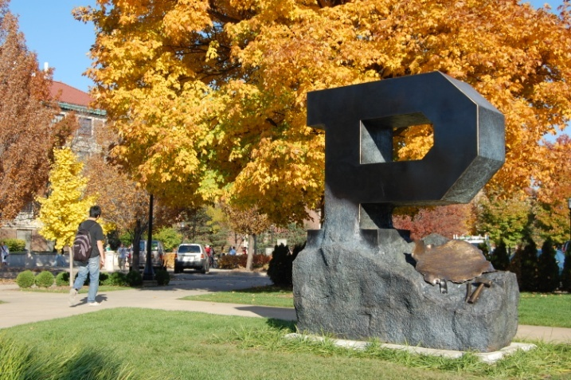
Purdue University
Safety
Precautions:
Be sensible
Walk accompanied rather than alone at night
Purdue is a safe place:
Walkways are well-lit
Safety text/email alerts about campus crime
ETS (Emergency Telephone System)
Look for blue light, push the button to call Purdue Police
Evening safe walk:
Call 765.494.SAFE (7233)
Someone will accompany you home or to your vehicle safely
Call 911

Slide 20
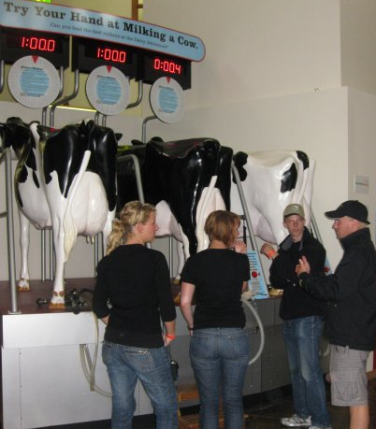
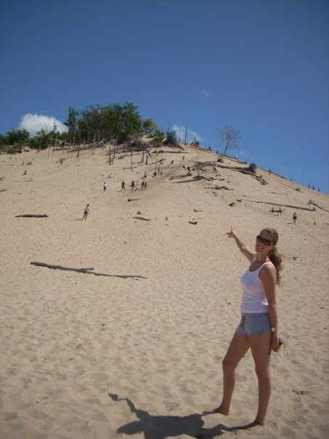
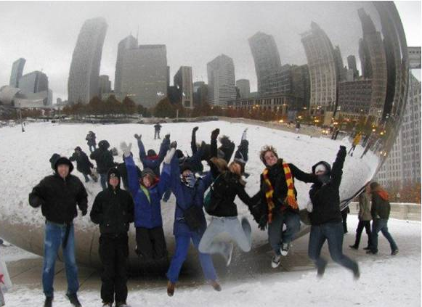
Purdue University
Attractions
Lafayette/West Lafayette:
Art Museum
Historic Prophetstown
Wolf Park
Civic Theatre
Lafayette Symphony Orchestra
Indiana Dunes
Fair Oaks Dairy
Turkey Run State Park
Lake Michigan
Shipshewana
Chicago
Indianapolis
Indianapolis Zoo
Banker’s Life Fieldhouse
White River State Park
Indianapolis Motor Speedway Hall of Fame Museum
Eiteljorg Museum of American Indians & Western Art

Slide 21
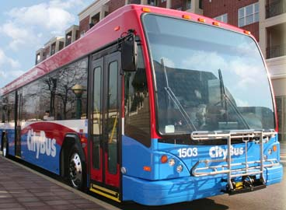
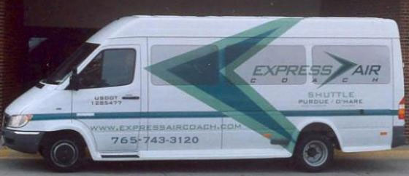
Purdue University
Traveling
Arrival to Purdue:
Fly to Chicago O’Hare Airport
Express Air Coach
Greyhound Bus
Amtrak Train
Fly to Indianapolis Airport
Lafayette Limo
Renting a car
Transportation Services:
Around Campus:
Walk or Bike
City Bus:
Free!
Many routes and times
Smartphone app that tells you when the bus will be here
Around Lafayette/West Lafayette:
City Bus – Free!
Around the United States:
Train – Amtrak
Bus – Greyhound
Plane – Indy or Chicago

Slide 22
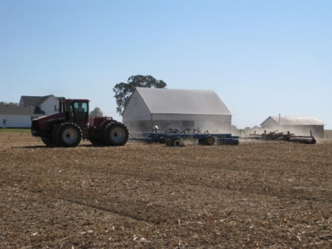
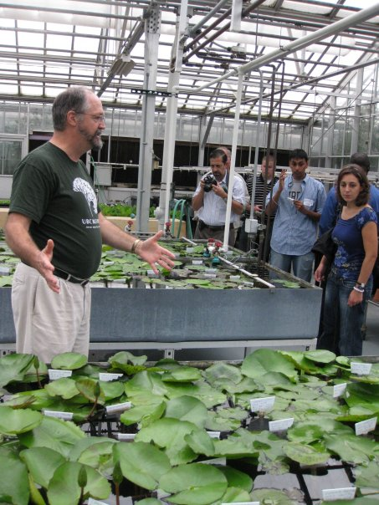
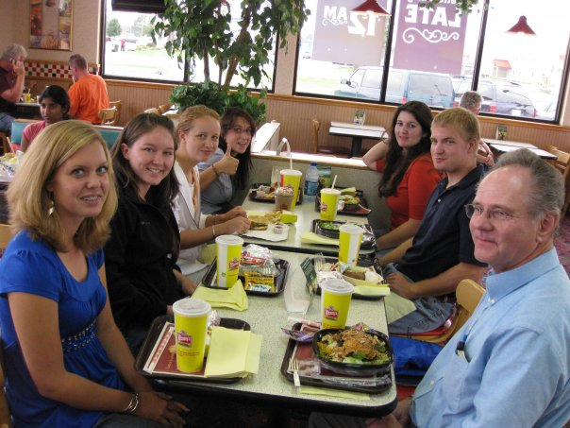
Purdue University
Employment
Campus employment:
20 hours or less per week
Student job postings
Academic Training:
Field of academic program
Equal to the length of time registered as Purdue student
Job Postings

Slide 23
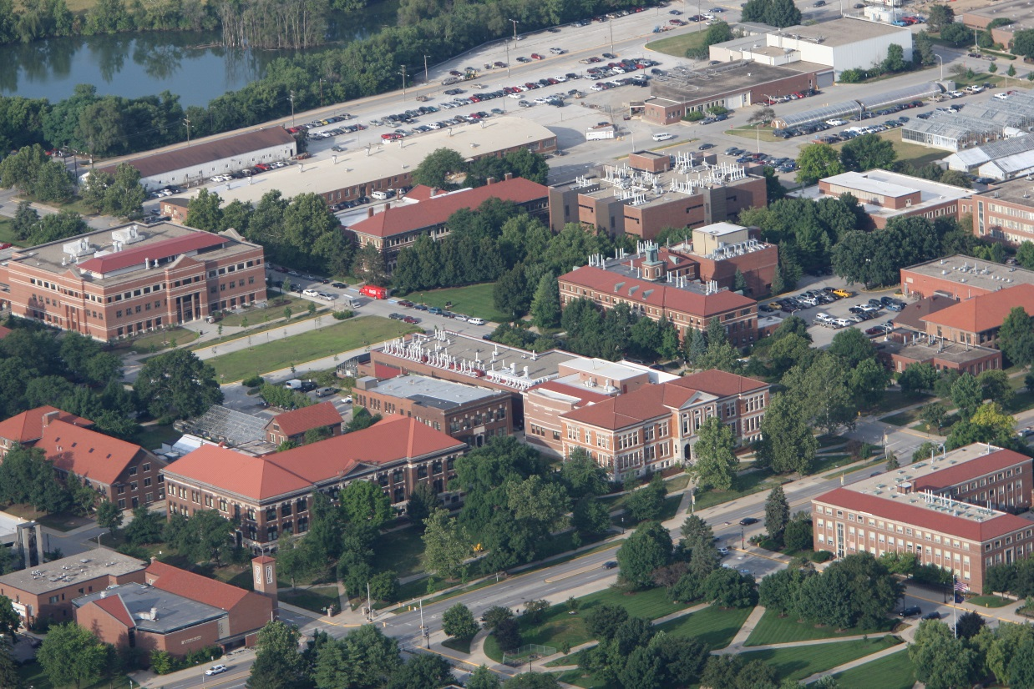
Purdue University
Purdue Map
http://www.purdue.edu/campus_map/

Slide 24
Purdue University
Purdue University Exchange Program
Contact your International Office
Kara Hartman
Study Abroad Manager
International Programs in Agriculture
615 West State Street, AGAD 26
West Lafayette, IN 47907, USA
Phone: 765-494-8458
Fax: 765-494-9613
Email: AgAbroad@purdue.edu
www.ag.purdue.edu/ipia/studyabroad

