Slide 1
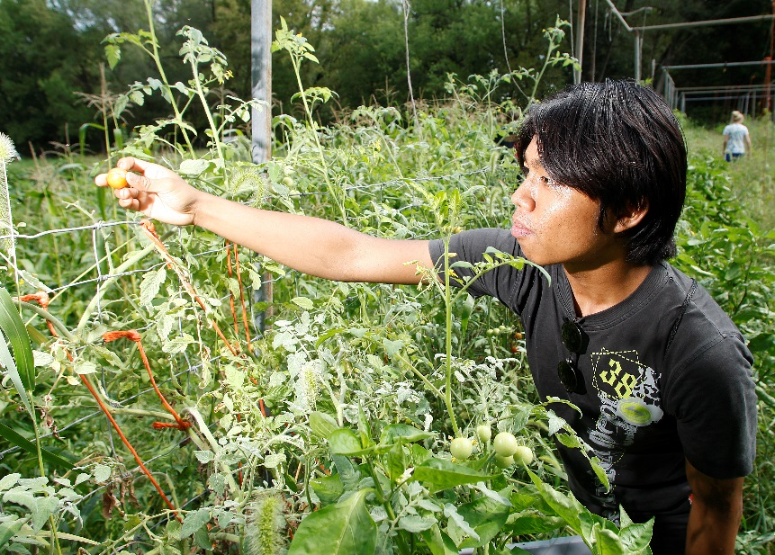
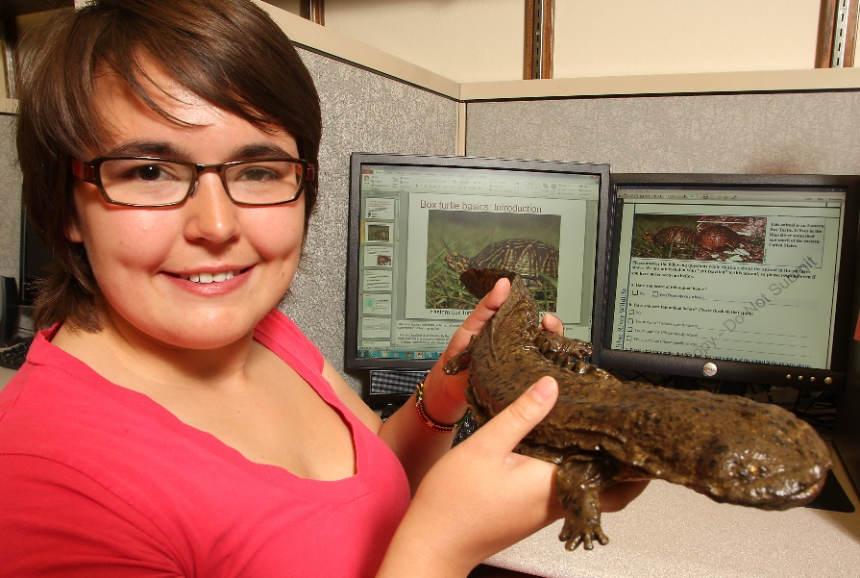
Study Abroad
www.ag.purdue.edu/ipia/studyabroad
www.purdue.edu
AgAbroad@purdue.edu
Contact your University’s International Office

