Slide 1
Co-producing sustainability transformations: fostering collective imagination
Josie Chambers
Assistant Professor | Urban Futures Studio
j.m.chambers@uu.nl
16.11.23

Slide 2
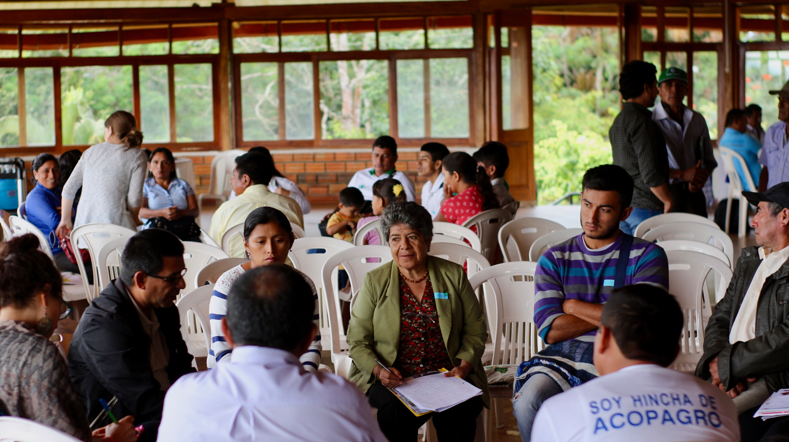
My journey into co-production

Slide 3
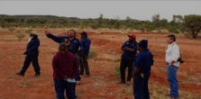
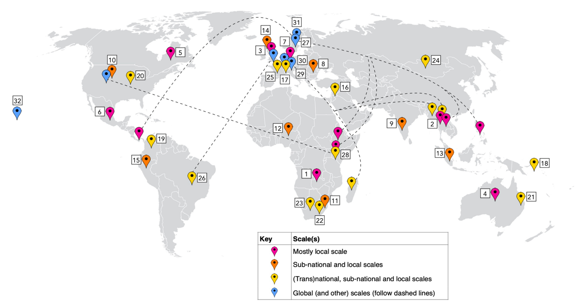
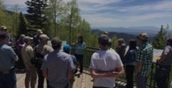
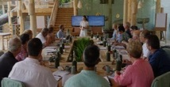
Analysis of 32 cases of knowledge/action-making
Opening the black box -- What does ‘co-production’ mean? What does it do?
Co-management
Learning networks
Most spanned 4+ disciplines
Most spanned 3+ sectors
2/3 led by >50% women
International dialogues

Slide 4
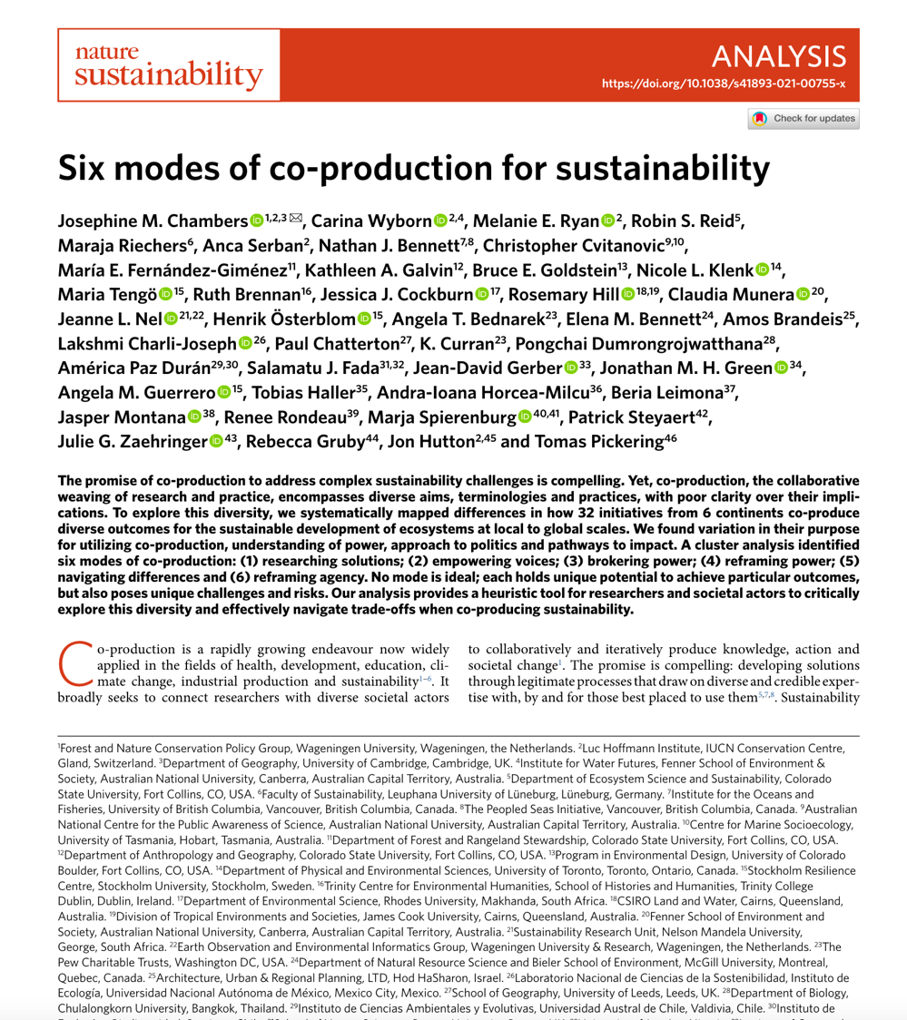
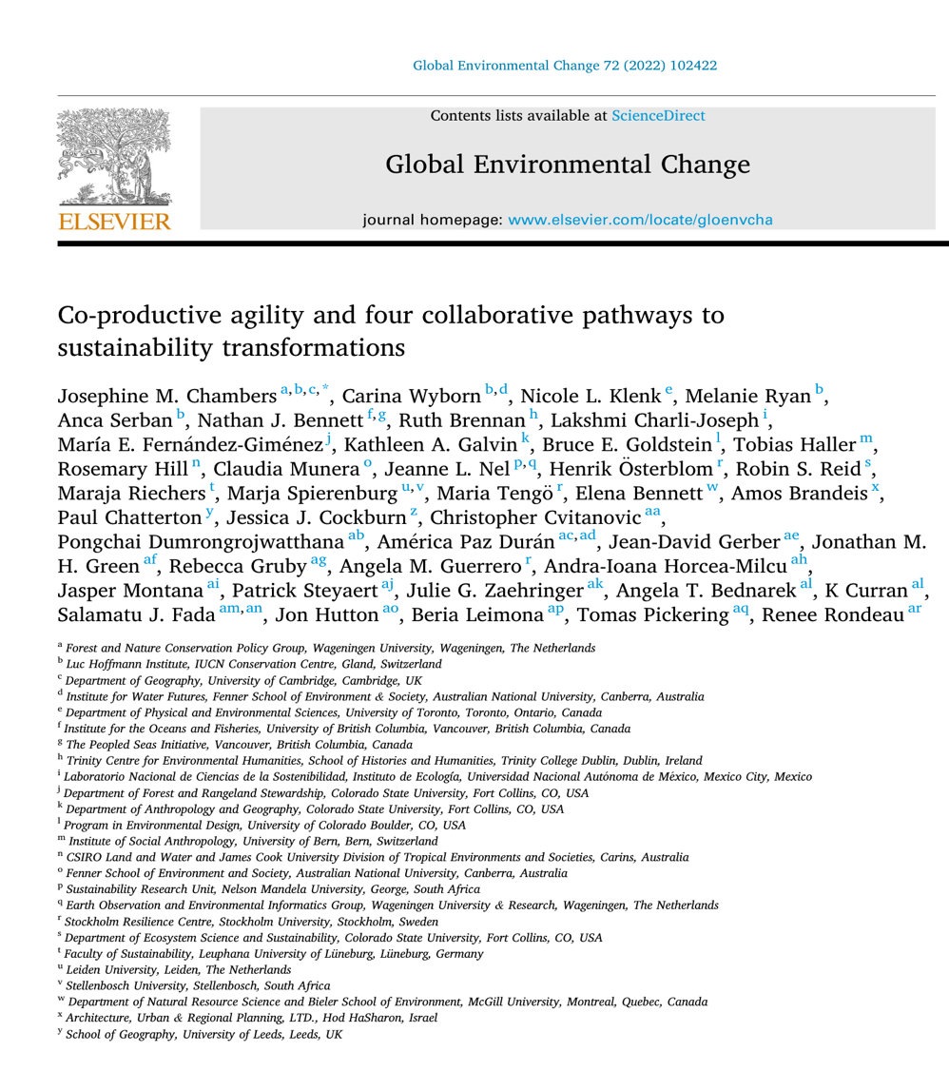

Slide 5
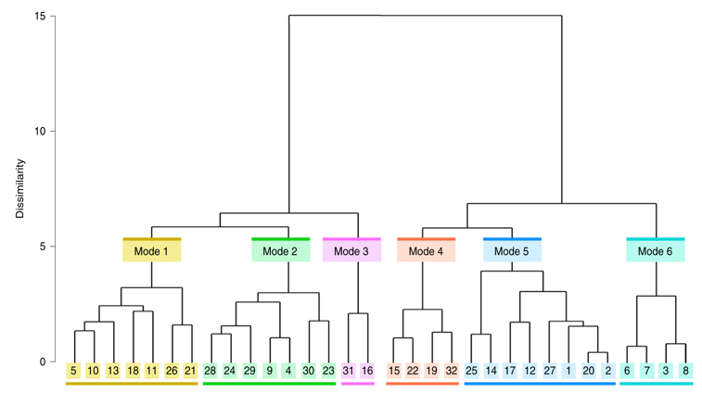
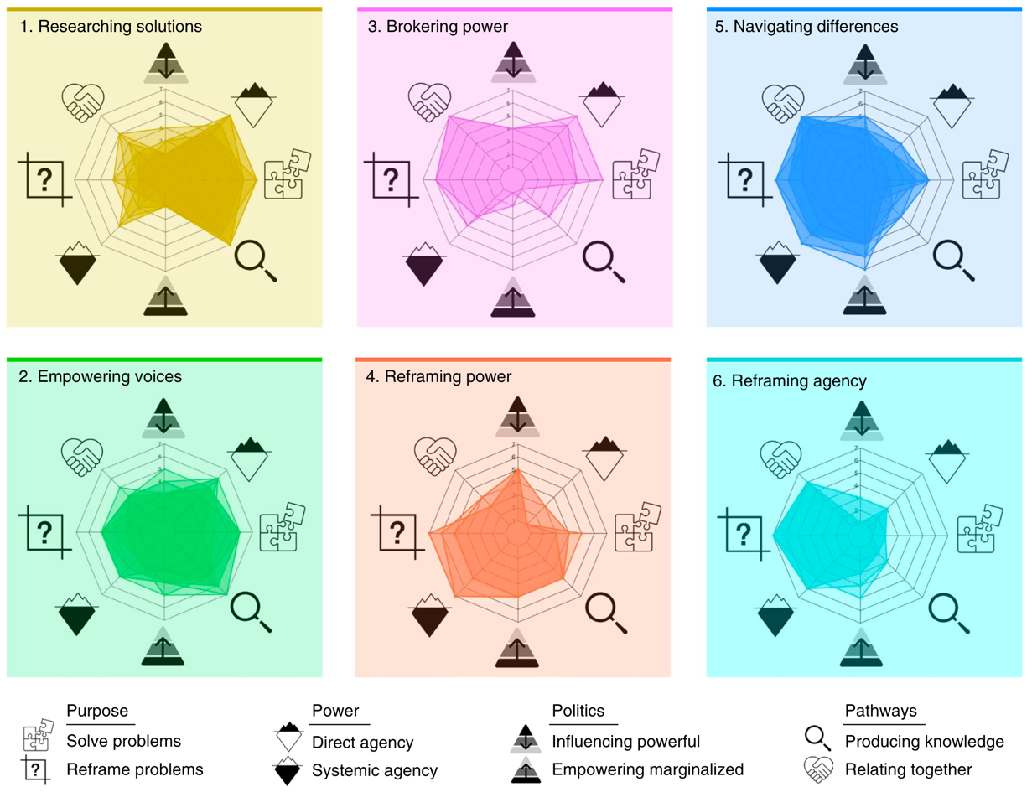
Plurality of approaches is important…

Slide 6
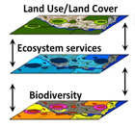
… but each mode poses opportunities and risks
Reframing, collective empowerment
Reframing, networks, institution-building, policy
Knowledge production to inform & justify decisions
’Echo chambers’, external blockers of progress
Requires skilled navigation of positionality & power
Can reinforce power & blame marginalized actors

Slide 7
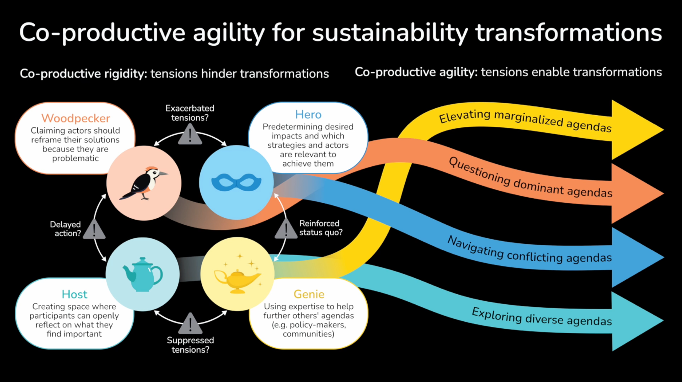
https://www.youtube.com/watch?v=4JfwUJZL4wo

Slide 8
Critical shifts to enable sustainability transformations
Stakeholder
Stakeholding
Dreamholding
Who is valued?
Western
Plurality
Decolonizing
How do we know?
Rational
Process
Imagining
Temporal orientation
Past -->
Present -->
Past --> <-- future

Slide 9
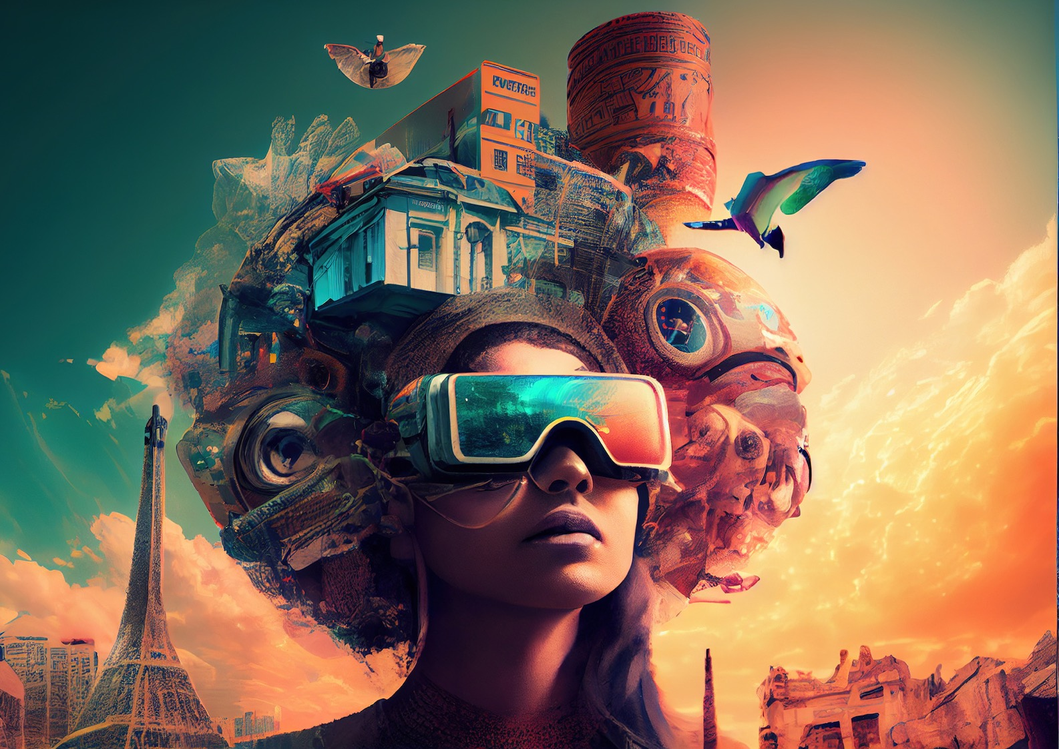
Fostering collective imagination
“Imagination is never very free” (Whitehead 1978)
We are in danger of utopia serving as a prison that furthers the “incremental impoverishment of what might be called Western imagination” (Jacoby 2005)
Politics of escapism?
Politics of inevitability?

Slide 10
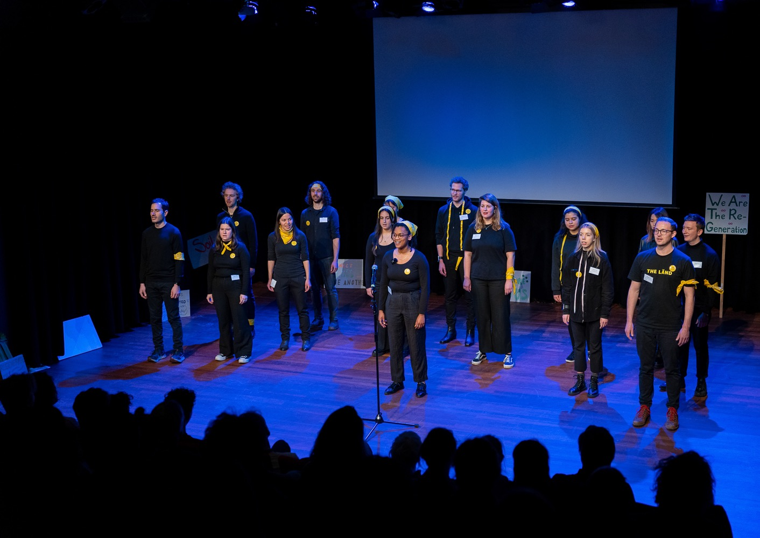
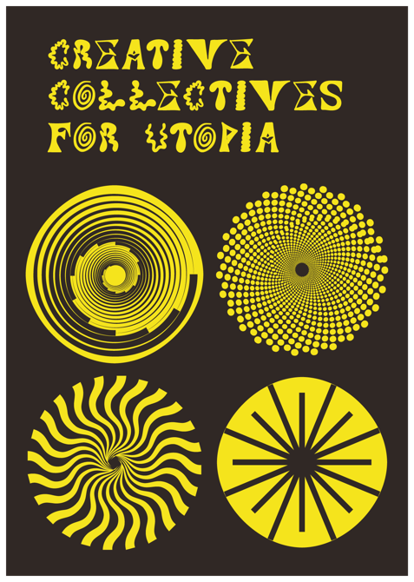
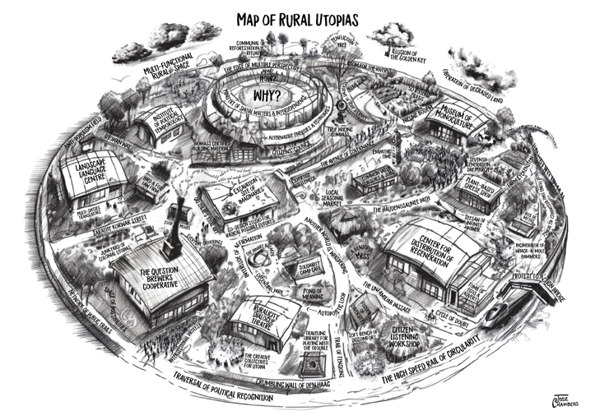
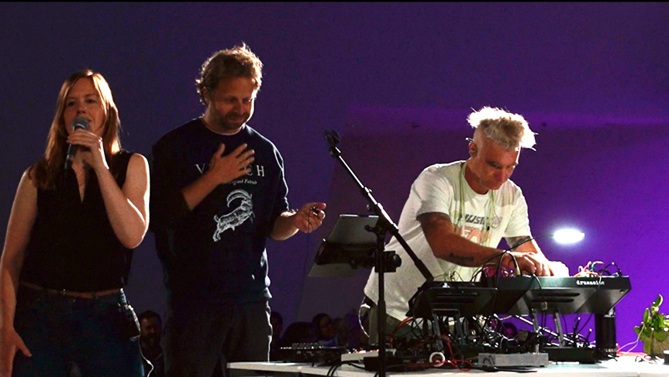
The role of artistic approaches

Slide 11
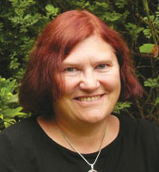
Utopia as method
“Utopia must be understood not as a blueprint or plan,
but as a method of exploring potential alternative futures…
Utopia is a form of speculative sociology of the future.”
“Music, art and literature not only carry utopian desire but offer a glimpse of what it is that is missing."
- Ruth Levitas

Slide 12
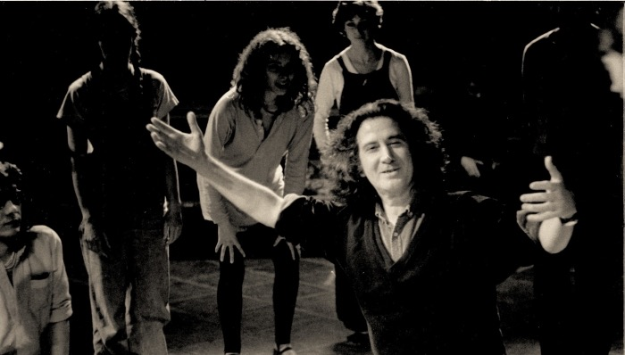
Utopia as method
Politics of imagination?
Politics of disruption?
Politics of representation?
Politics of emancipation?
Politics of deliberation?
Politics of prefiguration?

Slide 13
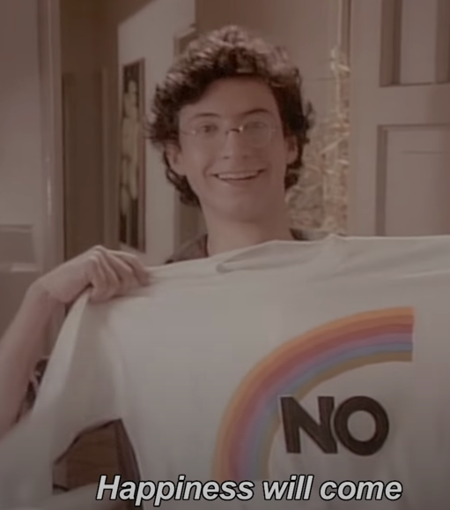
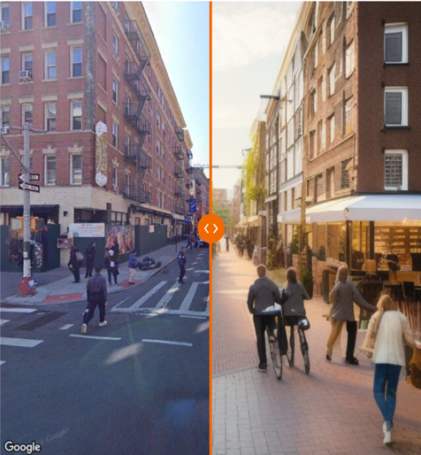
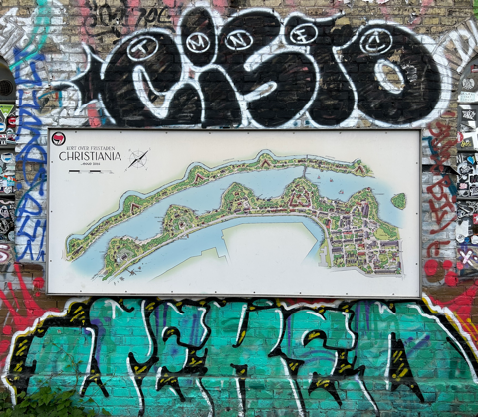
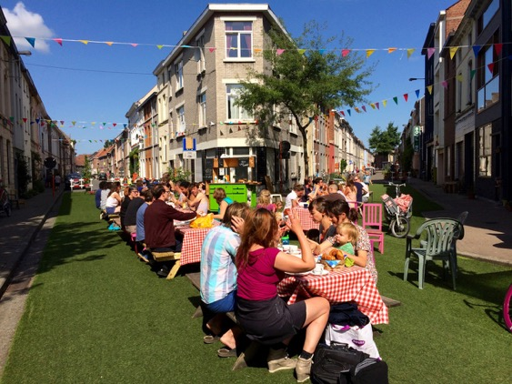
Utopia as method: three modes
Analytical and practical
https://dutchcyclinglifestyle.com
Architectural
“the imagination of potential alternative scenarios for the future, acknowledging the assumptions about and consequences for the people who might inhabit them"
Making utopias visible
Living Streets – Ghent, Belgium

Slide 14
Utopia as method: three modes
Archaeological
“piecing together the images of the good society that are embedded in political programmes and social and economic policies”
Ontological
Subjecting all utopias to critique
”all utopias, whether explicit or implicit have an embedded idea of what it means to be human, what is good for us and makes us happy”
Analytical and practical
Architectural
Making utopias experienced & felt
“the imagination of potential alternative scenarios for the future, acknowledging the assumptions about and consequences for the people who might inhabit them"
Making utopias visible

Slide 15
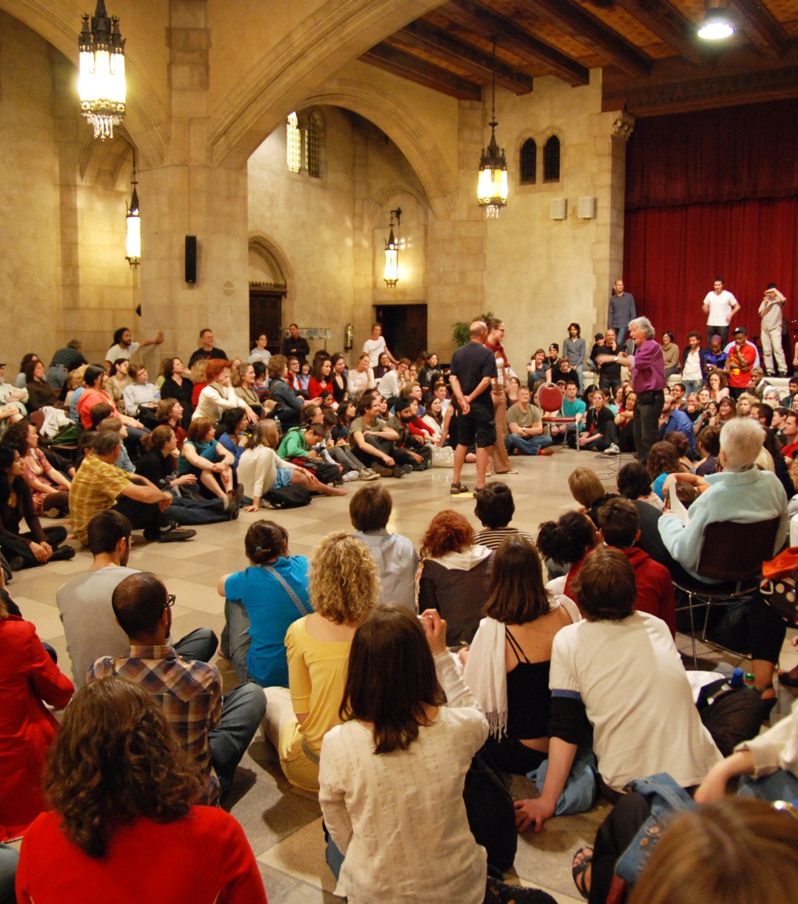
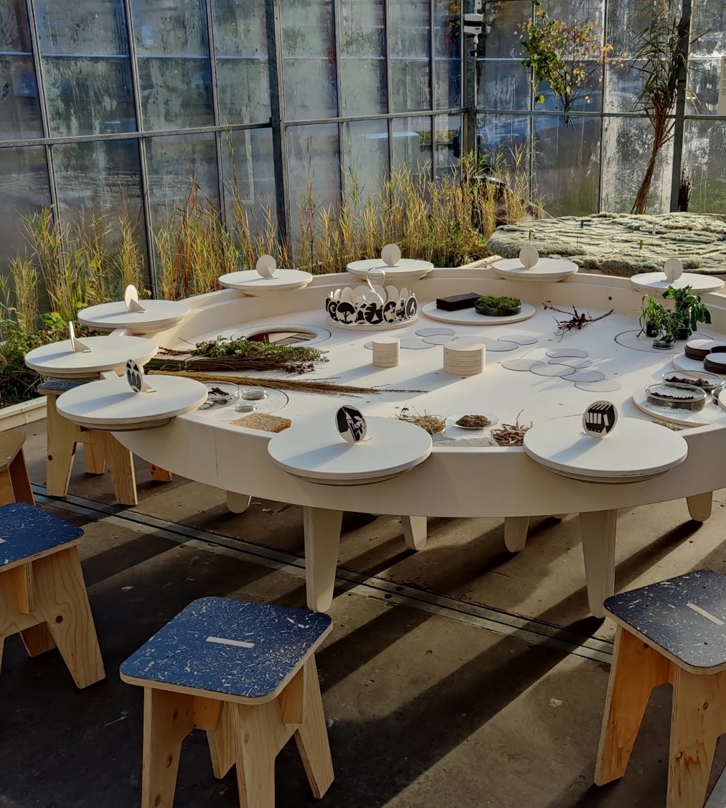
Utopia as imaginative political process?
Subverting dystopia
(e.g. theater of the oppressed)
Co-designing utopia
(e.g. possible landscapes)

Slide 16
The ‘how’ of transformation?
Social critiques of ‘utopian’ imaginaries
Speculative
co-production of the future
Creative modes for imagining together
Active
prefigurative experimentation

