Slide 1
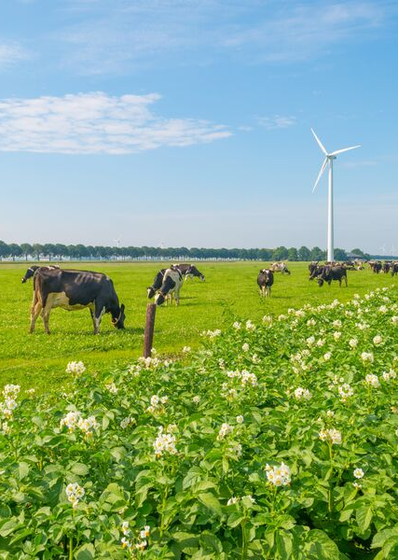
Euroresidue Grants
Grants for scientific visits, congresses, internships made possible by the former Euroresidue foundation

Slide 2

Euroresidue Grants
The former Euroresidue foundation has made available a one time funding to contribute to the workfield of Foodsafety for the following :
Short internships at renowned food safety Institutes ;
Training courses in the field of food safety ;
Travelgrants to relevant conferences and workshops.
The application is open to representatives from Academia and Foodsafety institutes/laboratories. Priority will be given to low and middle-income countries from Africa, Asia and South America.
Grant recipients are required to submit a brief report after using the grant.
Grant recipients are required to mention and thank the Euroresidue Foundation in their articles and/or presentations.
Deadline for applications is
1st of January 2025
Please submit your application via the digital form (for a link) or send an email to request an application form.
Applications will be assesed by Prof. Dr. Bruno le Bizec (LABERCA, SARAF), Dr. James Sasanya (IAEA) and Drs. Saskia Sterk (Director EURL ) WFSR.
Want to know more? Go to the Euroresidue website
For more information contact:
Saskia Sterk
Saskia.sterk@wur.nl

