Slide 1
Me My Diet and I
Flagship - Digital Twin
December 2022
Lydia Afman - Associate professor Human Nutrition & Health
Alain Starke – Postdoc Marketing and Consumer Behaviour

Slide 2
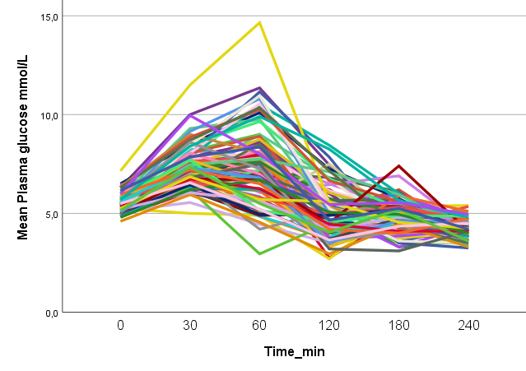
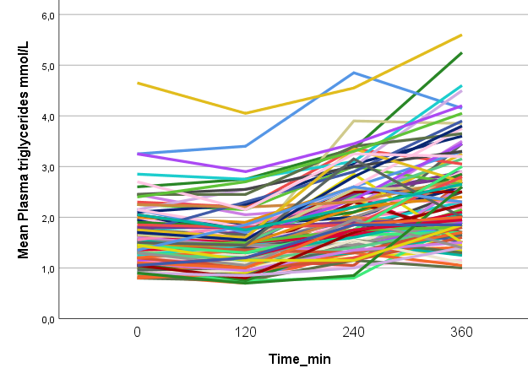
From population advice to personalized advice
Dietary advice for the
general population
People respond different
to the same foods/diet

Slide 3
Me My Diet and I
OVERALL OBJECTIVE:
To develop a digital twin that will give personalized dietary advice to reduce the personal after-meal triglyceride (fat) response.

Slide 4
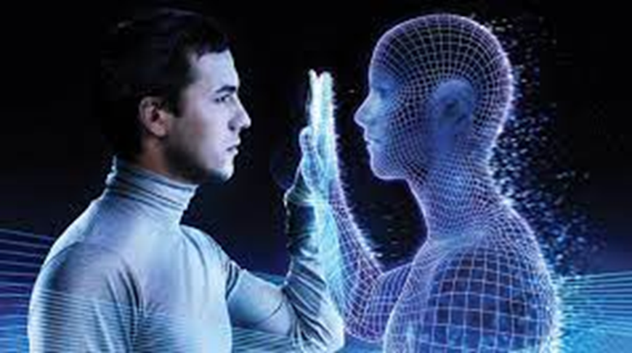
What is a digital twin?
A digital twin is a virtual representation that serves as the real-time digital counterpart of a physical object or process;
In our case a human
Metabolic response to nutrition

Slide 5
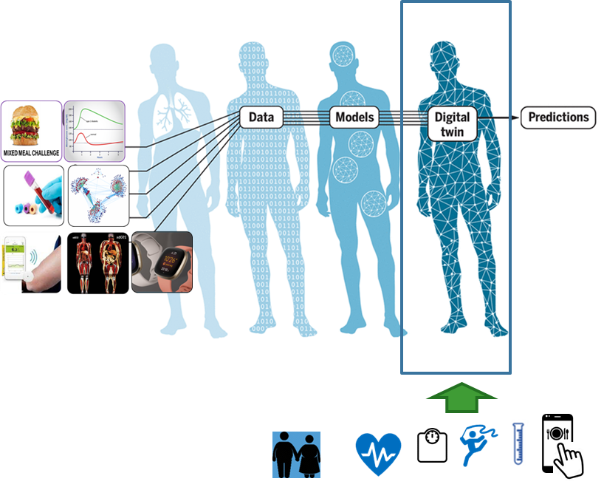
Digital twin
Predicted personalized dietary advice
Real-time feed back
JP Laubenbacher JP et al, Science, Mar 2021

Slide 6
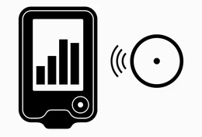
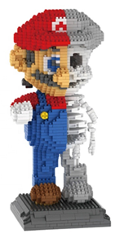
Envisioned digital twin
Personalized dietary advice
Overweight middle age male and female
Digital twin available in
Personal Health environment (PGO)
Real-time data sensors
and other registration

Slide 7
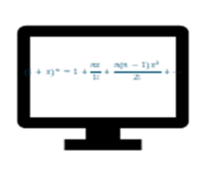
Algorithm to predict personal postprandial response
O'Donovan et al. iScience. 2022
Prediction model for meal response
Fasting TAG, liver fat, lipid profiles, vitamin B12

Slide 8
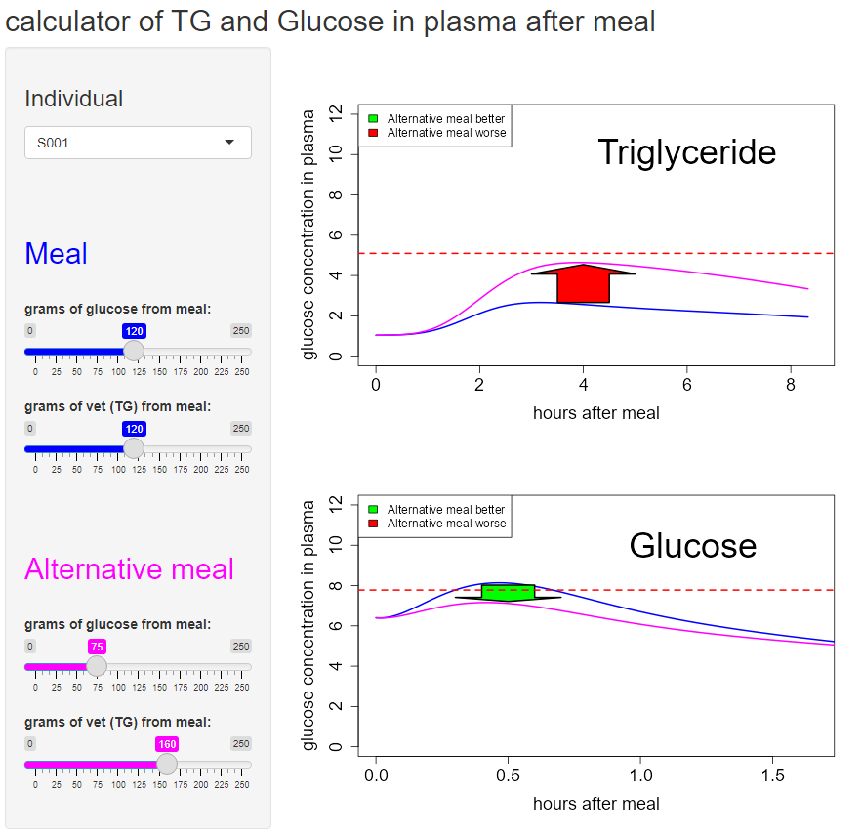
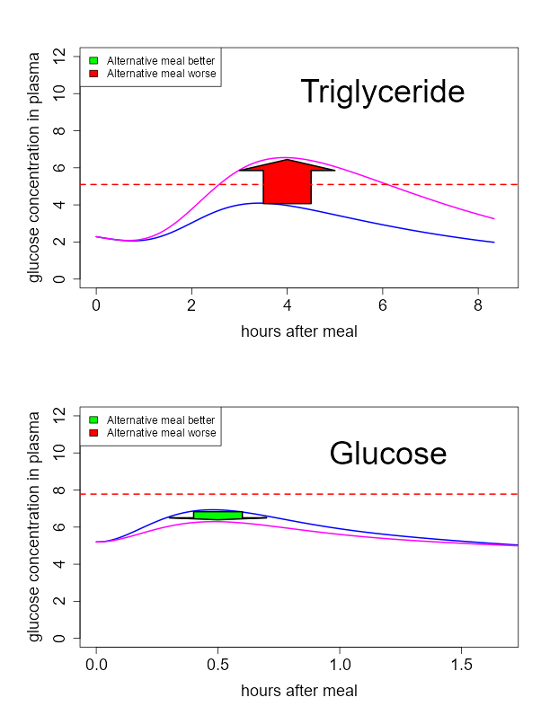
Persons react different on the same meal
PERSON 1 PERSON 34

Slide 9
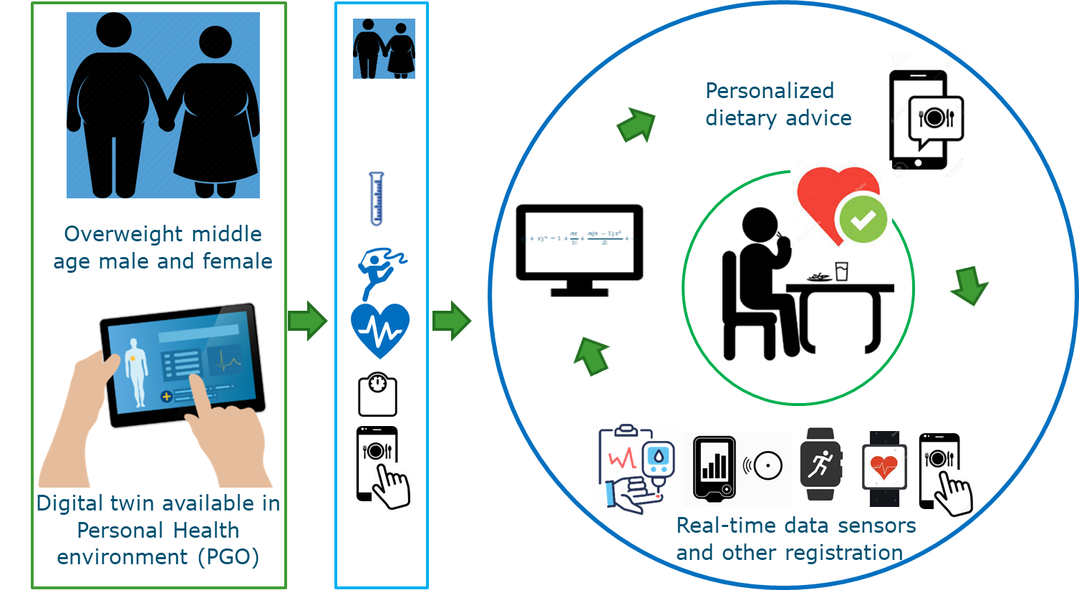
Envisioned digital twin

Slide 10
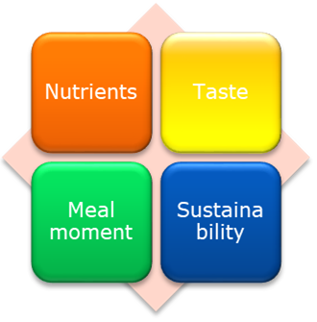
Combining databases to enable automatically dietary advice
Combining the following databases:
Nutritional content (NEVO)
Taste
Meal moment
Sustainability
Building an ontology to automatically create dietary advice – meal plan generation

Slide 11
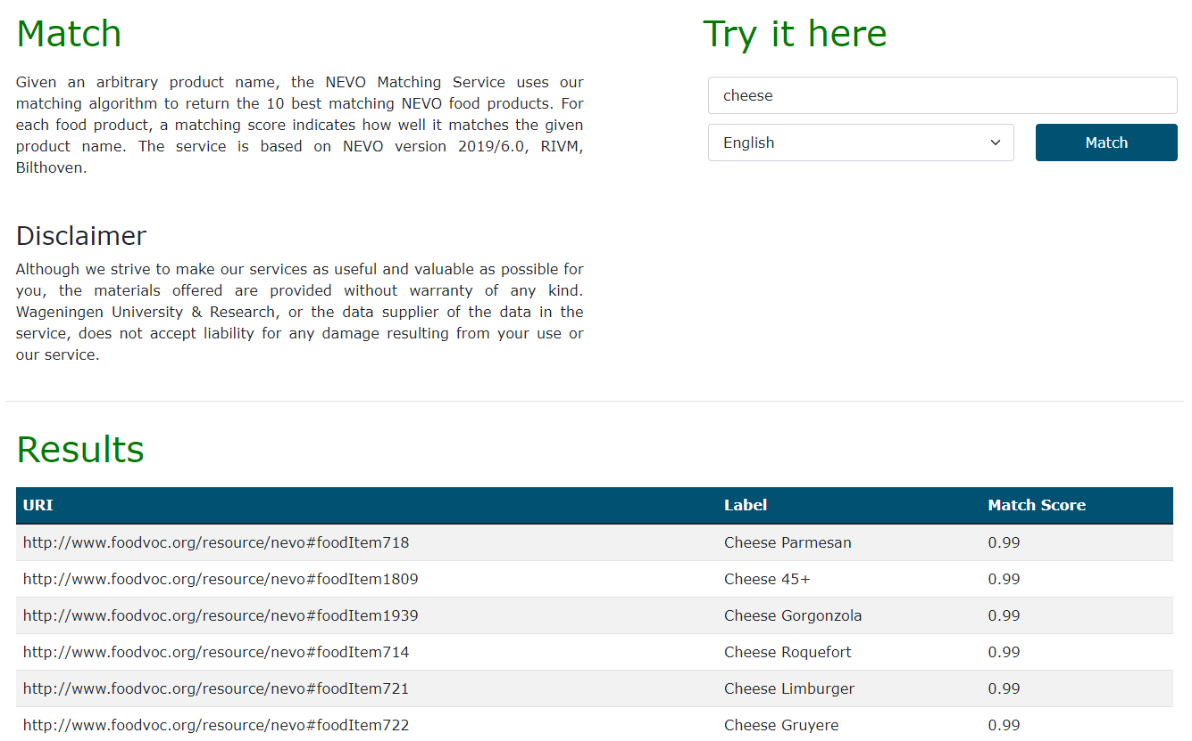
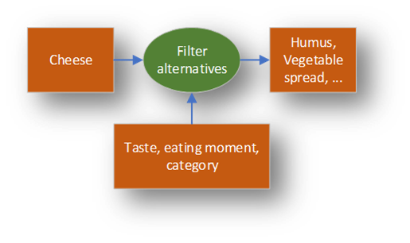
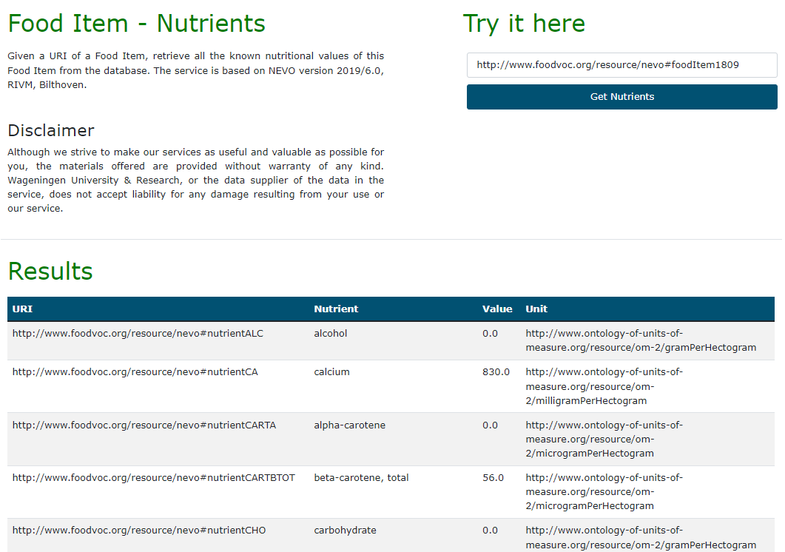
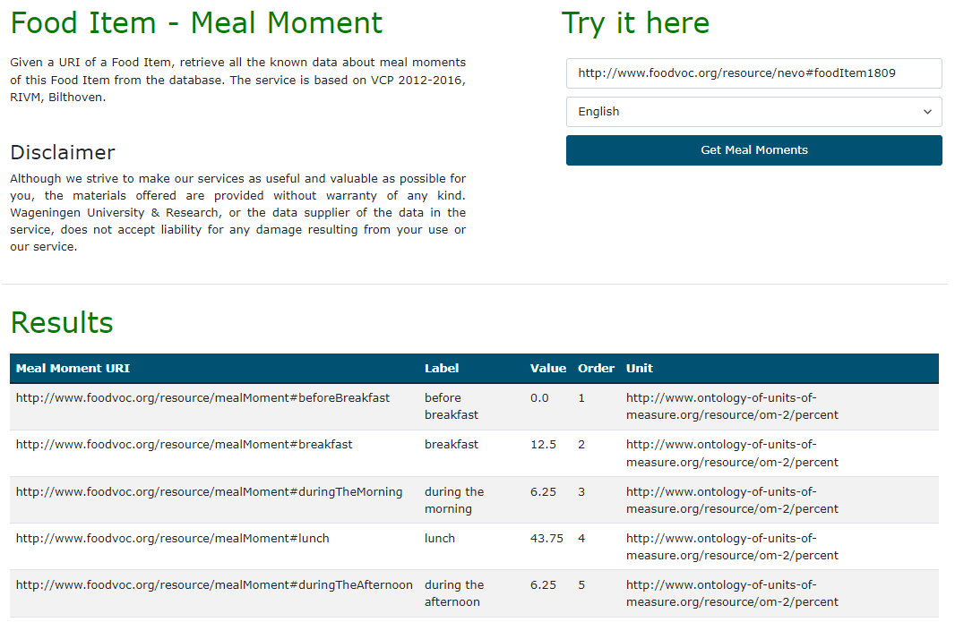
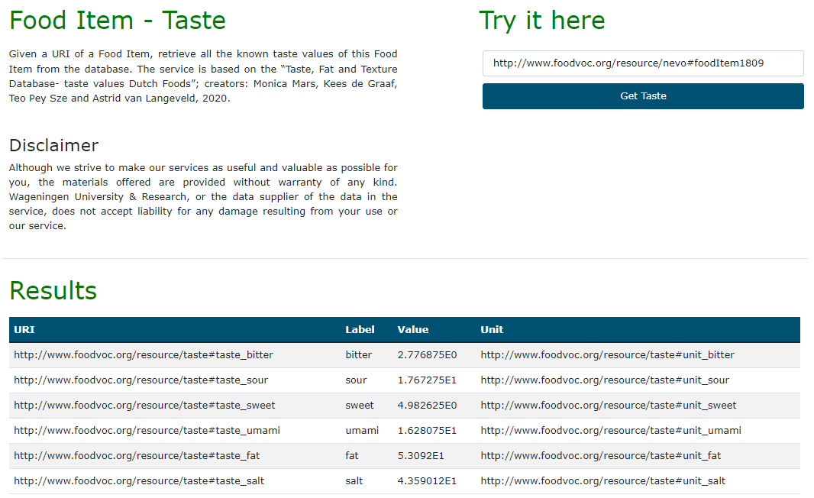
Combining datasets

Slide 12
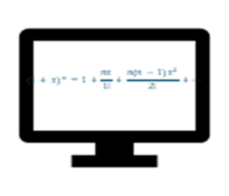
Meal plan generation
Meal plan
Nutrients
Taste
Meal moment
Sustainability
Evolutionary and genetic algorithms
More PUFA, less carbohydrates equal fiber

Slide 13
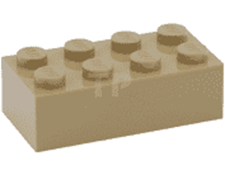
Envisioned digital twin

Slide 14
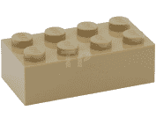
How to increase consumer acceptance of personalized dietary/food advice?
Literature Review: Examining factors in consumer acceptance of personalized nutrition services
Consumer Acceptance Study on personalizing food advice towards preferences: Examining product advice based on preferred food taste

Slide 15
What does the scientific literature say about consumer acceptance for personalized dietary advice?

Slide 16
Overview of Examined Factors for Consumer Acceptance of Personalized Dietary Advice

Slide 17
Literature Review: Insights and Implications
Insights
Personalized approaches typically outperform other approaches
Advice should consider whether consumers are willing to change and what they can do (e.g., costs, self-efficacy)
Missing links
Algorithmic personalization is still simplistic

Slide 18
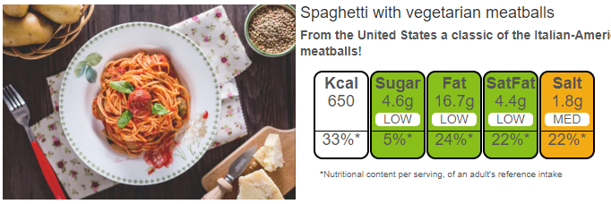
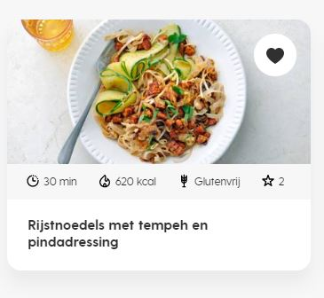
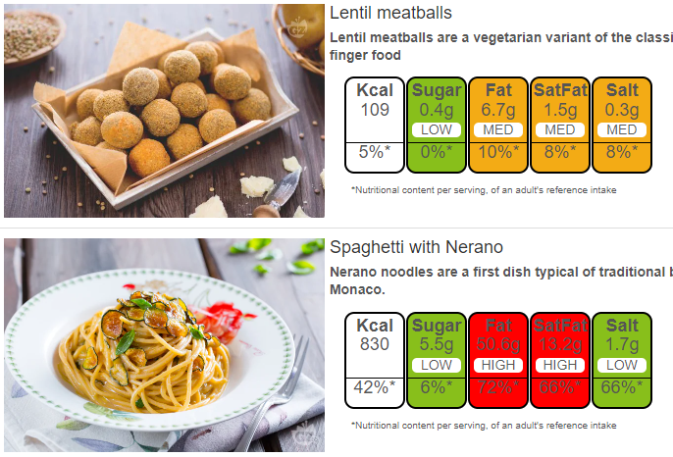
Personalizing advice towards user preferences
Use of Recommender Systems Showing dietary advice, products or meals based on:
What a user liked, consumed, or bought previously, by leveraging product or meal content (e.g., product names, ingredients)
Example: https://recipe-study.wur.nl

Slide 19
Literature Review: Insights and Implications
Insights
Personalized approaches typically outperform other approaches
Advice should consider whether consumers are willing to change and what they can do (e.g., costs, self-efficacy)
Missing links
Algorithmic personalization is still simplistic
Personal preferences are not included in the advice
E.g., the taste preferences

Slide 20
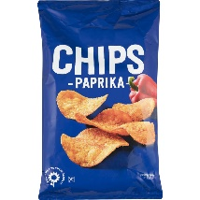
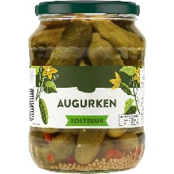
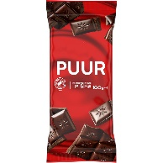
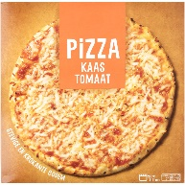
Personalizing food advice based on a product’s preferred taste
Product | Sweet | Sour | Bitter | Umami | Salt | Fatty
Paprika Crisps | LOW TO MEDIUM | LOW | LOW | MEDIUM | HIGH | HIGH
Gherkins, Sweet & Pickled | MEDIUM | HIGH | LOW | LOW | LOW TO MEDIUM | LOW
Dark Chocolate | HIGH | LOW | HIGH | LOW | LOW | HIGH
Slice Pizza Margherita | MEDIUM | LOW | LOW | MEDIUM | HIGH | HIGH

Slide 21
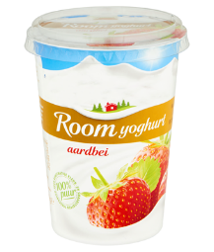
Personalizing advice towards user preferences
Recommending products based on a chosen reference product
Matching products on taste and product category, per eating moment (e.g.,: breakfast, milk products)
Compared to reference product | Condition 1 | Condition 2 | Condition 3 | Condition 4
Match in eating moment | ✓ | ✓ | ✓ | ✓
Match in taste |  | ✓ |  | ✓
Match in product category |  |  | ✓ | ✓
Reference: Cream yoghurt fruit
Consumer Acceptance
Notes:
Plaatje van voorbeeld met producten

Slide 22
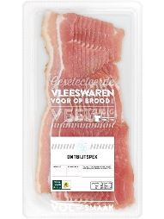
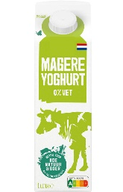
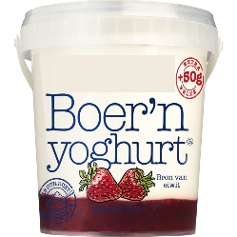
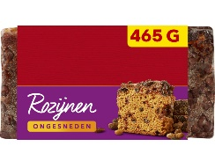
Personalizing advice towards user preferences
Recommending products based on a chosen reference product
Matching products on taste and product category, per eating moment (e.g.,: breakfast, milk products)
Compared to reference product | Condition 1 | Condition 2 | Condition 3 | Condition 4
Match in eating moment | ✓ | ✓ | ✓ | ✓
Match in taste |  | ✓ |  | ✓
Match in product category |  |  | ✓ | ✓
Reference: Cream yoghurt fruit | Bacon | Spiced cake with raisins | Low-fat yoghurt | Full-fat yoghurt
Consumer Acceptance | 0 | 0/+ | + | ++
Notes:
Plaatje van voorbeeld met producten

Slide 23
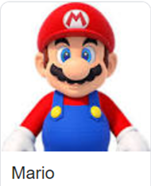
So how does it work: meet Mario and Luigi They look similar on the outside, but have different responses to meals, needs and preferences
Phenotype: male, BMI: 27kg/m2, high fasting TG, relatively high liver fat
Preferences: likes Italian food, lactose intolerant, loves meat
Phenotype: male, BMI: 25kg/m2, low fasting TG, relatively low liver fat
Preferences: likes to snack, cheese lover, green lifestyle, vegetarian
Predicted meal response
Feedback loop
More PUFA, less carbohydrates, equal fibre
Personalised advice
More fibres, less SFA, equal carbohydrates
Our digital twin
Personalised meal plans

Slide 24
Me My Diet and I - Team
WU
Human Nutrition & Health: Lydia Afman, Sander Kersten
Laboratory of Systems and Synthetic Biology: Maria Suarez-Diez, Henk van Lingen
Marketing and Consumer Behaviour: Ellen Van Loo, Arnout Fischer, Alain Starke
WR
Wageningen Economic Research: Marc-Jeroen Bogaardt, Machiel Reinders, Muriel Verain
Wageningen Food Biobased Research: Diederik Esser and Lorijn van Rooijen, Jan Top
Wageningen Plant Research, Subdivision Biometrics: Hendriek Boshuizen, Hubert Fonteijn

