Slide 1
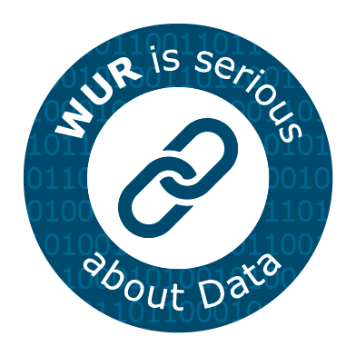
Data Management at WCDI
-----------
FAIR data management of WCDI data Project
February 2024
Image courtesy: Noun project

Slide 2
What to expect today
Part I – basics
WCDI
Quick recap on work done by WCDI Data Stewards
Part II – FAIR data management of WCDI data
Aim
Relevance

Slide 3
WCDI: In a nutshell
One of the nine research institutes of WR - 82 FTEs
Key roles: Project Management, Applied research, Education
Working fields and expertise: Environment, Livestock, Global One Health, Economics, Agronomy, (Agro)biodiversity, Plant Genetic Resources, Aquaculture, Climate Change, M&E.
Work focused on the context of Food Systems Transformations in the Global South with a wide range of national, regional, and international partners.

Slide 4
Quick recap: Work done so far (2022-2023)
Survey among WCDI colleagues to understand the type of data currently collected at WCDI.
Drafted the WCDI Data Management Protocol following the WUR template.
Drafted Data Sharing Guidelines for projects with many partners generating data.
Shared Good Data Practices in intranet.
Prepared a “what to do with data” Workflow-Chart.
Series of seminars for WCDI staff to familiarize and adopt the WUR Data Management Plan in their projects.
Bundled everything in an Online Portal.
Notes:
https://arngupta.wixsite.com/data-at-wcdi

Slide 5
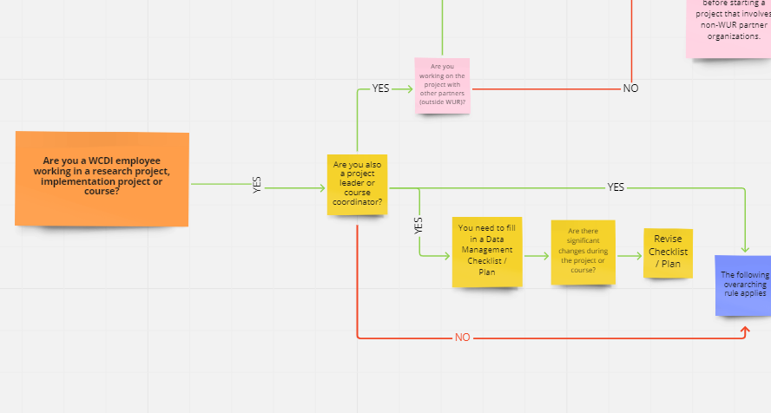
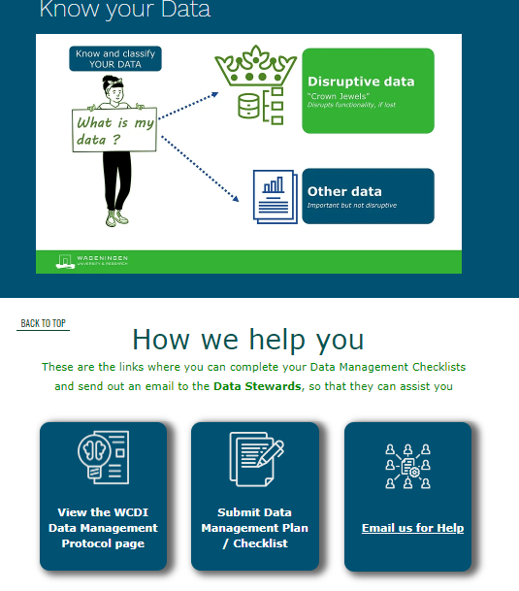
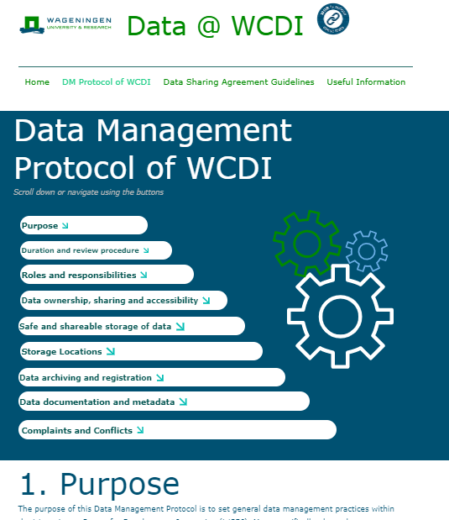
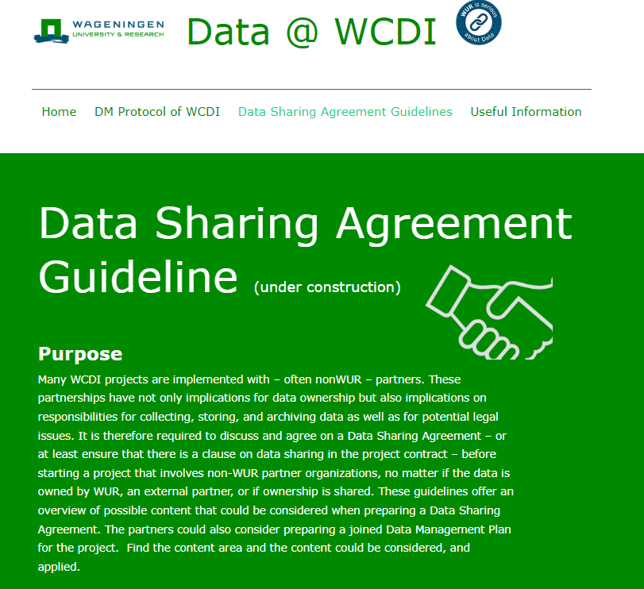
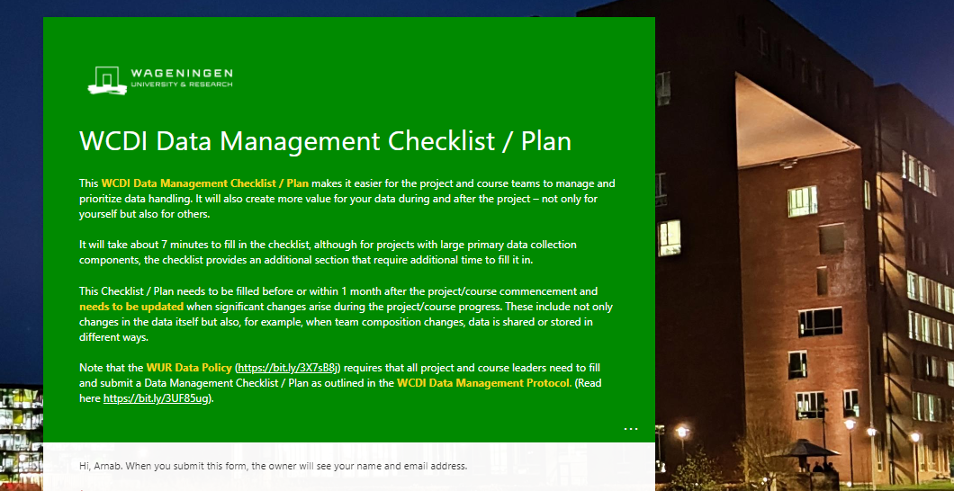
Quick recap: Products
And many more important and useful resources available at the WUR Research Data Management web pages.
Notes:
Lots of additional information at WCDI and WUR portals to help you out.

Slide 6
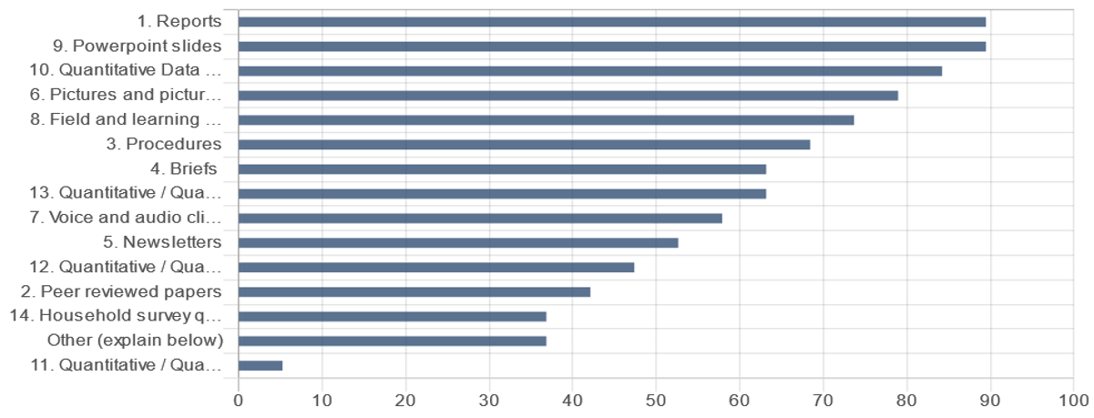
Quick recap : What did we conclude?
WCDI / SSG handles some unique type of data.
WCDI works with large volumes of research and non-research data stored in different formats and locations (locally, Teams, cloud), inside and outside W-drive.
Qualitative and quantitative data such as surveys, audio/video files (interviews), curated course materials.
Needs to be handled differently.

Slide 7
WDCC Project: FAIR data management of WCDI data
Aim: Develop standardized workflows/ procedures leveraging on WUR’s common data solutions infrastructure that will ensure proper archiving of the diverse research and non-research data produced at WCDI following the FAIR principles.
Yoda platform: Focus on optimizing Yoda for data management and streamlining data sharing in our collaborations with Global South and other partners.
Central to this transformation is the emphasis on robust metadata.
Strengthen staff capabilities with broad documentation and training materials, supplemented by example use-cases.

Slide 8
Why is this relevant for WCDI but also for WUR as a whole?
Raise awareness on and implement FAIR data culture at WCDI/WUR.
Data management of unconventional research data.
Need to go beyond internal WUR data sharing (see https://intranet.wur.nl/umbraco/en/news/towards-better-data-sharing/0).
Data sharing with a broad range of international partners (beyond EU).
For the upcoming WCDI-WEcR merger, it's crucial to have a unified data system.

