Slide 1
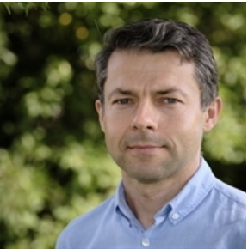
Lunch meeting
A learning trajectory for researchers who are “curious” about applying Data Science and Artificial Intelligence in their research
dr. ir. Lukasz Grus
dr. Aalt-Jan van Dijk
Notes:
Uitleggen hoe mensen vragen kunnen stellen, mic uit, camera aan.

Slide 2
Meeting agenda
Introduction to learning trajectory;
What is data science and artificial intelligence and what we do with that at WUR?;
Your expectations;
Introduction to the “National AI course” and the next steps.

Slide 3
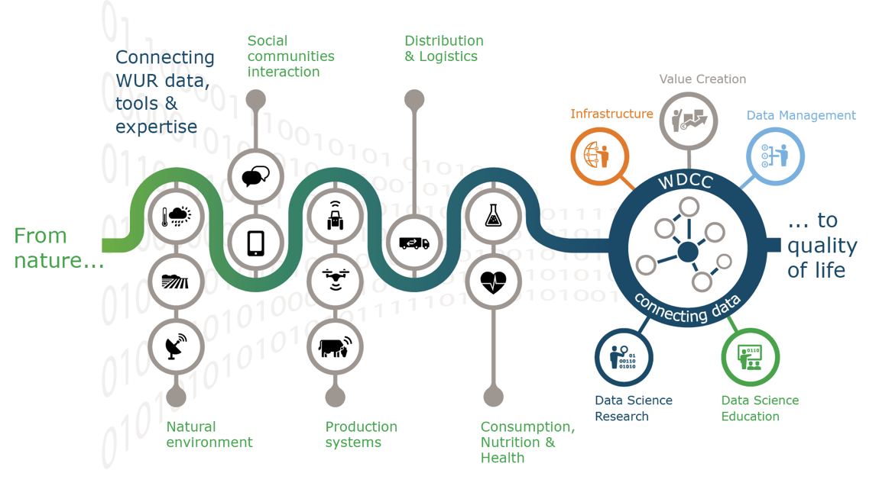

Slide 4
Learning trajectory
Lunch meeting
1 hour
Workshop hands-on with AI
2,5 hours
Online Course AI
Next steps
Now
The coming 6-8 weeks
December/January
t.b.d.

Slide 5
The goal of the learning trajectory
To help you engage into Data Science and AI applications in your research
To inform you what knowledge and skills are needed?
To teach you some basics of those skills
To connect you with WUR Data Science and AI communities

Slide 6
Data science for the curious....
But what is data science?
Aalt-Jan van Dijk

Slide 7
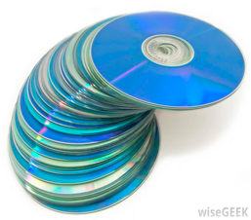
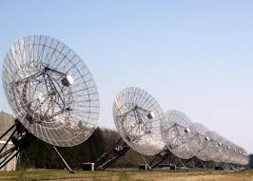
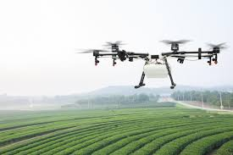
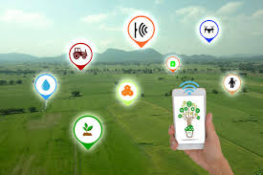
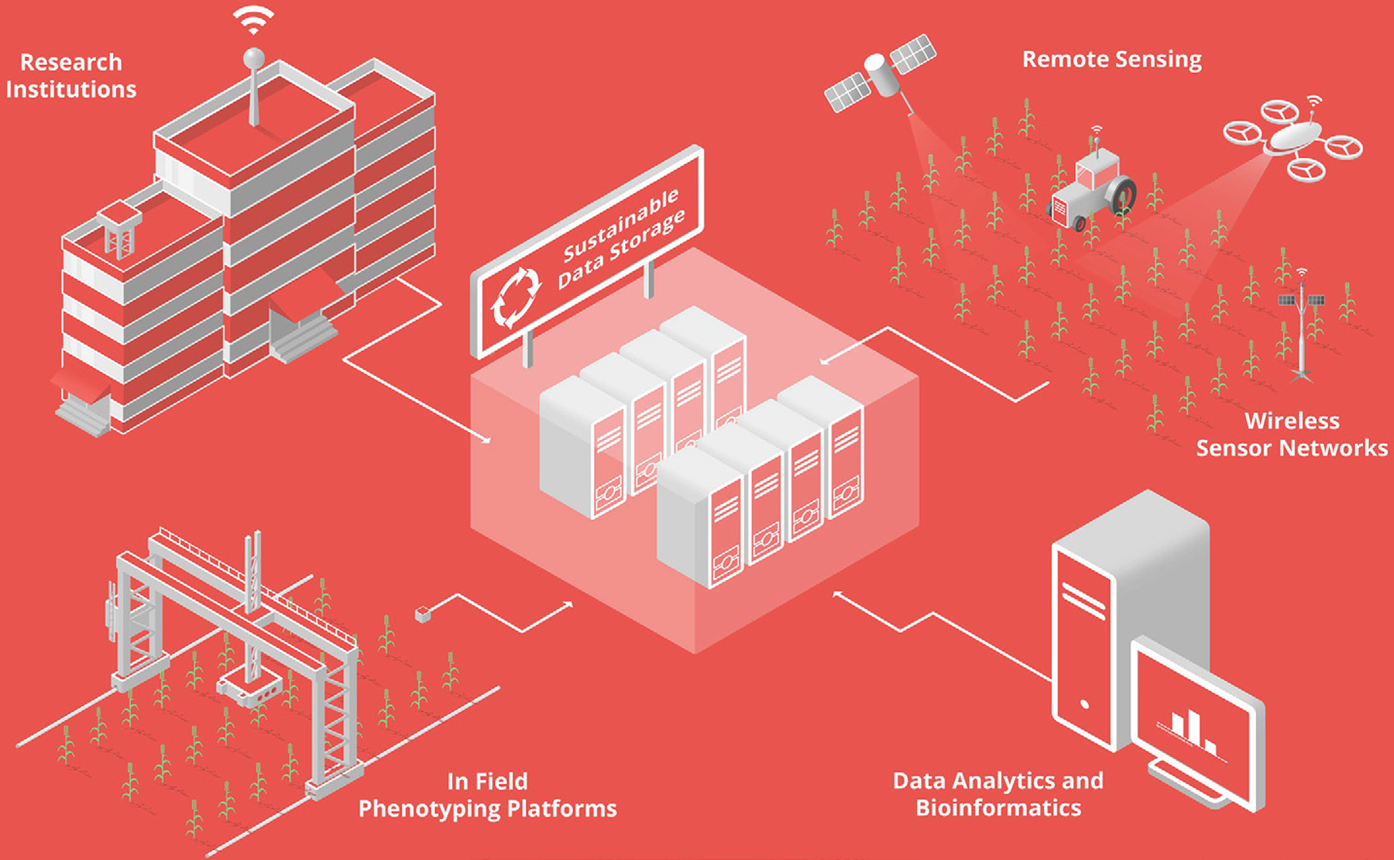
Data

Slide 8
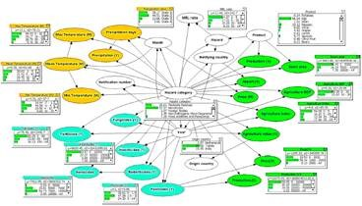
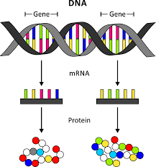
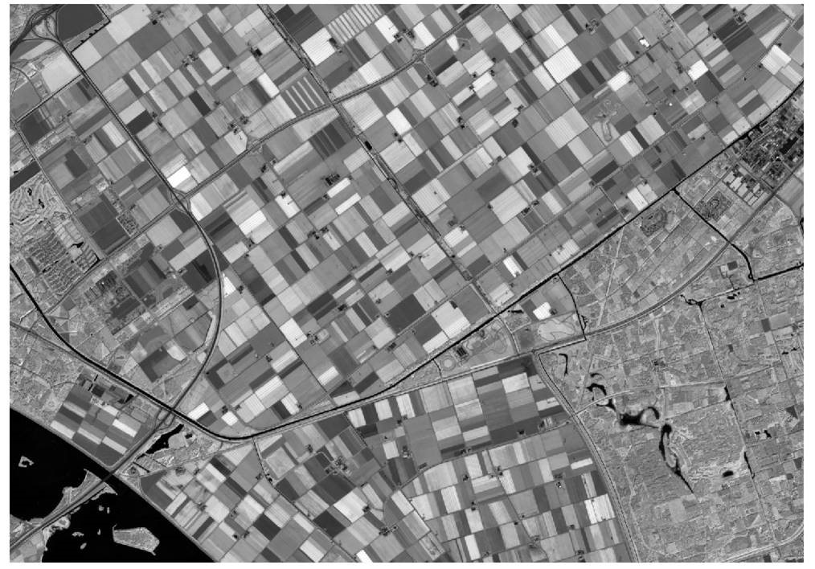
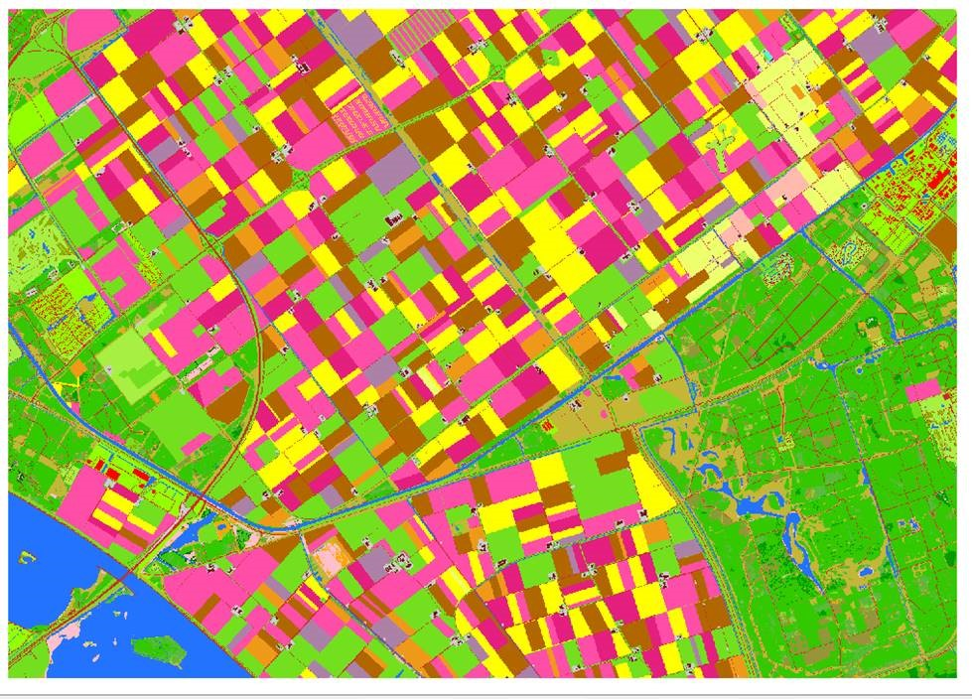
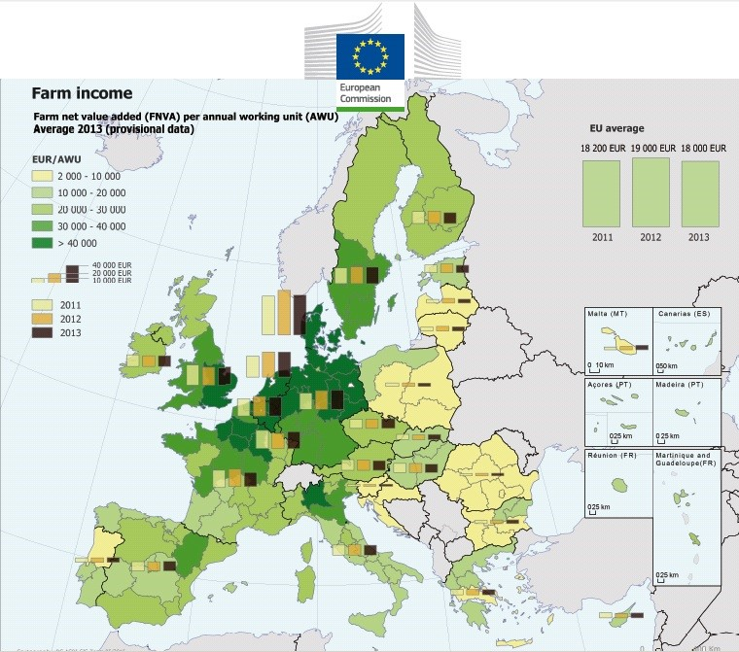
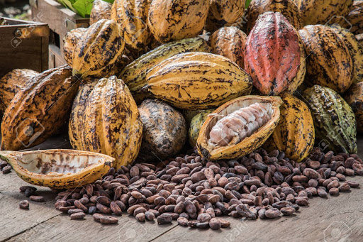
Wageningen data science examples
Molecular biology Land-use Food safety
Biology/ecology Farm income

Slide 9
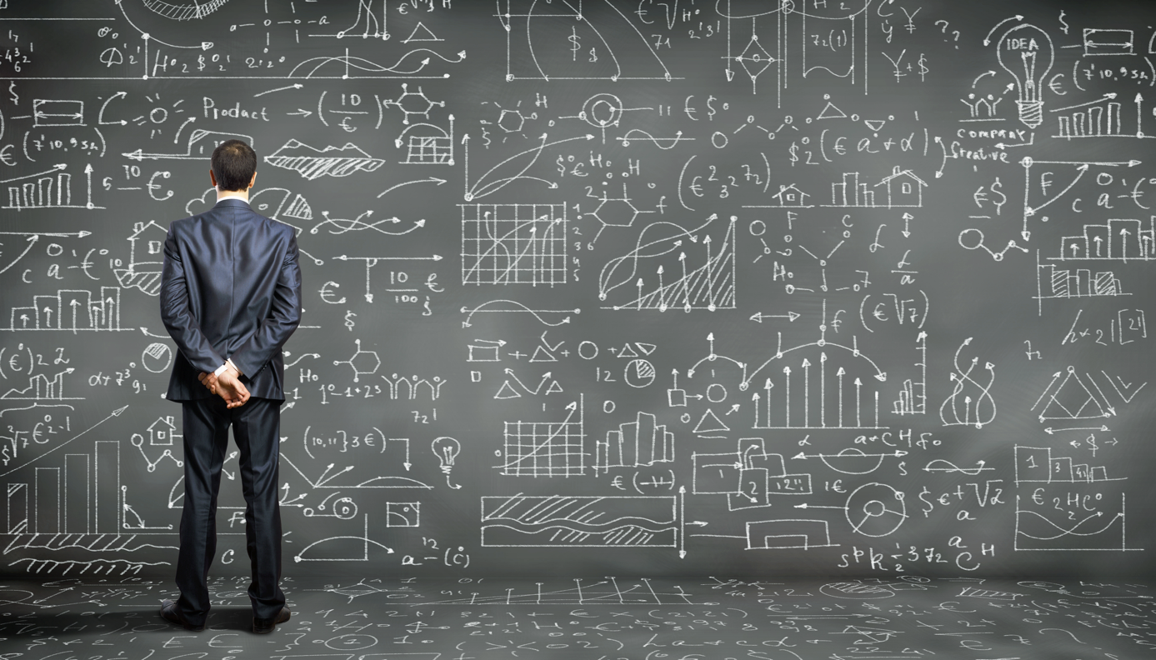
Data science
Statistics
Mathematics
Application domain
Scientific method
Data science
Tool and database use
Data
exploration and interpretation
Data management
Computing and programming

Slide 10
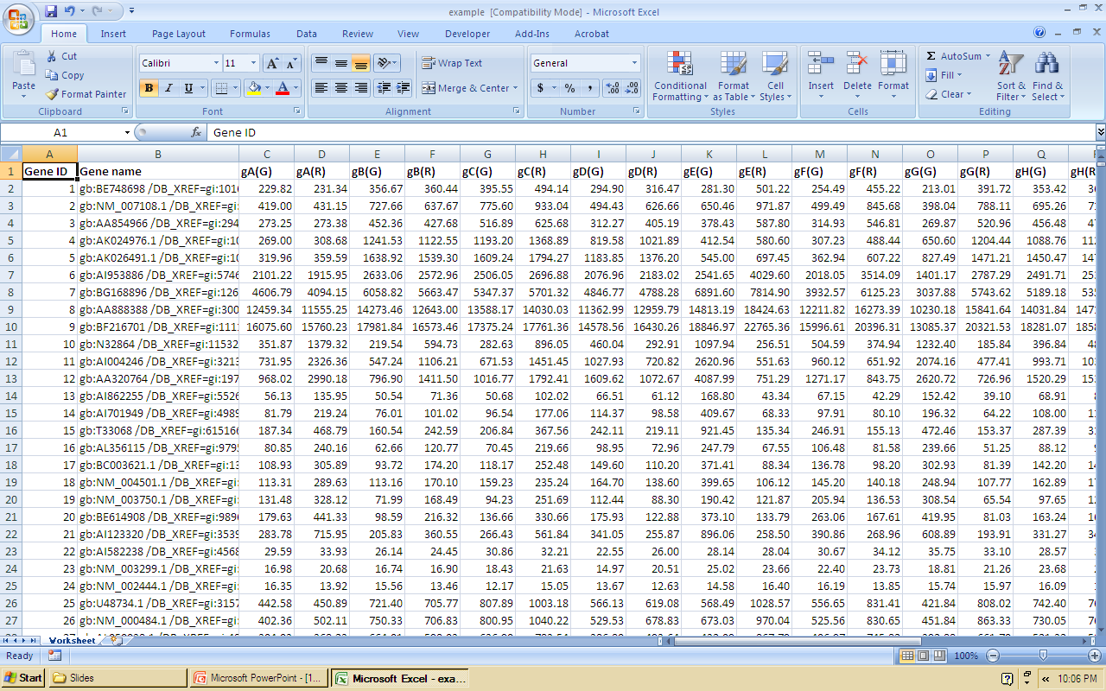
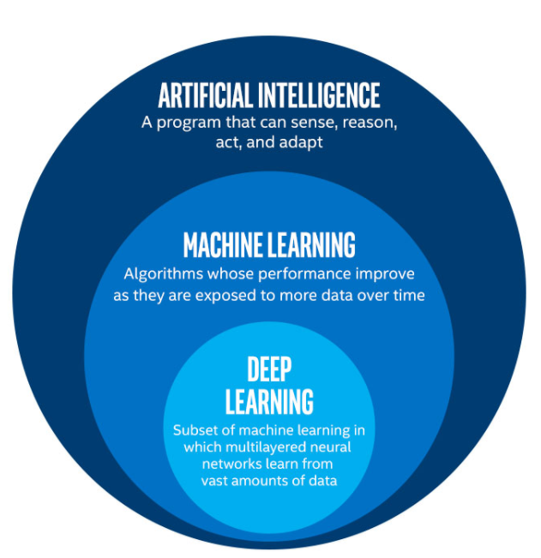
From raw data to knowledge
FAIR principles, linked data
Computer vision
Structured vs unstructured data
Visualization
Machine learning (Artificial Intelligence)

Slide 11
Machine learning
Learn from examples
Identify predictive patterns
Typically: optimization of error function
https://blogs.nvidia.com/blog/2018/08/02/supervised-unsupervised-learning/

Slide 12
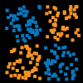
Example of machine learning in 2D
http://playground.tensorflow.org
Tensorflow uses deep learning

Slide 13
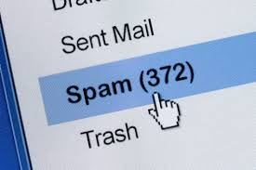
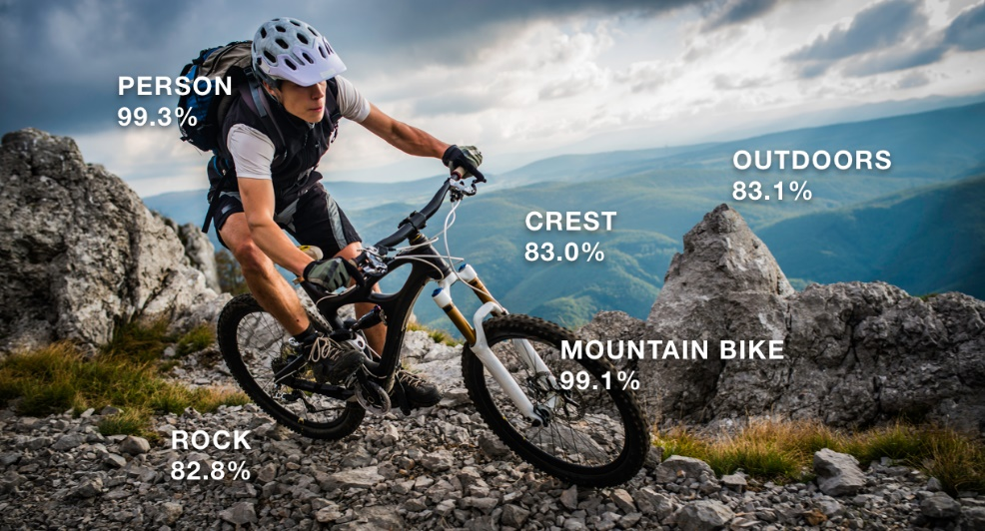
Examples of machine learning

Slide 14
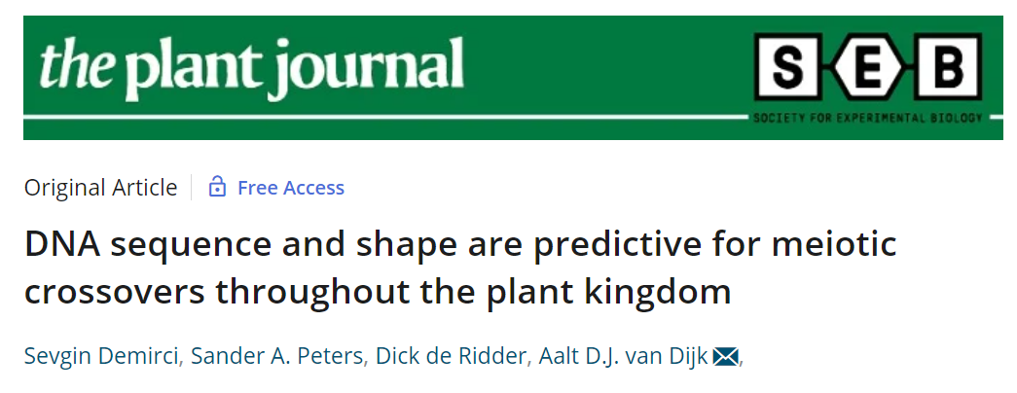
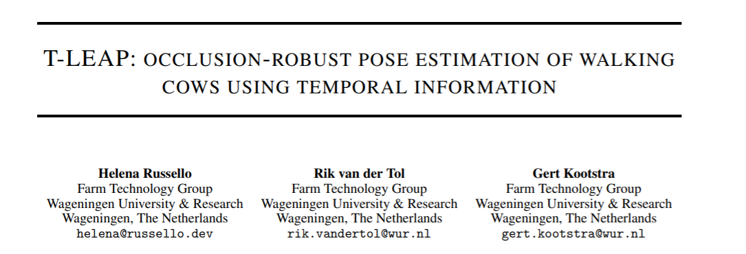
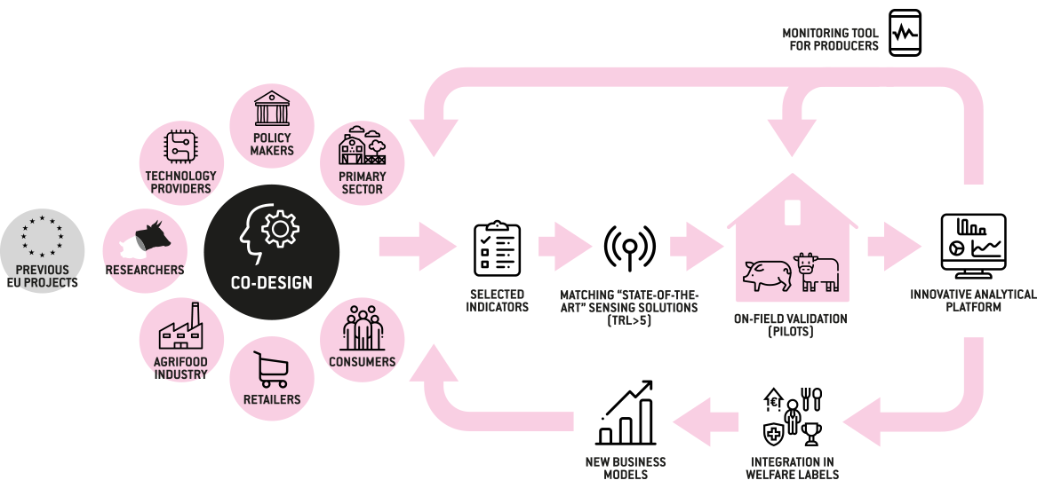
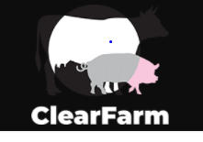
Wageningen examples of machine learning

Slide 15
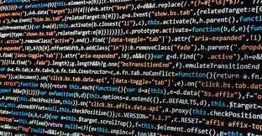
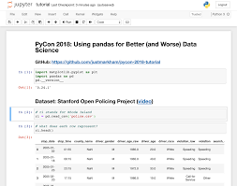
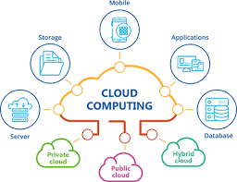
Technologies (1)
Languages: python, R, matlab, ....
Notebooks: Rstudio, Jupyter,...
Cloud computing services: Azure, AWS,...
Platforms: knime, Azure ML studio,...

Slide 16
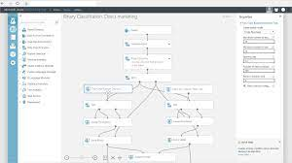
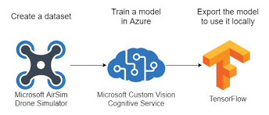
Technologies (2)
Jupyter notebooks:
Code and (rich) text
Various languages (incl. python)
Python library scikit learn (sklearn):
Coherent access to main set of machine learning algorithms
Well-documented
Low/no code:

Slide 17
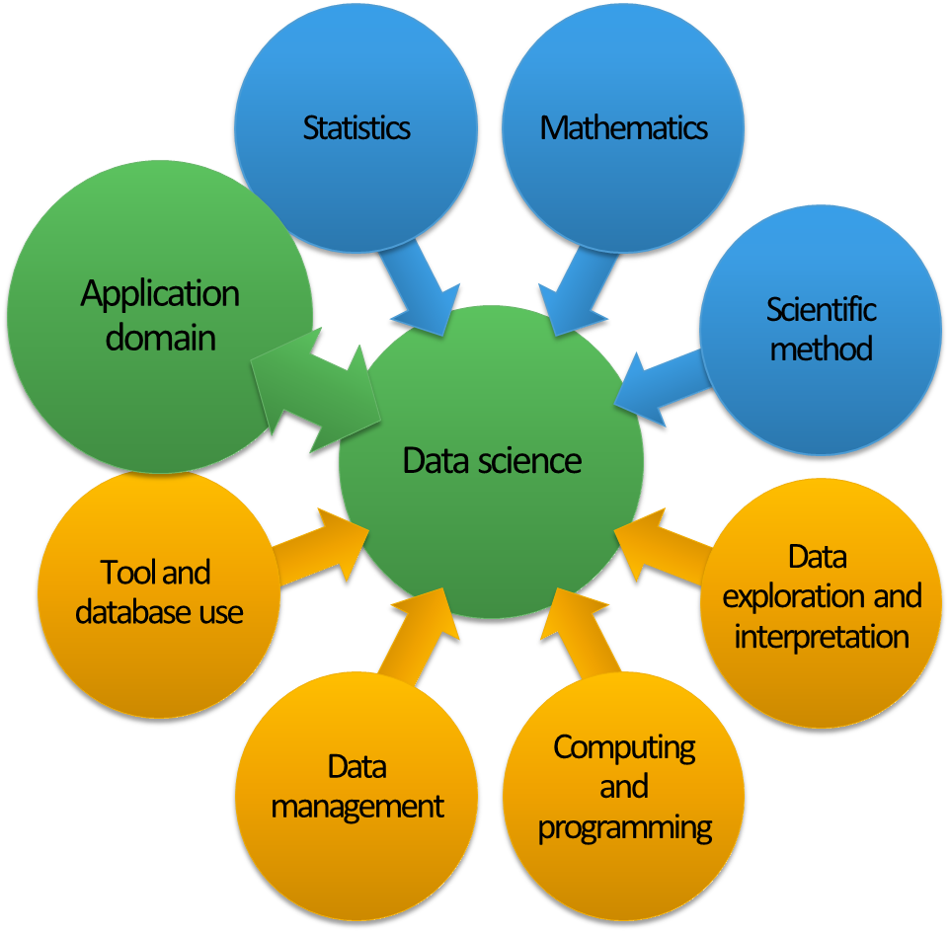
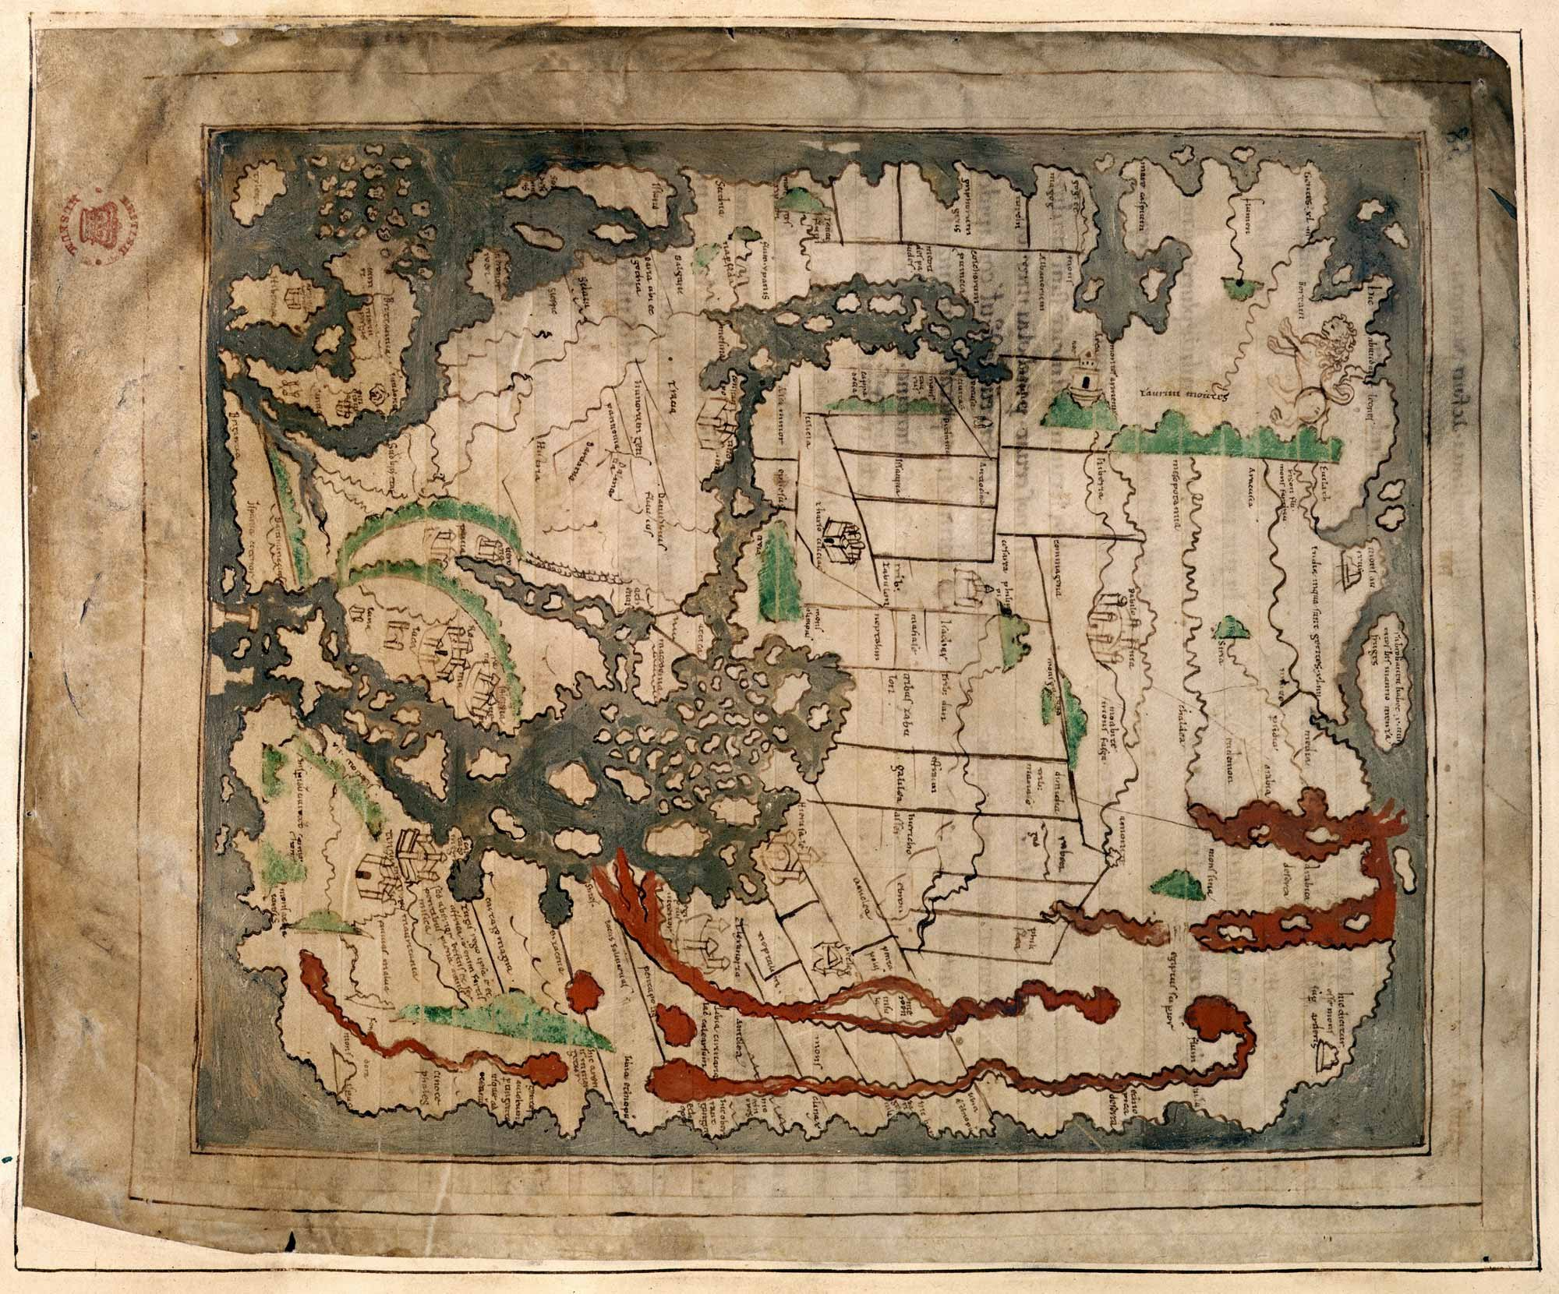
Wrap-up

Slide 18
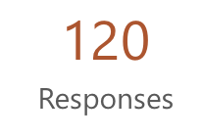
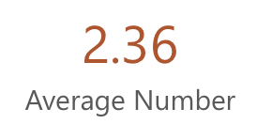
Expectations

Slide 19
17 %

Slide 20
Applying data science techniques to a data set in the consumption domain given a problem related to health or sustainability.
Automated identification of species from images and film; genomics; analysis social media
Using AI to automatically measure baby's food preferences through their face expressions.
Algorithms that transform sensor data into relevant information.

Slide 21
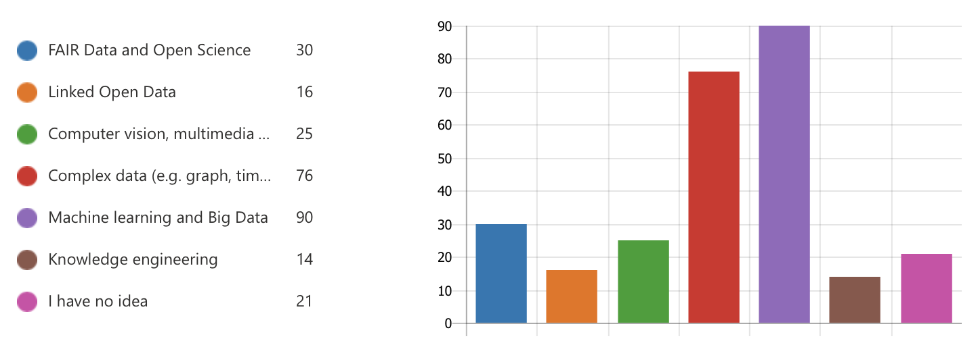

Slide 23
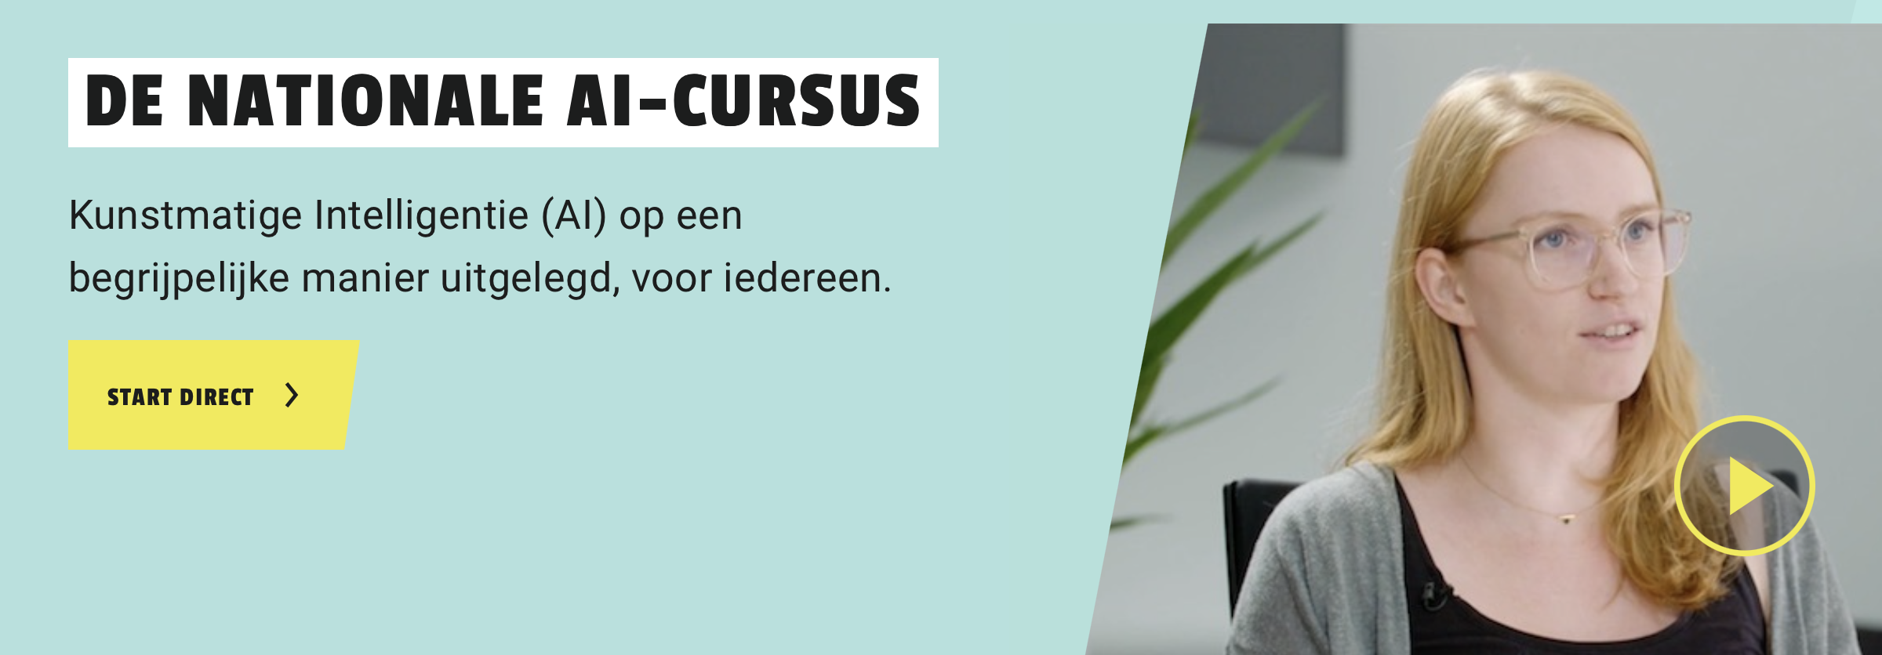
Learning trajectory
Lunch meeting
1 hour
Workshop Hands-on with AI
2,5 hours
Online Course AI
Next steps
Now
The coming 6-8 weeks
December/January
t.b.d.
Notes:
At the end continuation

Slide 24
National AI Course
To prepare you for the future with AI
8 modules, 36 documents to read, duration 4-6 hours
Required for the next workshop
Notes:
Hier ook de tijdlijn laten zien

Slide 25
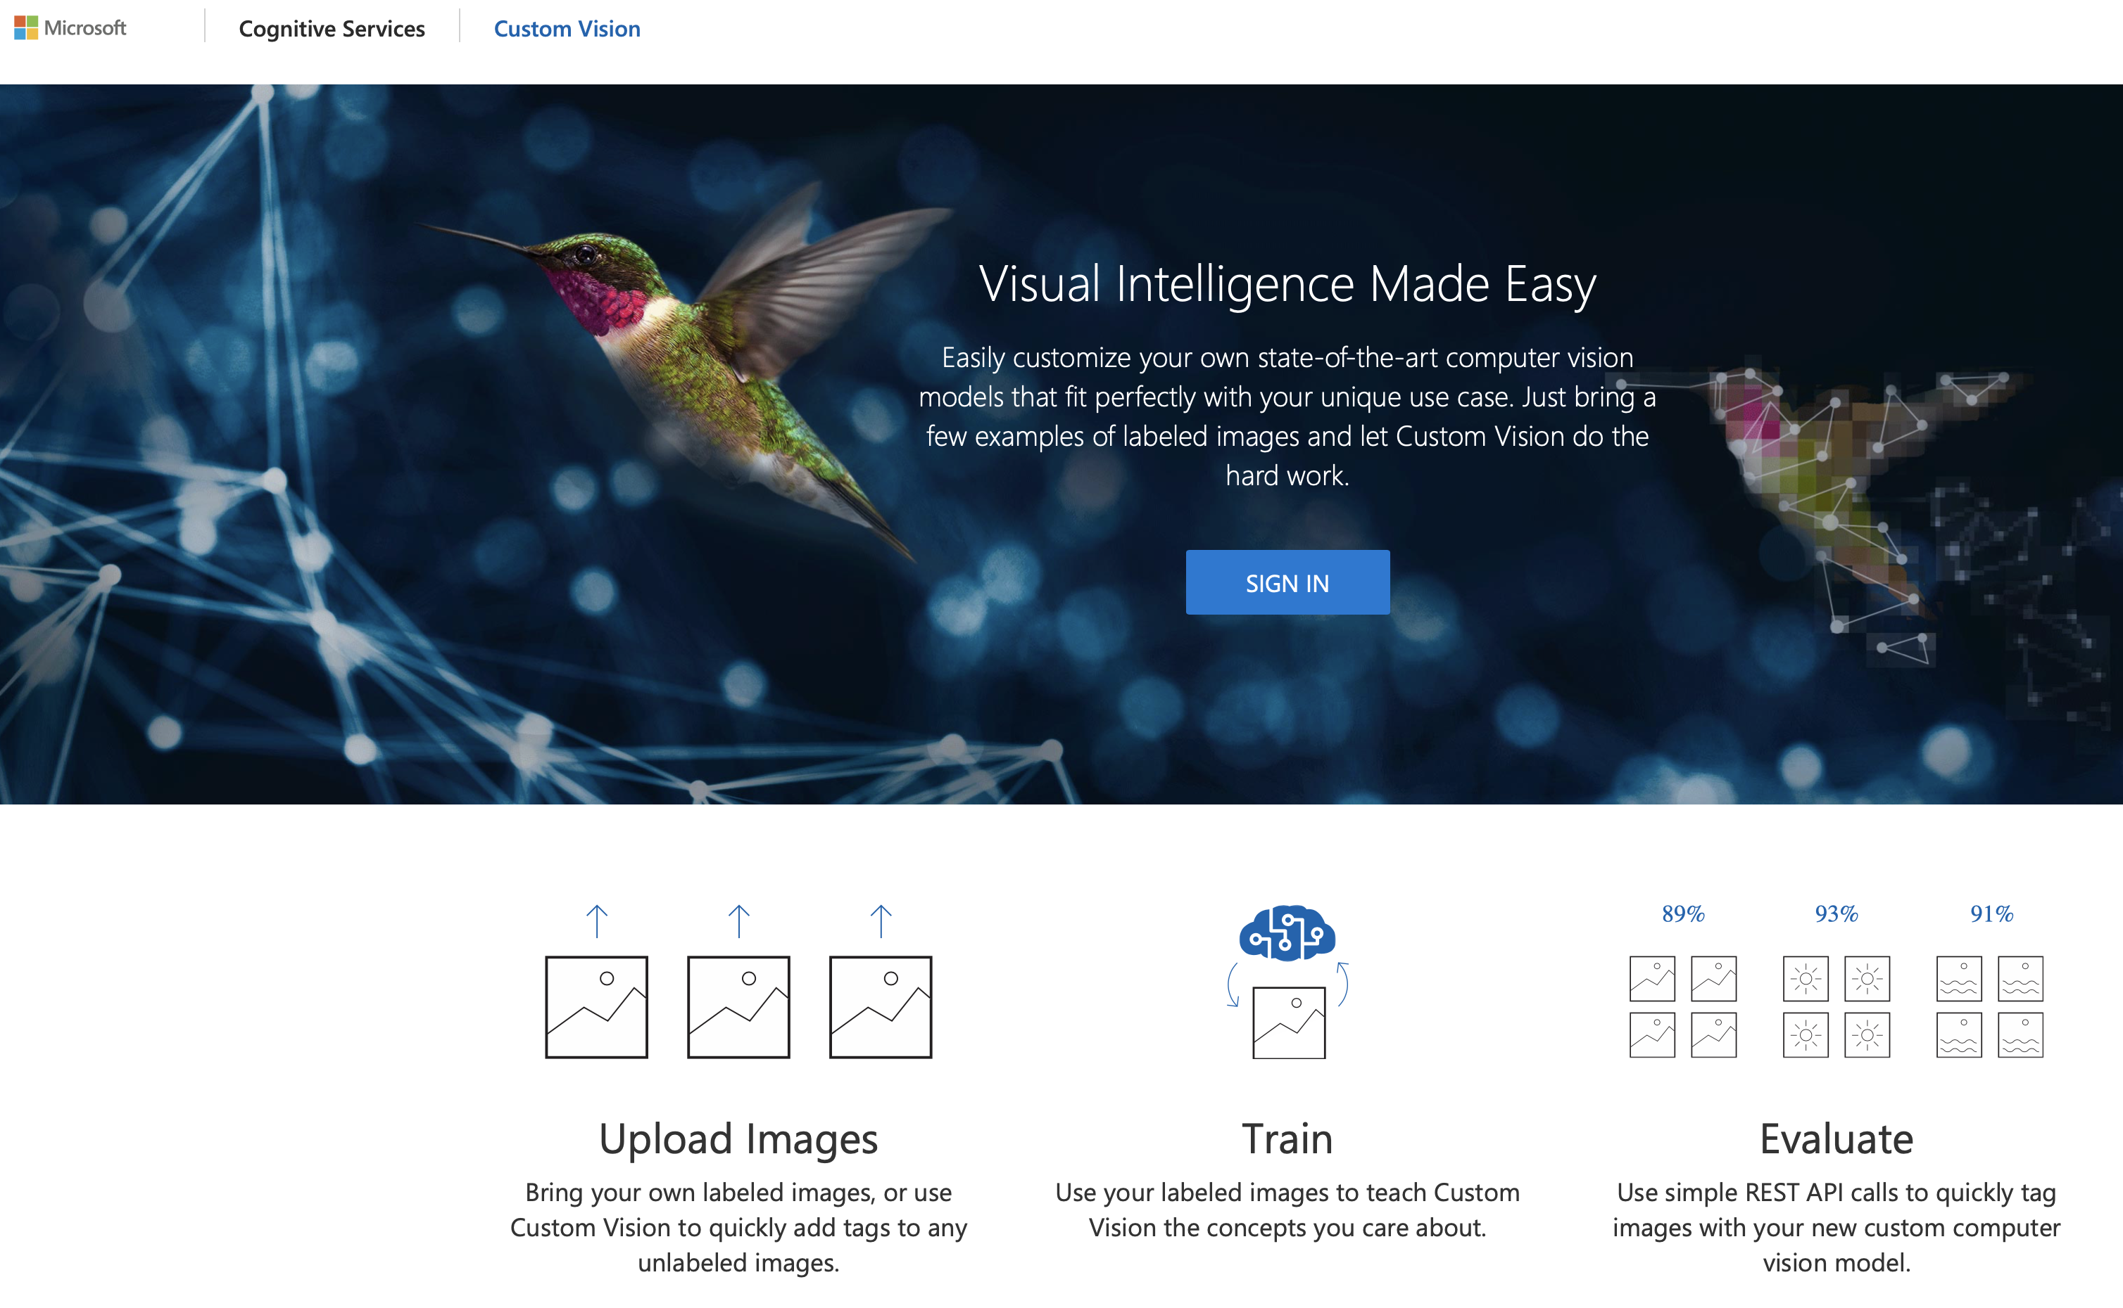
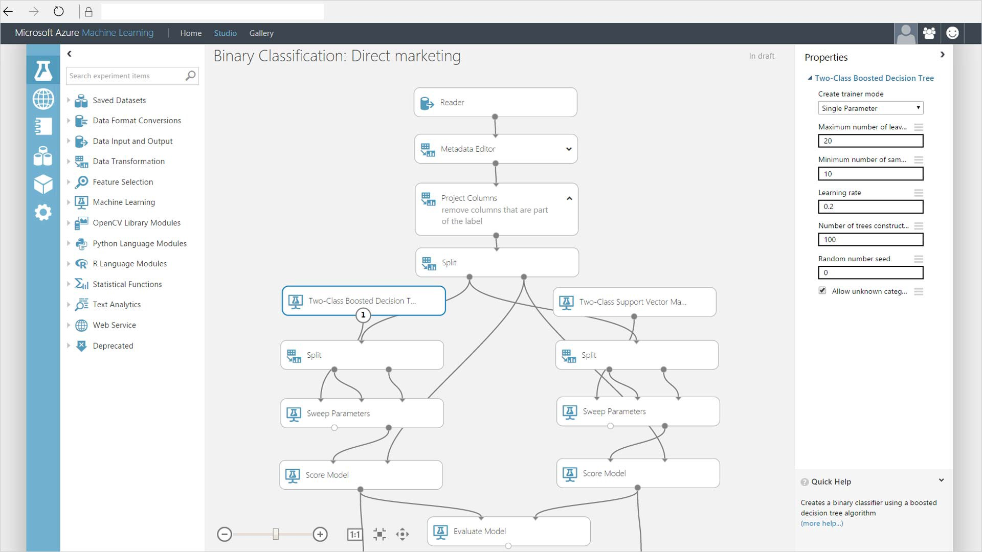
Learning trajectory
Lunch meeting
1 hour
Workshop Hands-on with AI
2,5 hours
Online Course AI
Next steps
Now
The coming 6-8 weeks
December/January
t.b.d.
Notes:
At the end continuation

Slide 26
Sneak-preview
Notes:
Ook iets vertellen over vervolg: communitie, online resource,
Feedback vragen van mensen.

Slide 27
For those interested and having more free time
Part I Introduction to AI (4-8 hours) Part II Building AI (50 hours)
https://www.elementsofai.com

