Slide 1
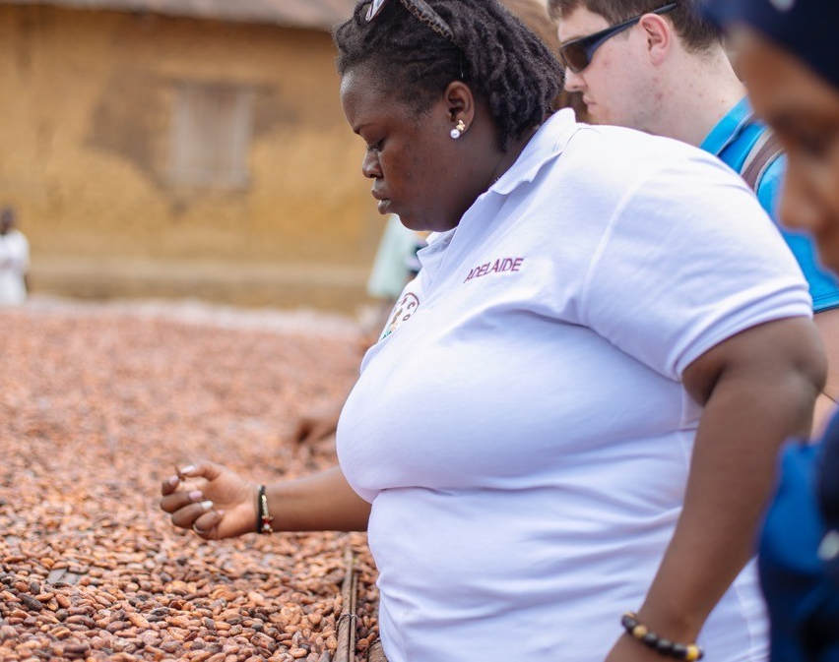
Breaking and re-making development pathways Reflections on International multi-stakeholder student action researches as a ‘new’ way for North South collaborations
Alexander Nuer & Robin Bukenya

Slide 2
Project Beyond fairtrade
Project
Beyond Fair Trade, Transnational entrepreneurship and partnerships with African Diaspora
Background Wagenignen Science shop
The Science Shop collaborates with non-profit groups in society by organizing research projects that find answers to their questions
Research question(s?)
How can international collaborative action research by students engage in a multi-stakeholder process of understanding the role of returnees in development and create a more inclusive and equitable cocoa value chain?
How to make the cocoa chain more equitable?
Objective:
Transforming the Cocoa value chain through action research

Slide 3
Involved stakeholders
Africa in Motion
Wageningen University - The Science Shop
University of Cape Coast, Ghana
University of Ghana
(at Dutch Embassy) Policy makers, NGOs, private sector)

Slide 4
Methods
Structure research(es)
Overall coordinator project
(Research) coordinator Netherlands
Researchers (Reseach) Coordinator Ghana
Researchers
Network mapping
Multi-stakeholder workshop(s)
Simultaneous researches & interships
Questionnaires and interviews

Slide 5
Action research principles
Human capacity flourishing and emancipation: Stimulating individuals to empower themselves and utilize their innate capacities
Participation and democracy: Research where the ‘researched’ become coresearchers in determining the purpose and outcome of the research
Reflexive orientation: On-going reflection by researcher and co-researcher to assess the development of the various stages of the research process
Understanding complexity: Assuming complexity as a basis, the research is to be adaptive to the local context and unexpected on-going processes
(Reason and Bradbury 2008)

Slide 6
(In)direct Outcomes
ACT policy brief – Researching the stakeholder and level of participation in decion-making process
AIM cover letter – Proposal to work with returnees in the cocoa sector we propose to establish a Returnees Management Office (RMO) in Ghana.
SHAER platform (movement with AIM)– International youth platform for development with Africa (Equal Trade certification – fairer value chain)
Paper – Impact COVID-19 on food sovereignty in Ghana (PHD Ghana)
Policy brief – HRDD brief related to value chain and rights by (Master WUR)
Research paper - University of Cape Coast – The role of the farmer unions in making Ghana’s Cocoa sector socially just
Cocoa Festival (online) - open event & multi-stakeholder (SHAER trade), KUMASI,
Cocoa foto Exhibition pictures at Wageningen University: ‘Thanks for supporting poverty’
Formation of Cocoa Coalition – knowledge and practitioners in Cocoa value chain
Start-up Kumasi drink – Using cocoa fruit to make a popular drink (sold in AH supermarket)

Slide 7
Background North-South development pathways
Colonialism, Post-colonialism, Neo-colonialism etc.
North – South power dynamics
Relations, Perceptions and perspectives
Theories: Paradigms ----- From North and South

Slide 8
Challenges
Fear of criticism (too positive?)
Working across systems, cultures and stakeholders (key stakeholders)
Hidden assumptions and perspectives
COVID-19
Diversity of values complementary or conflicting?
Development pathway dependencies
Control, guidance or freedom… A *spark* or holding the reigns?

Slide 9
Relativity…
Relativity in the context of development
What exists today will not work tomorrow…
Models need a rethink vs universality
E.g. Concept of FairTrade needs re-think, there is no fair in fair trade ---- > even if we use stakeholder theories, fair trade is made in West
Solution - (teaching) multidisciplinary background, each student uses examples from local contexts
Multi-disciplinary teaching, using practical (personal) cases
Context of multi-disciplinearity on different perspectives North South…survival vs sustanainability

Slide 10
Contextualization…
Rivera-Santos (2018):
“Discussions have typically revolved around whether management theories are context-specific or context-free, around the extent to which studying non-traditional contexts can help refine current theories, and whether new theories need to be developed to understand these different settings”.
3 main approaches to integrating context into (management) research
Context-free models or knowledge— theories and empirical insights that are designed to be universal
Context bound models or knowledge—theories and empirical insights that highlight the differences across contexts
Context-specific models or knowledge—theories and empirical insights that only apply to a given context
(Tsui,2004, 2007)
“Overall, scholars working on Africa therefore seem to have emphasized the role of the context in their contributions significantly more than in other Contexts”
(Rivera-Santos, 2018)

Slide 11
Breaking and re-making
New/Alternative voices: Promoting Ghanaian research and scholarship
Setting a different precedent through action research
Harnessing diversity
Institutional economic perspective in terms of what is ethical and what is not ethical (e.g. child labour) and what is fair, who makes that choice?
Changing the level playing field from the onset
Flexible, iterative process
Complexity
Challenging assumptions, models and predictions
Re-defining values and priorities (rights)
Cross-cultural awareness (brokering)
Appreciative Inquiry
Reflexivity in context of multi-disciplinarearity on different perspectives North South…eg. How it in survival vs

Slide 12
Useful insights of student action researches (cross-sectoral)
Coordinated (international) action research has a vast potential to contribute to transformation processes because:
Students are creative and positive!
Student have time and are open-minded
Not costly but can have great impact
Commitment can be very high (continuation)
Need guidance on topic and process (clear case and objective formulation)
Incorporate reflection structurally

Slide 13
Conclusions / Suggestions
Reflections and decisions (around the same table)
Indisciplinary (student) research potential (cases) and capacity inventorisation and utilisation
Incorporating African scholarship – new paradigms
‘Wicked’ problems & ‘wonderful’ opportunities

Slide 14
Suggested models…? Control vs freedom?

Slide 15
Panel questions…
What type of action research does your research focus on? Why and how is this a suitable method to research on/with cross-sector interactions?
What are your key insights for understanding cross-sector interactions?
Which key challenges do you encounter with this approach and how have you addressed them?
What are two questions you would like to ask the CSSI audience?

