Slide 1




A Shell Game?
The Use of Science in Anticipatory Climate Litigation
I. Möller, J. Alkema, J. Chambers, J.E. Livingston, C. Macchi, N. Bernaz, A. Gupta, S. Karlsson-Vinkhuyzen, E. Turnhout
Presented at the Earth System Governance Conference in Toronto, 20. October 2022

Slide 2

The Case
April 2018 – March 2023 (schedule appeal)
Charge based on violation of Dutch tort law: ‘unwritten standard of care’
Verdict called on Shell to curb scope 1,2 & 3 emissions in line with the Paris Agreement and IPCC, 45% reduction by 2030 (baseline 2019)
First time NGOs succeed at making an oil corporation accountable for its contribution to climate change in court
Notes:
Shell produces about 1% of global emissions, more than many countries
Reduction of scope 1&2 emissions are obligatory, reduction of scope 3 emissions are a ‘serious best efforts obligation’

Slide 3
Anticipatory climate litigation
Special case because it focuses on ex-ante liability charges for climate change impact rather than ex-post charges
Targets a form of behaviour (in this case a business model) that is considered dangerous, rather than a damage that has already taken place
Significant for climate litigation in general, given the difficulty of establishing causal links between cause and effect
Focuses on attributing responsibility to take meaningful action in the present in order to prevent harm in the future

Slide 4
The role of science
Ex-post litigation
Ex-ante litigation?
Draws on science as a source of evidence to establish cause and effect of a certain harm in order to press charges
Call for improvement of ‘attribution science’ to make causalities clearer
Acknowledges limitations of science to provide ‘truth’ in complex situations like climate change
Emphasises the symbolic and performative power of science in mobilizing knowledge claims
Notes:
Ex-post: Considerable uncertainties mean presenting science as ‘the truth’ makes it vulnerable to critique, potentially undermining its contribution and authority

Slide 5
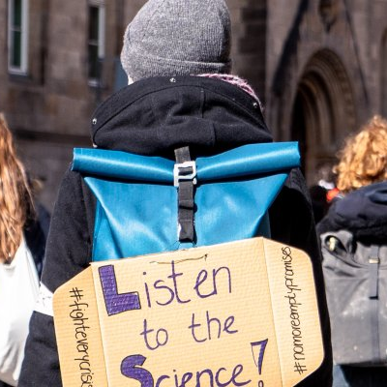
Research question
How do the three actors involved in the case (Milieudefensie, Royal Dutch Shell, and the Dutch District Court in the Hague) interpret and arrange scientific evidence for anticipatory climate litigation?

Slide 6
Analytical approach
DANGER
Delineation
What is the danger?
Causality
What causes the danger?
RESPONSIBILITY
Contribution
What did the defendant contribute to causing the danger?
Foreseeability
What did the defendant know about the cause of danger?
Avoidance
How can the danger be avoided?
Expectation
What actions can reasonably be expected of the defendant to avoid causing the danger?

Slide 7
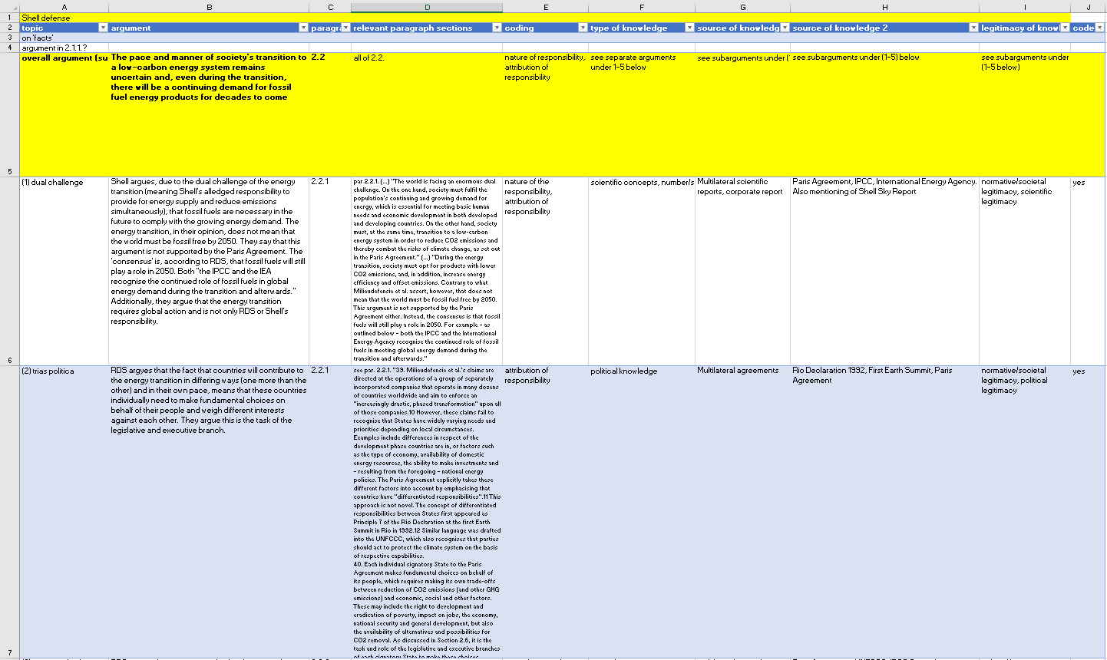
Notes:
In depth argumentative analysis of the summons, the defence statement and the verdict

Slide 8

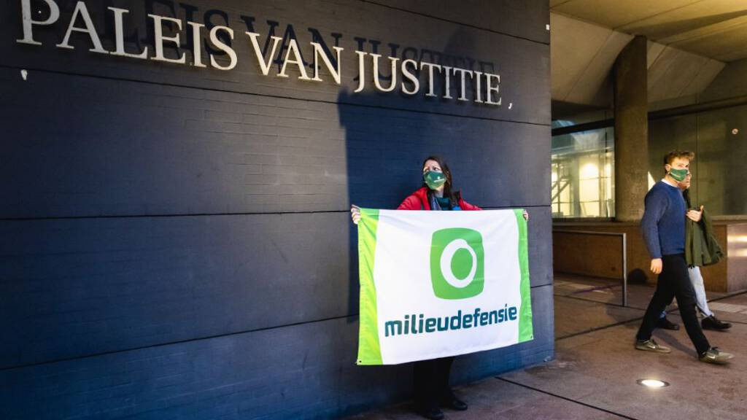
Science and Danger
Highlights consensus and strength of process around IPCC’s science on CC causes and impacts
Relies on well-known figures and concepts to emphasise urgency
Highlights that IPCC will never present any definitive conclusions about danger
Emphasises that IPCC does not report on risks specific to the Netherlands
Builds alternative narrative of ‘twin challenge’ and SDG7
Concludes that CC will have serious impacts on NL citizens, irrespective of uncertainties and lack of NL specific science in IPCC
Argues that SDG7 was never meant to interfere with Paris Agreement
Notes:
Well known figures: burning embers diagram, five reasons for concern, concept of ‘tipping points’

Slide 9
Science and Responsibility
Uses scientific articles to identify a 1.5 conform emission pathway and to estimate Shell’s emissions
Uses social science research on obstruction and delay tactics to make case for foreseeability
Argues that there is no one “right way” to reach global climate goals and that emissions study is an outlier and commissioned by Greenpeace
Argues that its knowledge was no different from anyone else’s
Concludes that Shell emits ‘significant amounts’ of CO2
Extensively cites ‘Oxford Report’ to acknowledge scope 3 emissions
While current emissions not unlawful, intentions are incompatible with collective reduction obligations
Notes:
Climate Analytics (attributes high authoritative value because of use by World Bank and UNEP)
Article by Richard Heede (who includes scope 3 emissions in estimate, which Shell contests as an outlier)

Slide 10
Key insights on the use of science
Uncertainty is countered by concreteness: numbers, figures and qualitative cases/narratives serve to put science in context and make it relevant despite general uncertainties
Legitimacy is key: wide consensus and reference to authoritative organisations serve to strengthen role of science; limitations in procedure serve to weaken it
Science and politics are interwoven: the close link between scientific consensus and political consensus (esp. IPCC and Paris Agreement) is particularly relevant for the court’s decision making

Slide 11
Conclusion
In anticipatory climate litigation, presentations and perceptions of consensus and political endorsement are key for scientific impact
The wider societal context and its acknowledgement of climate science is thus equally, or more, important than concrete numbers on cause and effect

Slide 12
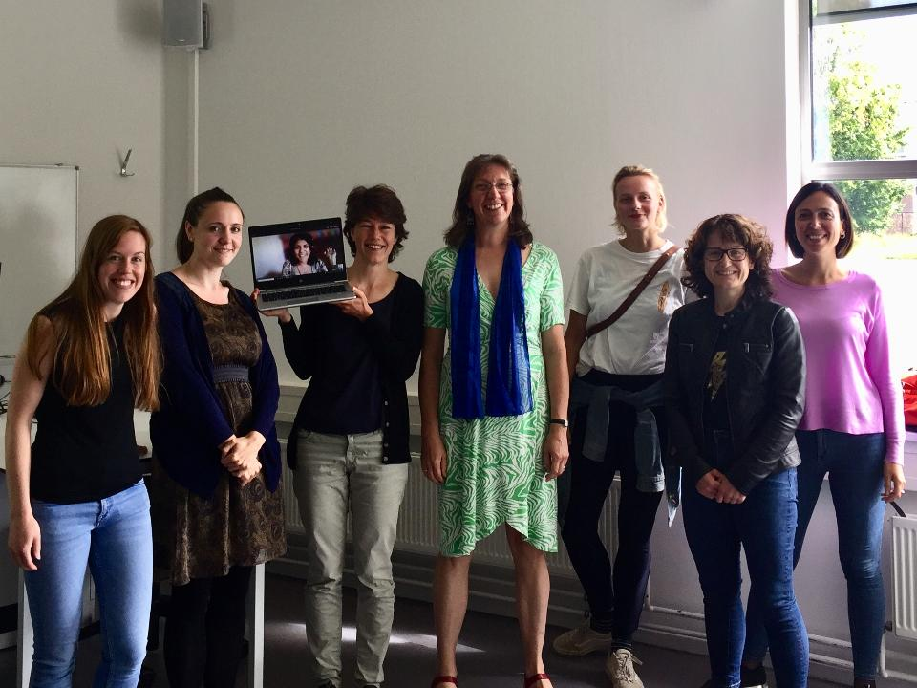

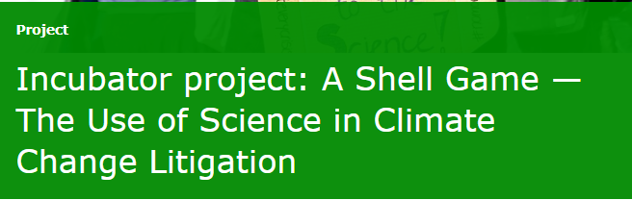
Thank you!
Contact:
ina.moller@wur.nl

