Slide 1
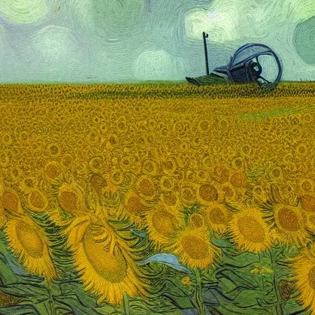


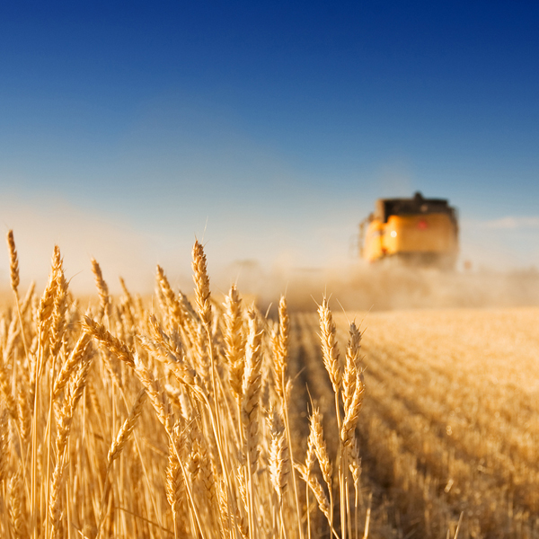


Artificial intelligence for agri-environmental digital twins
Prof dr Ioannis Athanasiadis
ioannis.athanasiadis@wur.nl www.wur.ai
Digital Twins Conference
Dec. 14, 2022, Wageningen
Notes:
I am really happy to join you today, I will give you an overview on how we use artificial intelligence, in digital twins for understanding nature and feeding the world.

Slide 2
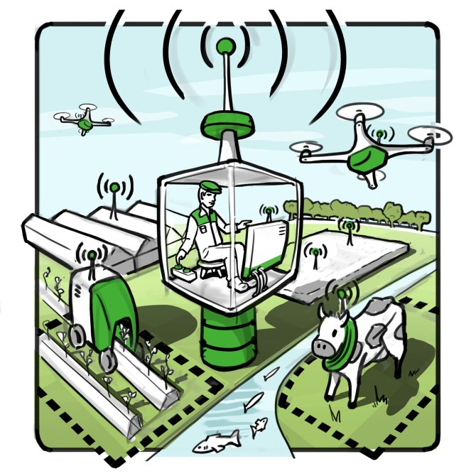
The farm of the future (tomorrow?)

Slide 3
The data landscape
Landscape
Soil
Climate
NDVI
Weather
Soil
Agricultural
practices
Crop calendar
Historical yields
Cultivars
Phenotypes
Genotypes

Slide 4

Mind the gap
Data Infrastructures
Existing
knowledge
Value
Artificial Intelligence
Notes:
Extracting value from data requires both AI and analytics and infrastructures. And more specifically, it re quires a continuous close collaboration between the two.
Such gap still today remains and narrowing is requires an inter-disciplinary approach, that incorprates domain-specific expertise and existing knowledge.

Slide 5
Mind the gap (2)
Uncertainties of cross-scale phenomena
Inherent difficulties of massively collecting data
Data not useful for farmer decisions or policy choices
  too coarse, incomplete or noisy, with high spatial and temporal variability
Models (theory or simulation-driven) reached their limits
  exclude several factors at various scales, hard to be reused
Case studies are fragmented, non-comparable
Notes:
Agrifood systems involve uncertainties of cross-scale phenomena, and inherit the difficulties of massively collecting data, including heterogeneity and noise.
It is common ground today that despite the increasing volume and variety of sources of data becoming available, data are not necessarily useful for improving our understanding for either farmer decision-making or policy choices. Data in our domains are too coarse, incomplete or noisy, with high spatial and temporal variability.
Similarly, our models, (either theory or simulation-driven) reached their limits, as they often exclude several factors at various scales, hard to be reused
Research is fragmented in non-comparable case studies.
Process-based models require detailed ground-truth data for calibration, which are often not available.
And statistical models cannot be easily be extrapolated beyond their original spatiotemporal context.

Slide 6
The way ahead
NEW data-intensive scientific discoveries via AI and DTs
- learn from heterogeneous data at different spatial and temporal scales
- encode prior knowledge into reusable models
- make trustworthy estimates in new conditions
Notes:
The way ahead, is to enable new data-intensive scientific discovery via AI and DTs by:
Learning from heterogeneous data at different spatial and temporal scales
Encoding prior knowledge into reusable models
Making trustworthy estimates in new conditions.
However, this is not a straightforward process.

Slide 7
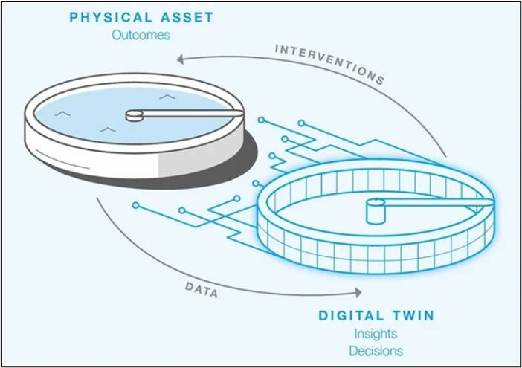
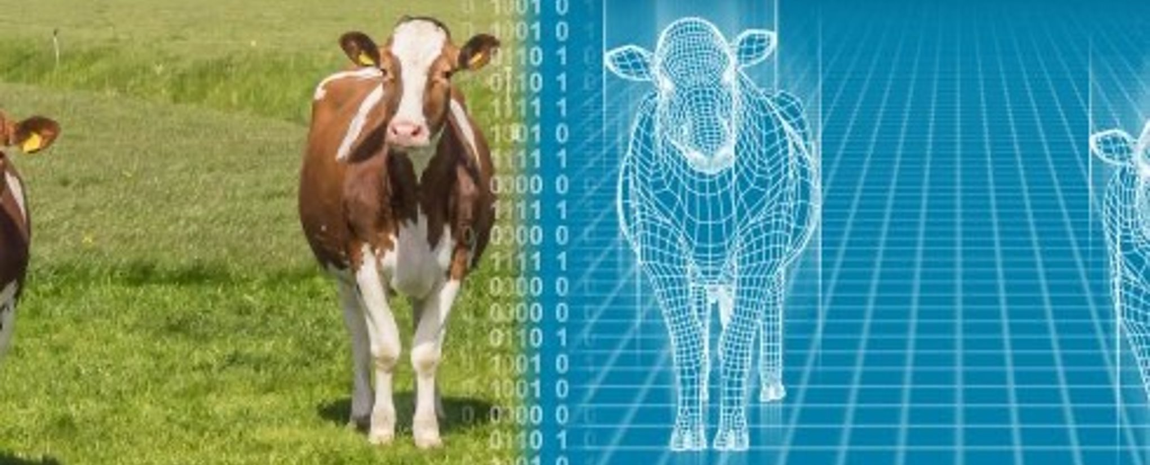
Digital Twins
Digital Twin:
A dynamic virtual representation of a physical object or system,
that uses real-world data, simulation, combined with data analysis and machine learning models
to enable understanding, learning, and reasoning
Notes:
DT can be used to answer what-if questions and should be able to present insights in an intuitive way

Slide 8
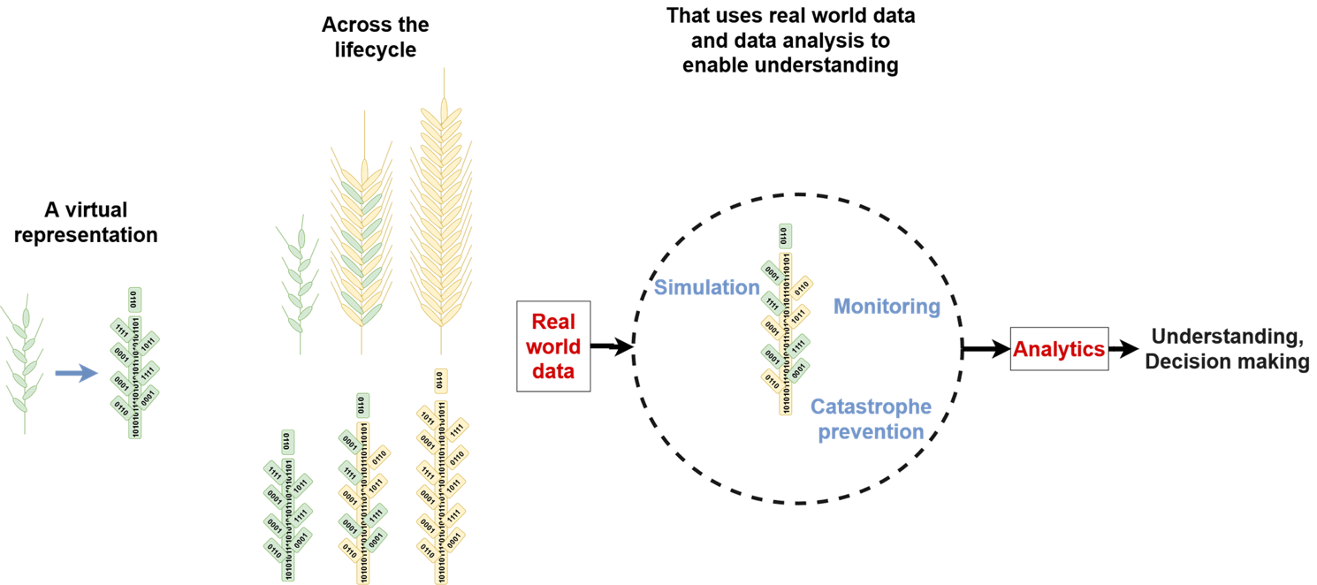
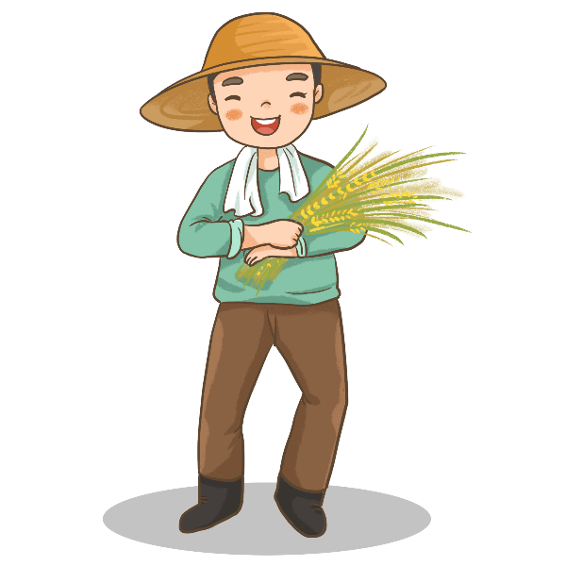
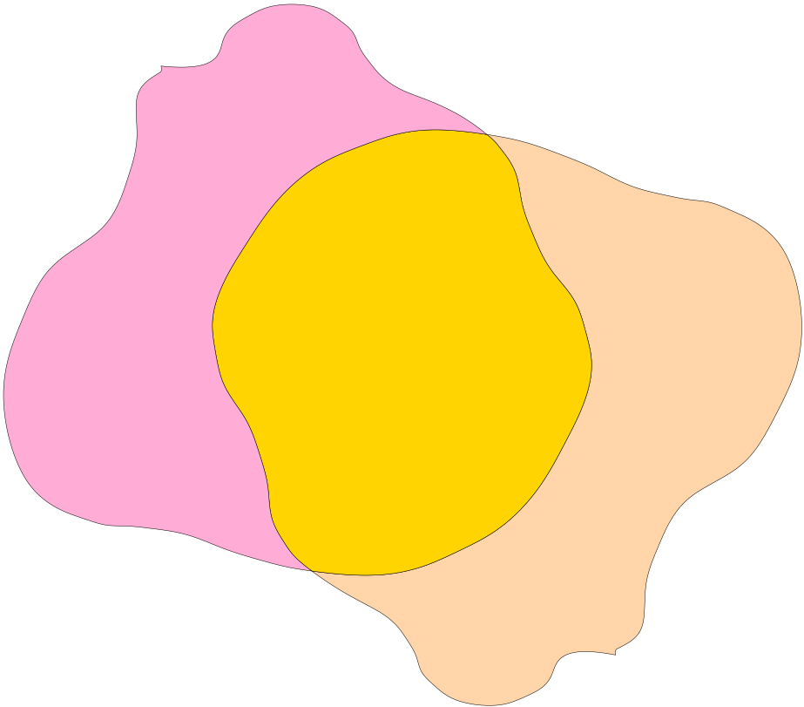
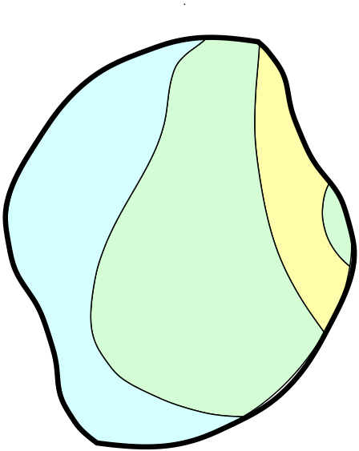
Digital Twins
real-time
individual
scenarios
sensing
data streams
simulation models
(modular, multi-scale,
predictive)
actionable
knowledge
decision support
vector illustration by 千图网 from Pngtree.com
feedbacks
actuate / learn
Pylianidis et al, Computers & Electronics in Agriculture, 2021, http://doi.org/10.1016/j.compag.2020.105942

Slide 9
The way ahead
Semantics and FAIR data
Matched AI methodologies
Tacid knowledge
Disciplinary silos
Scale interactions
Multi-view learning
Simulation-assisted
ML
Actionable knowledge via DT
Data gaps
Uncertainty
Low fidelity data
Explainable
AI
Partial views
Case fragmentation
Limited data availability
Reinforcement Learning
Notes:
from the AI toolbox, as learning with mixed and noisy data, and multi view and reinforecement simulation-assisted learning and exaplinable AI
developing new applications and enable new insights and actionable knowledge via DTs.

Slide 10
PhD A. Samourkasidis, WUR 2019

Slide 11
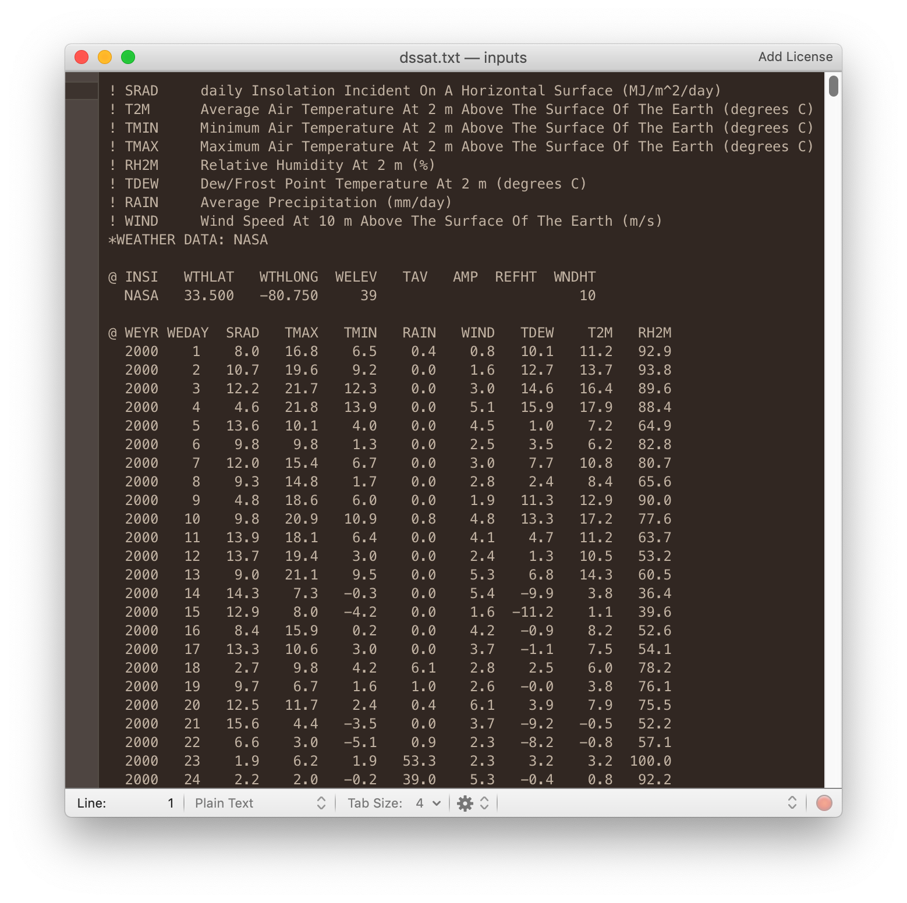
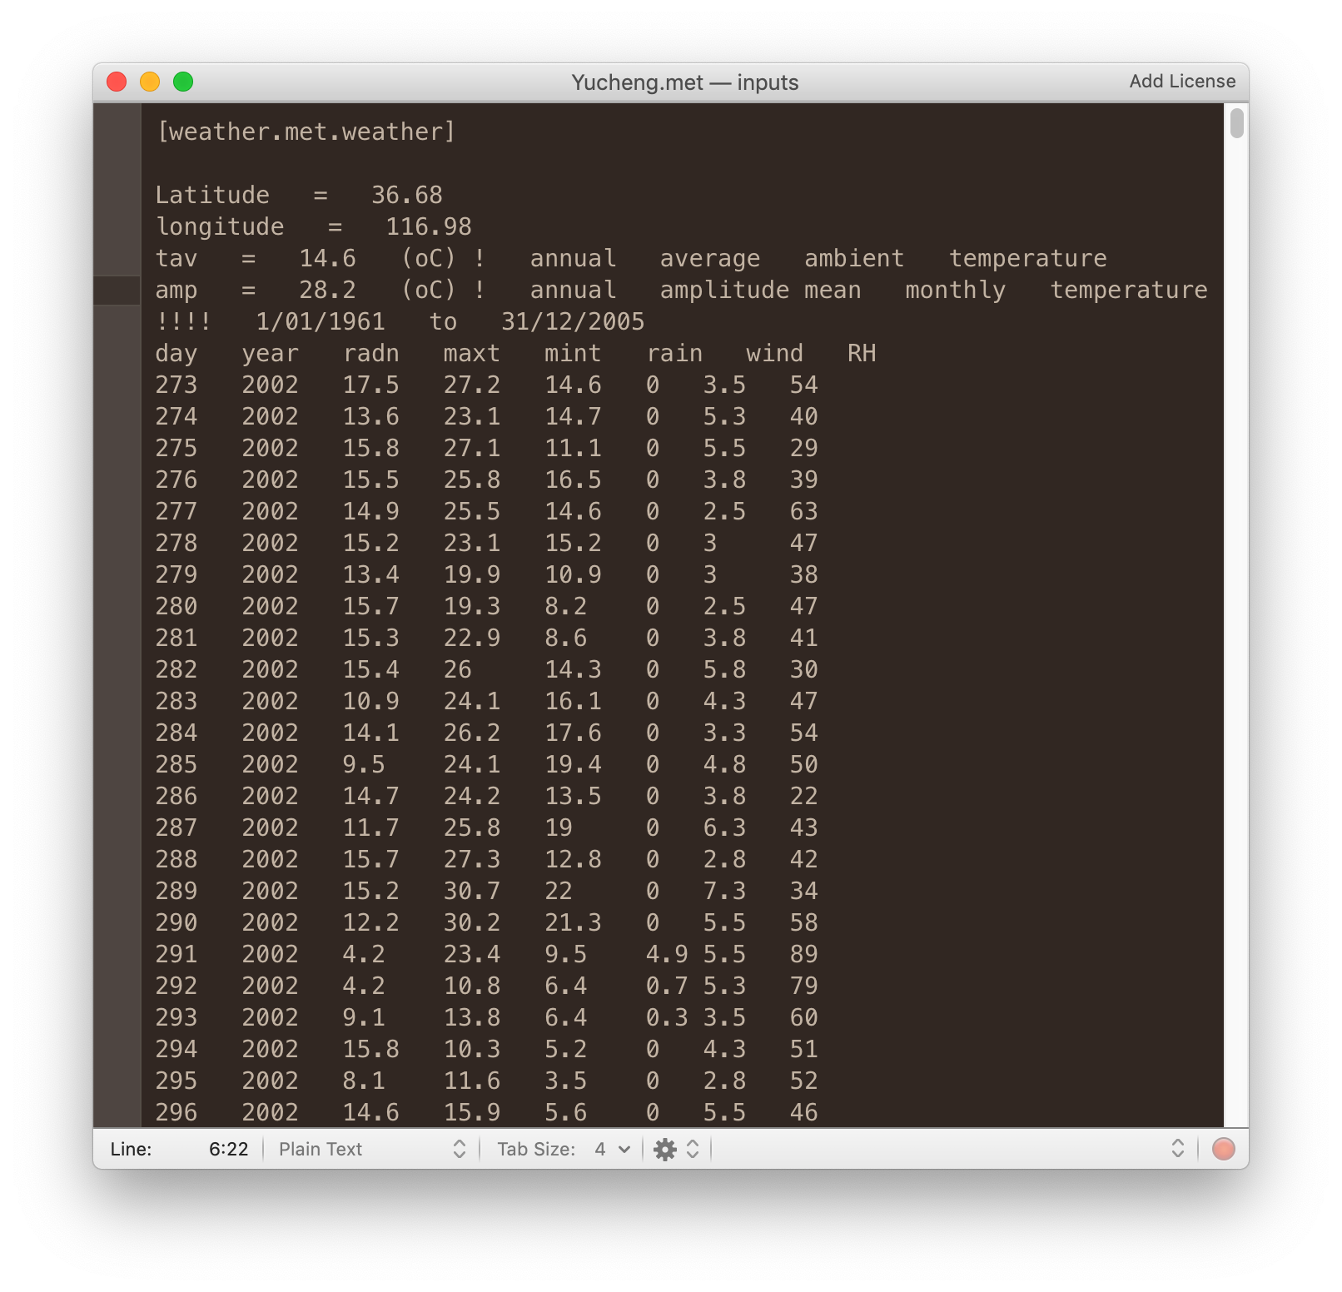
Converting between legacy formats
A. Samourkasidis, I. N. Athanasiadis, A semantic approach for timeseries data fusion, Computers and Electronics in Agriculture, 169:105171, 2020, doi:10.1016/j.compag.2019.105171.
Notes:
DSSAT to APSIM

Slide 12
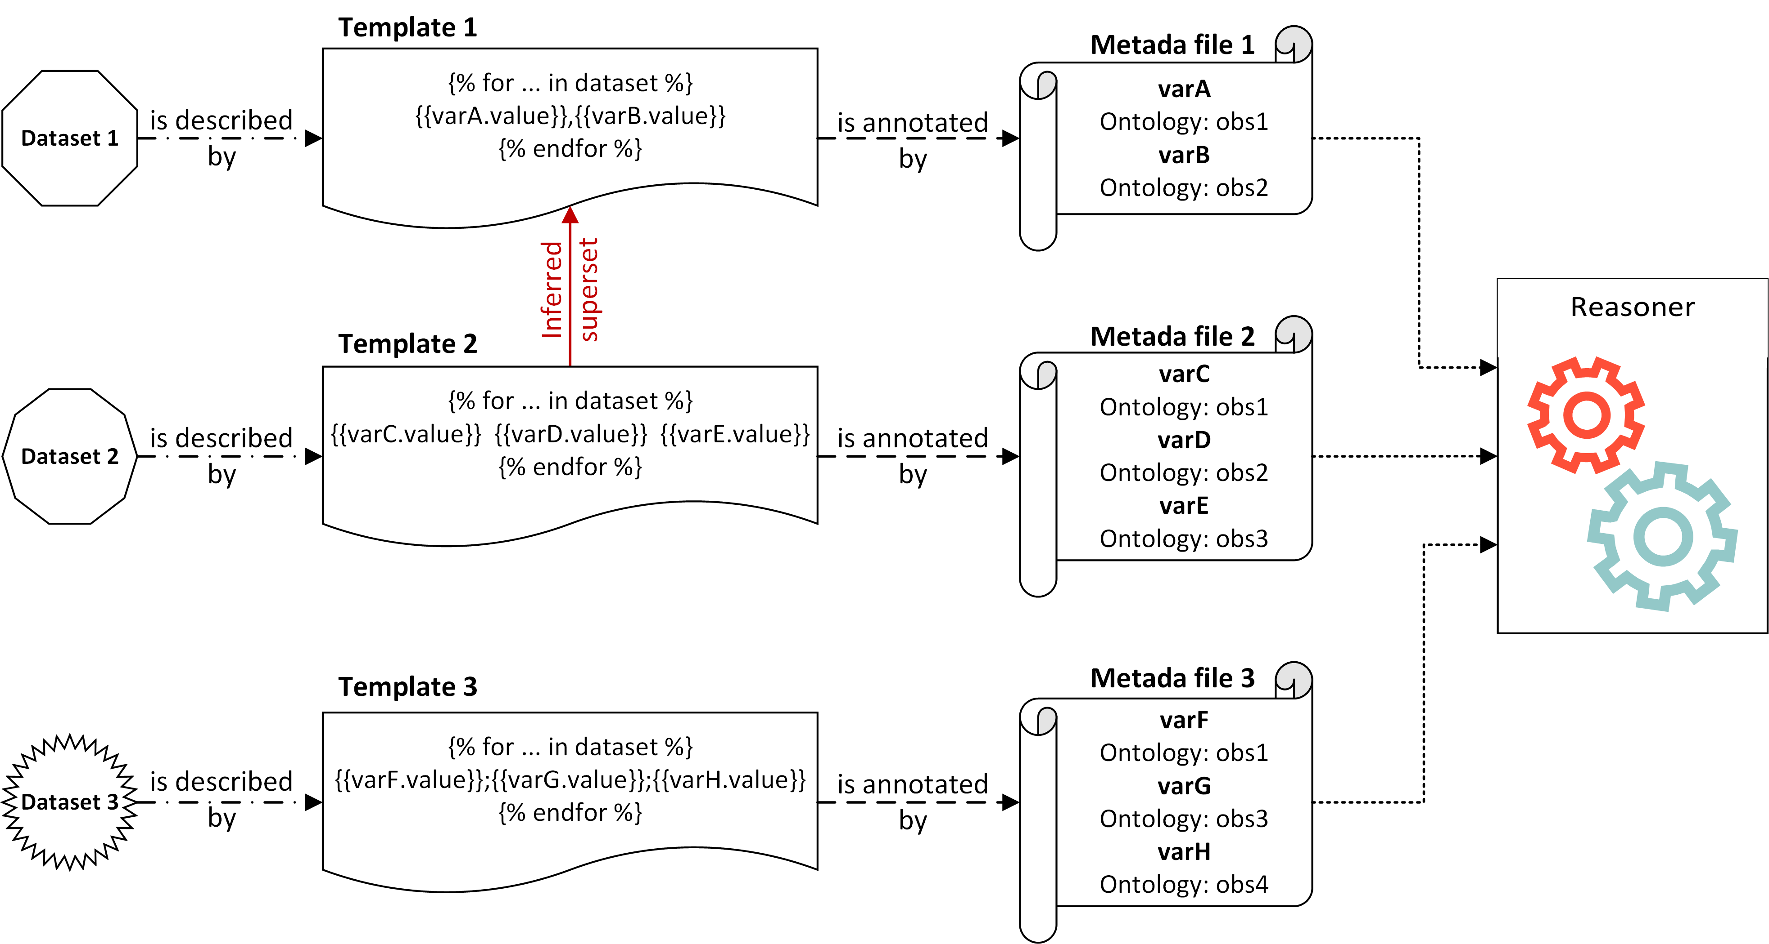
Abstract architectural design
A. Samourkasidis, I. N. Athanasiadis, A semantic approach for timeseries data fusion, Computers and Electronics in Agriculture, 169:105171, 2020, doi:10.1016/j.compag.2019.105171.

Slide 13
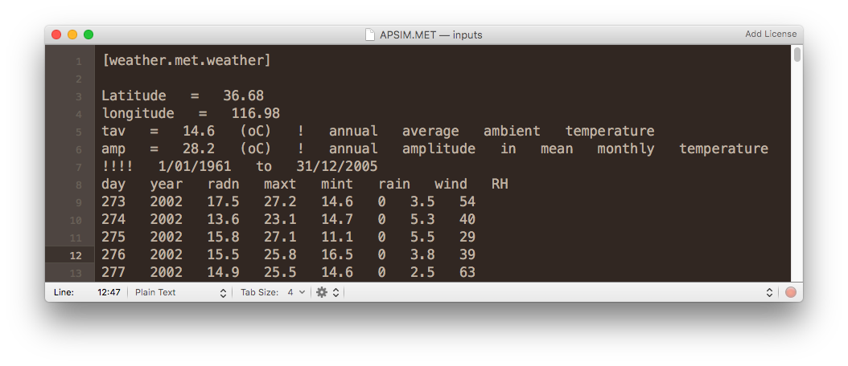


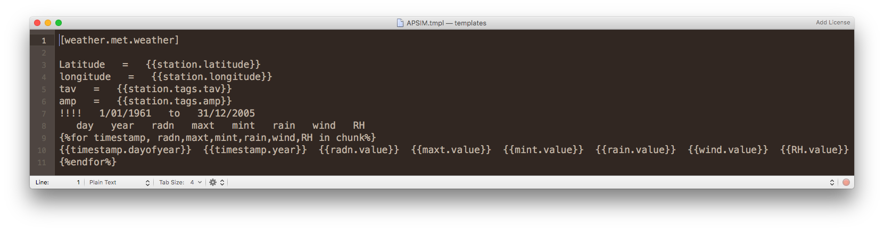


Templates example

Slide 14
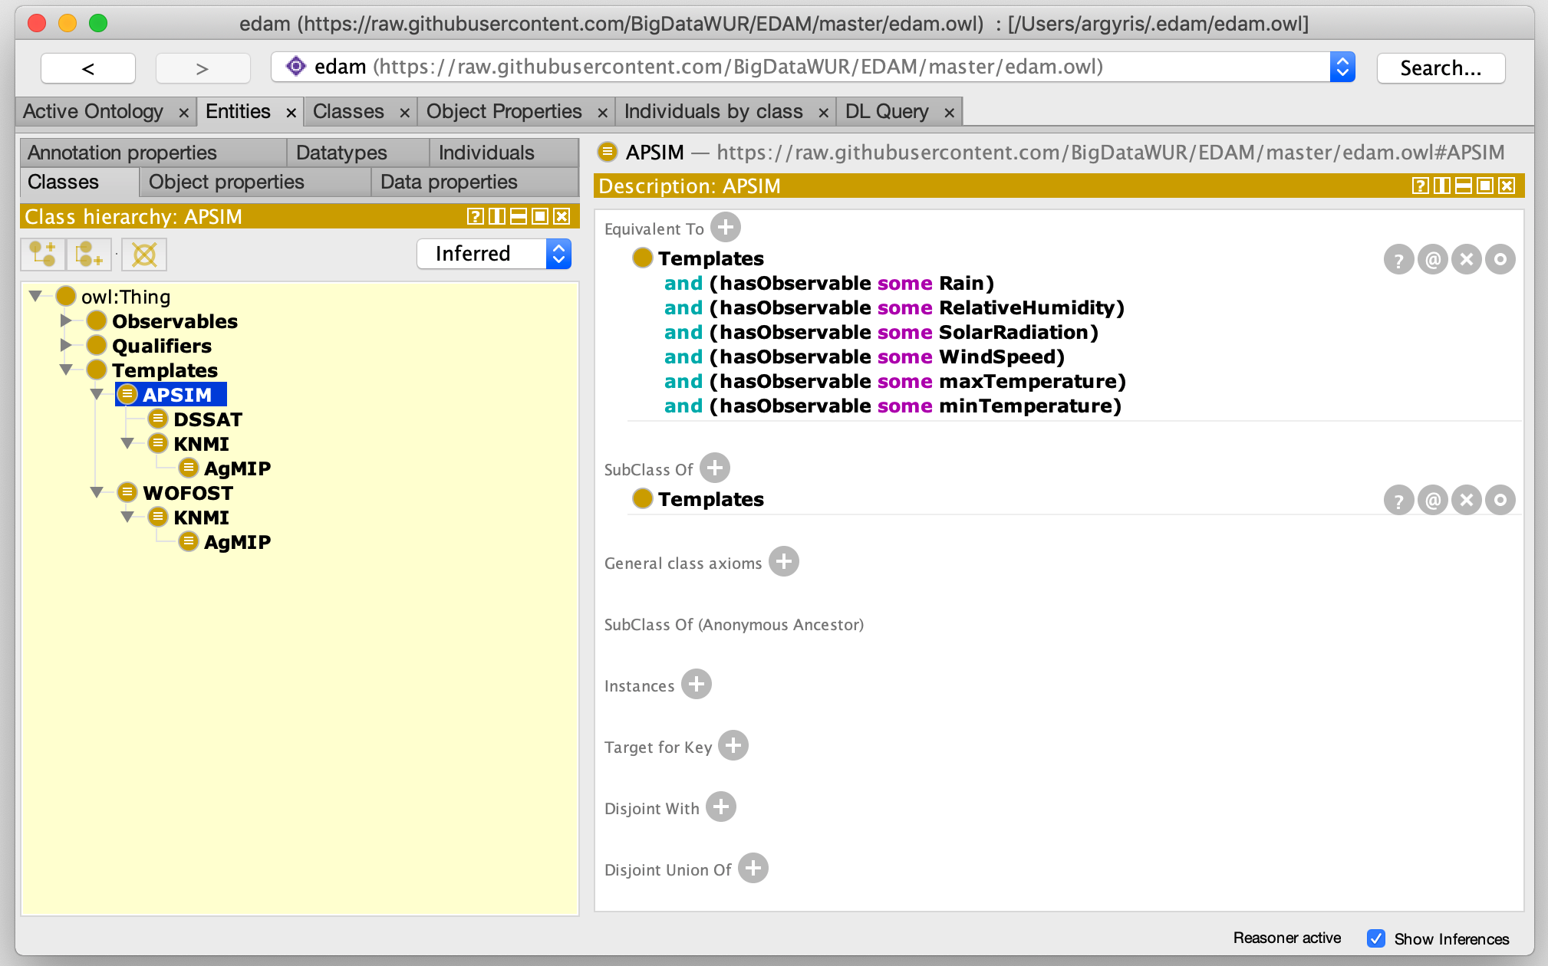

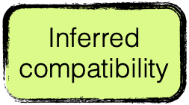
Reasoner in action - DSSAT and APSIM

Slide 15
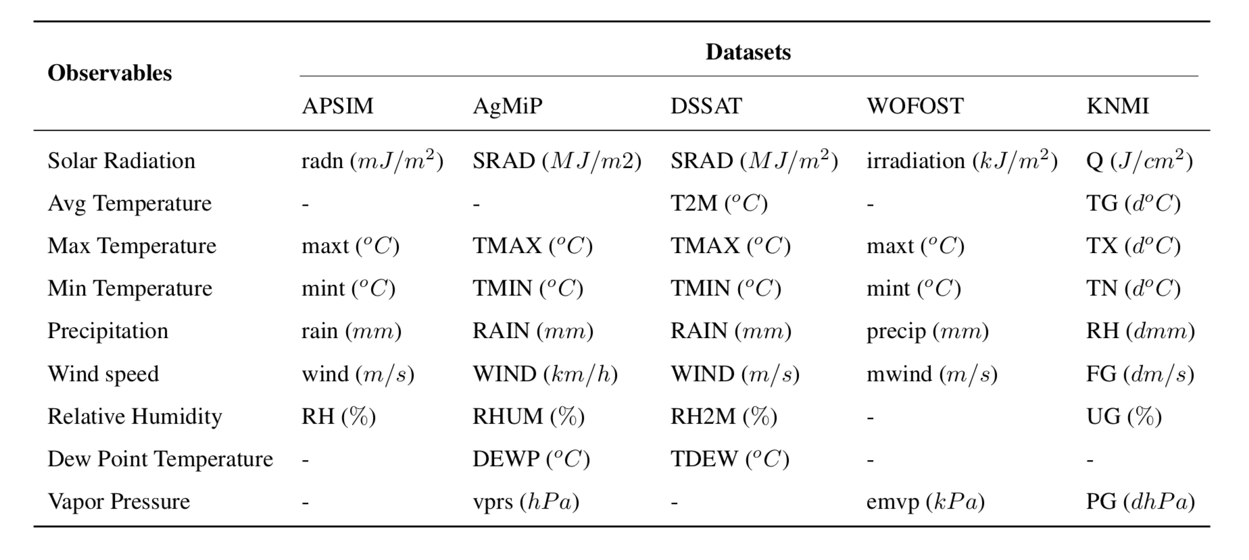
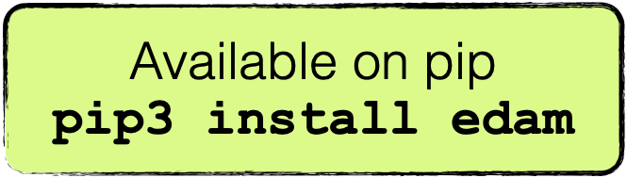
Demonstration

Slide 16
Key findings
Integrating heterogeneous timeseries is a manual and custom process
Similar modelling solutions use different vocabularies
Declarative approaches can address semantic heterogeneity
In EDAM, we took first steps towards:
  Inferring compatibility of models (and datasets)
  Syntax transformation
  Unit transformation
A. Samourkasidis, I. N. Athanasiadis, A semantic approach for timeseries data fusion, Computers and Electronics in Agriculture, 169:105171, 2020, doi:10.1016/j.compag.2019.105171.

Slide 17
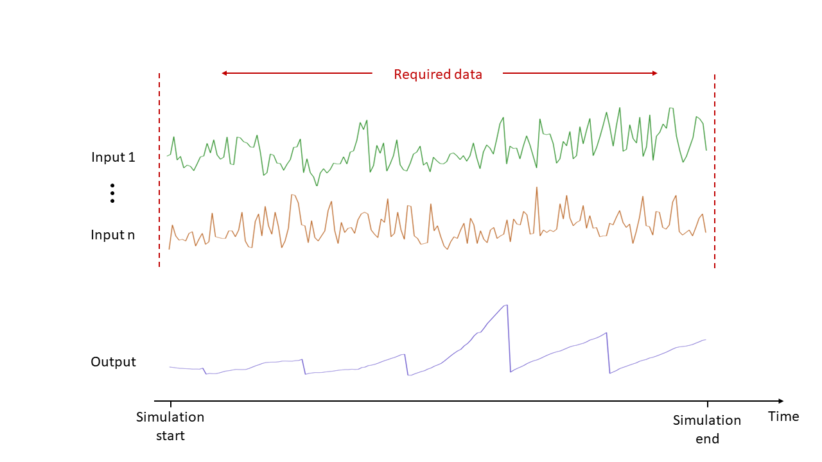
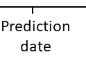
Simulation-assisted machine learning for operational digital twins
Process-based models typically require daily data until the end of the season
i.e. need future inputs
Here we asked machine learning to give a hand!
Crop growth model
Required data
Final yield
C. Pylianidis, V. Snow, H. Overweg, S. Osinga, J. Kean, I. N. Athanasiadis, Simulation-assisted machine learning for operational digital twins, Environmental Modelling & Software, 148:105274, 2022, doi:10.1016/j.envsoft.2021.105274.

Slide 18
Simulation-assisted machine learning for operational digital twins
Machine learning is used for predicting the end-of season targets without daily inputs
to develop operational Digital Twins!
Machine learning model
Required data
Final yield
C. Pylianidis, V. Snow, H. Overweg, S. Osinga, J. Kean, I. N. Athanasiadis, Simulation-assisted machine learning for operational digital twins, Environmental Modelling & Software, 148:105274, 2022, doi:10.1016/j.envsoft.2021.105274.

Slide 19
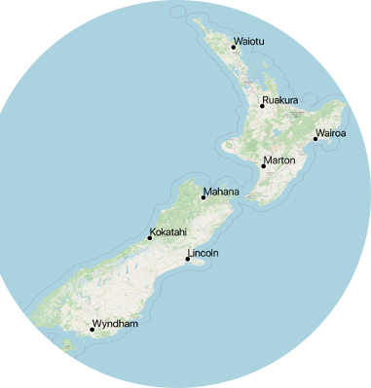

Case study: operational decision support for fertilizations in pastures
A DT for supporting tactical fertilization decisions for grasslands
Inputs: only 4 weeks prior to fertilization (no future data)
Outputs: Nitrogen response rate (i.e. does it worth fertilizing?)
Developed using a synthetic dataset of 1.3 million simulations using APSIM, in 8 locations in New Zealand,
in collaboration with AgResearch
C. Pylianidis, V. Snow, H. Overweg, S. Osinga, J. Kean, I. N. Athanasiadis, Simulation-assisted machine learning for operational digital twins, Environmental Modelling & Software, 148:105274, 2022, doi:10.1016/j.envsoft.2021.105274.
Notes:
An operational DT that estimates the nitrogen response rate in grass-clover pastures, without having ever seen the response in the location for which it makes predictions:

Slide 20
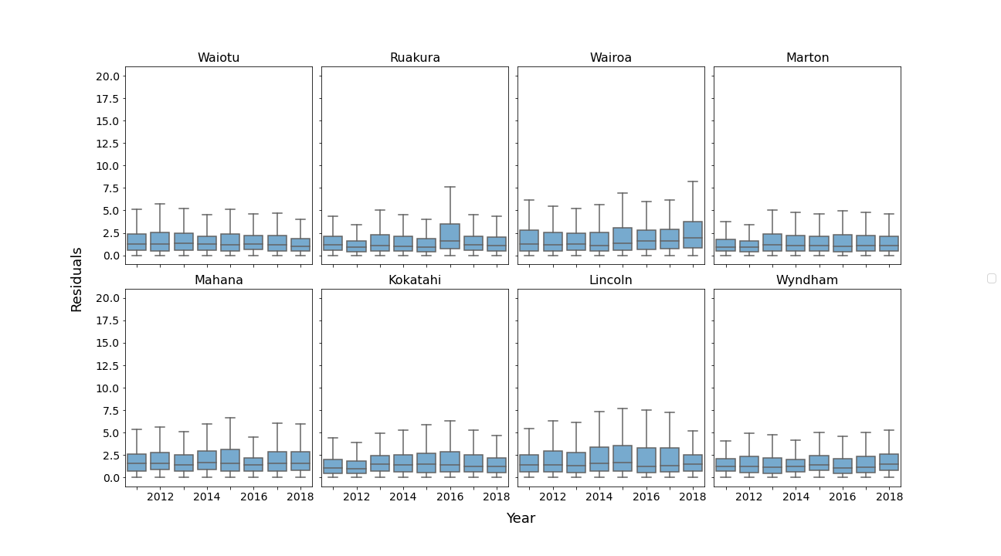
Results in unseen locations
Error residuals are within the margin of 5kgDM/kgN/ha
that has been set as a practical threshold for using the model in practice
C. Pylianidis, V. Snow, H. Overweg, S. Osinga, J. Kean, I. N. Athanasiadis, Simulation-assisted machine learning for operational digital twins, Environmental Modelling & Software, 148:105274, 2022, doi:10.1016/j.envsoft.2021.105274.
Notes:
The results have been very promising, as you can see: For all locations, a tactical machine learning model developed was able to estimate the NRR within a margin of 5kg/kg that was set as an threshold for using the model in practice, using only 4 weeks of weather prior to fertiliation

Slide 21
Alternative architectures
We further improved alternative machine learning architectures
for operational decision making
C. Pylianidis, I. N. Athanasiadis, Learning latent representations for operational nitrogen response rate prediction, Computing Research Repository, AI for Earth Sciences Workshop at 10th Int'l Conf Learning Representations (ICLR 2022), doi:10.48550/arXiv.2205.09025.
Notes:
The results have been very promising, as you can see: For all locations, a tactical machine learning model developed was able to estimate the NRR within a margin of 5kg/kg that was set as an threshold for using the model in practice, using only 4 weeks of weather prior to fertiliation

Slide 22

Simulation-assisted machine learning for operational digital twins
A method to develop operational digital twins with limited data, by combining machine learning with process-based models
Operational conditions: less input variables, no future values, and lower resolution (weekly instead of daily data)
Generalizes well in previously unseen conditions
This line of research is followed up in the Horizon Europe project PHENET (2023-2027)

Slide 23
Reinforcement learning for tactical fertilization decision making
In reinforcement learning, agents learn from rewards, rather than labels
In this case, we reward positively an agent for increasing yield, and negatively it for using nitrogen for fertilization
Reward: weight_{storage organ} – c * weight_{fertilizer applied}
H. Overweg, H. N. C. Berghuijs, I. N. Athanasiadis, CropGym: a Reinforcement Learning Environment for Crop Management, Computing Research Repository, AIMOCC 2021 Workshop at 9th Int'l Conf Learning Representations (ICLR 2021), 2021, doi:10.48550/arXiv.2104.04326.
Notes:
. In reinforecement learning, an agent learns from a reward that is associated to its actions. In our case we rewarded an agent for increasing yield, and punishing it for using nitrogen for fertilization. We compared the agent against a dummy reactive agent that would just fill up the soil with nitrogen, and a standard practice agent that would apply nitrogen and sidedress once.

Slide 24
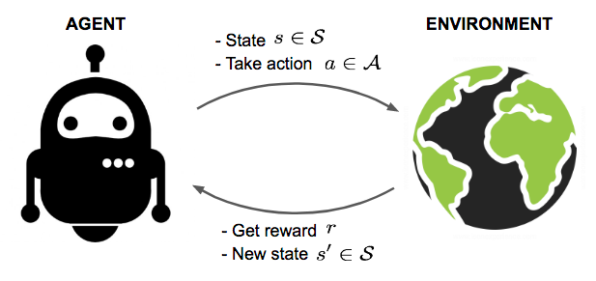


Case study: Wheat in the Netherlands
Reward: weight_{storage organ} – c * weight_{fertilizer applied}
H. Overweg, H. N. C. Berghuijs, I. N. Athanasiadis, CropGym: a Reinforcement Learning Environment for Crop Management, Computing Research Repository, AIMOCC 2021 Workshop at 9th Int'l Conf Learning Representations (ICLR 2021), 2021, doi:10.48550/arXiv.2104.04326.
Notes:
We coupled WOFOST with the OpenAIGym environment for reinforcement learning

Slide 25
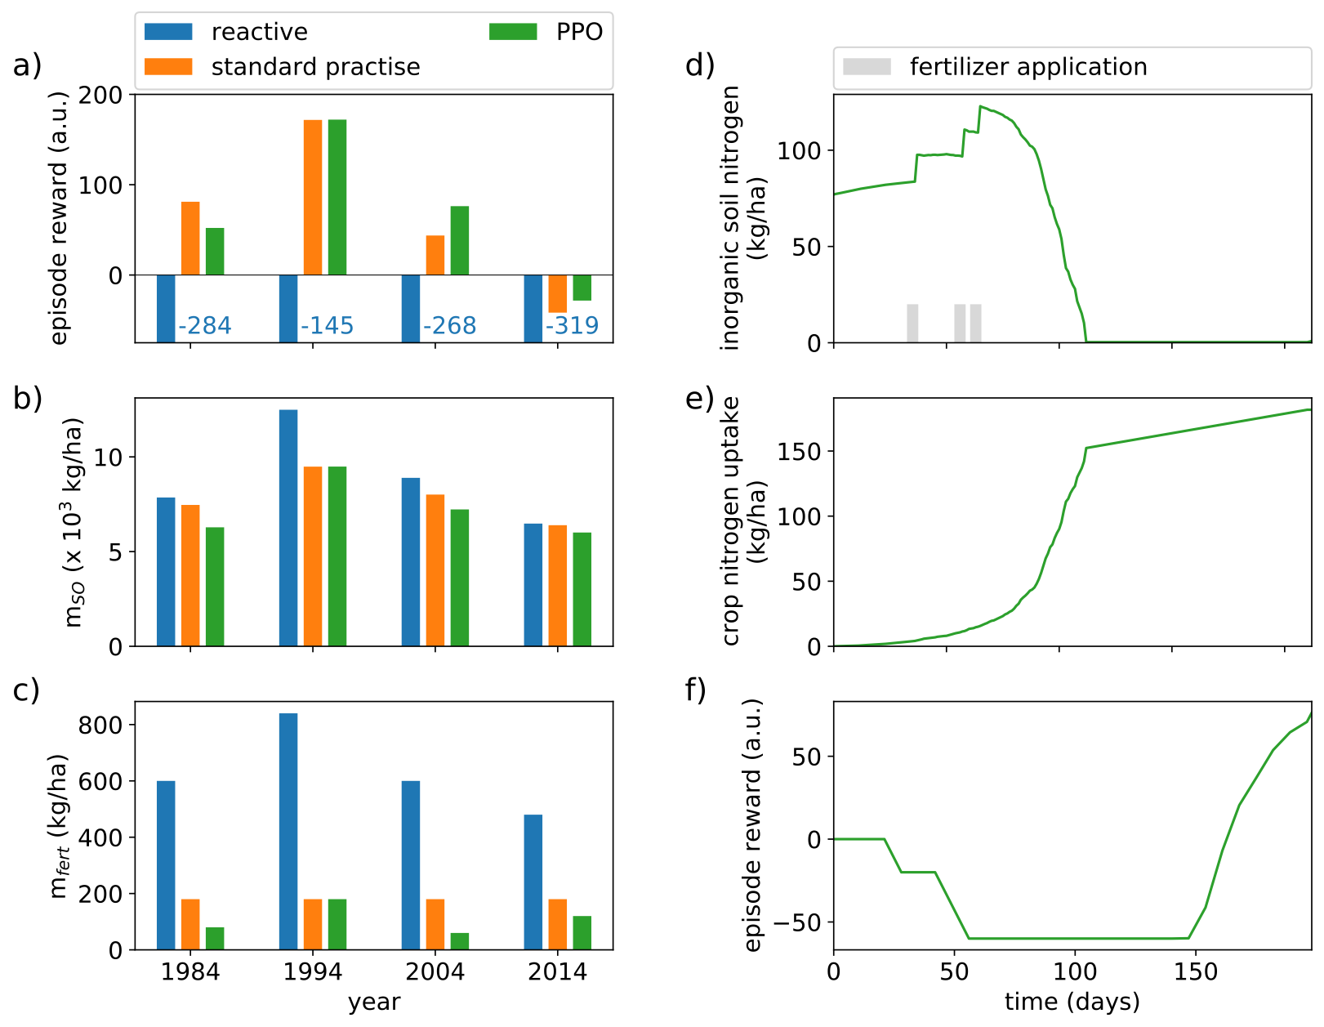
Results on test (unknown) years
RL
H. Overweg, H. N. C. Berghuijs, I. N. Athanasiadis, CropGym: a Reinforcement Learning Environment for Crop Management, Computing Research Repository, AIMOCC 2021 Workshop at 9th Int'l Conf Learning Representations (ICLR 2021), 2021, doi:10.48550/arXiv.2104.04326.
Notes:
We compared the agent against a dummy reactive agent that would just fill up the soil with nitrogen, and a standard practice agent that would apply nitrogen and sidedress once.
On the right hand side, we see on top the yield for the three agents, in the four years in the test set, and bottom the amount of nitrogen used for fertilization. Overall, we observe that the reinforcement learning agent is able to maintain high yields, while reducing fertilization use by the experience it learned from past perfromance.

Slide 26

Reinforcement learning for tactical fertilization decision making
Reinforcement learning agent is able to maintain high yields, while reduces fertilization
Reinforcement learning agent learns by “experiencing” a crop-growth simulation environment
No labels are needed
This line of research is continued in the Horizon Europe project “Smart Droplets” (2022-2025)

Slide 27
Looking forward
High resolution data - Real time sensing
Scenarios – What if analyses
“Integration first” - linking data, models, systems
Sim2Real gap
Nature variability
Scales

Slide 28


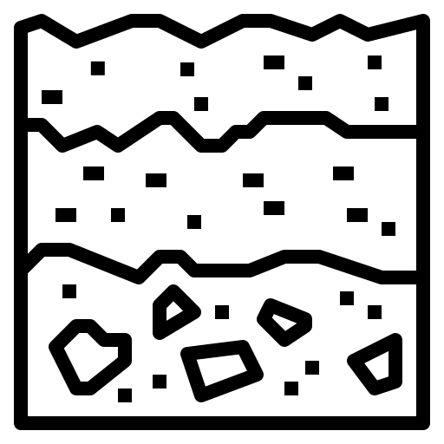




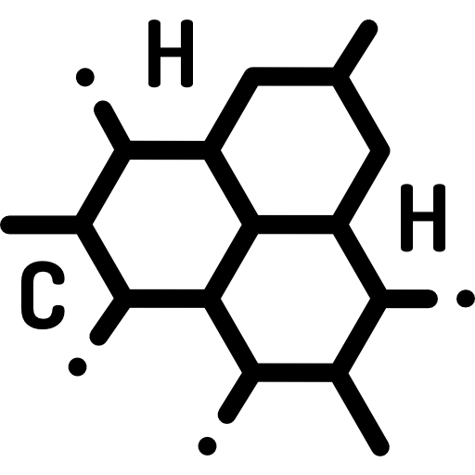


Looking forward
Genetics
Environment
Management
p
Notes:
What type of AgriFood AI do we aim for?

Slide 29
Artificial intelligence for agri-environmental digital twins
Thank you!
Prof dr Ioannis Athanasiadis
ioannis.athanasiadis@wur.nl www.wur.ai
Notes:
I am really happy to join you today, I will give you an overview on how we use artificial intelligence, in digital twins for understanding nature and feeding the world.

