Slide 1
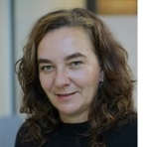
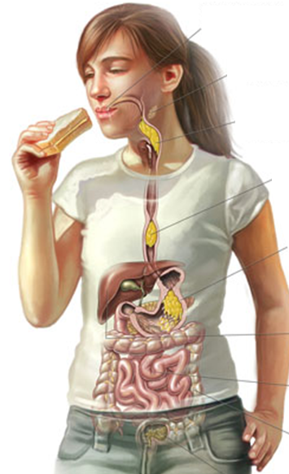
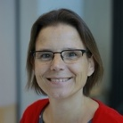
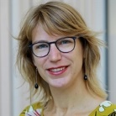
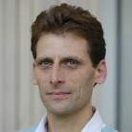
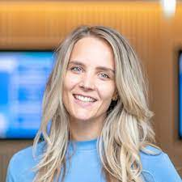
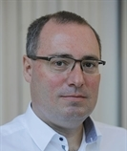
Introduction: Sensory Science and Eating Behaviour Chair Group
Understanding how Sensory properties Influence food choice, intake and health
Prof. Ciarán Forde
Texture/Oral processing, Children, Energy Density
Associate Prof. Gerry Jager
Children's preferences, Cognition, Psychology
Associate Prof. Monica Mars
Endocrine, Digestion, Big Data, Taste, Tracking Eating
Associate Prof. Sanne Boesveldt
Odour perception, food choice, clinical populations
Associate Prof. Paul Smeets
Gastric/Brain imaging (MRI), Digestion/Neuroscience
Assistent Prof. Marlou Lasschuijt
Children, Oral processing, Imaging, Tracking eating behaviours
Prof. Markus Stieger
Food texture/Oral processing, Food Technology
Special Prof. Liesbeth Zandstra
Food choice, Reward, Food Context
Dr. Victoire de Wild, Academic Lecturer
Child eating behaviours/Preferences, Vegetable acceptance

